Slide 1

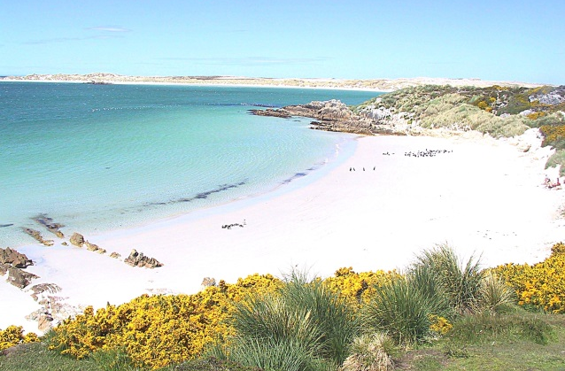

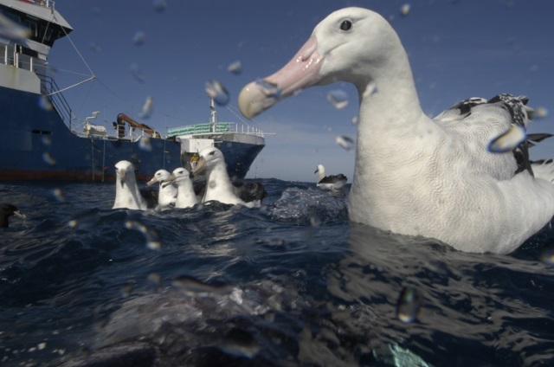

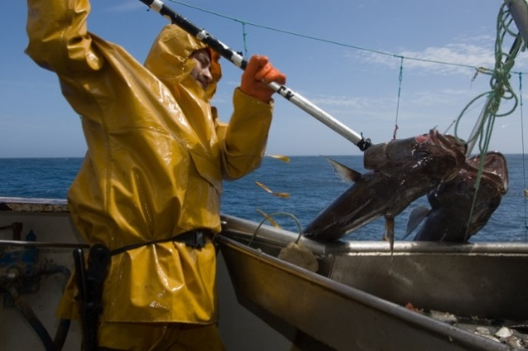
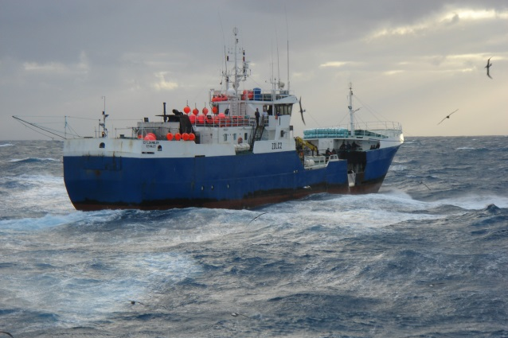
CONSOLIDATED FISHERIES
COLTO Depredation Workshop
Punta Arenas, Chile
March 2016

Slide 2
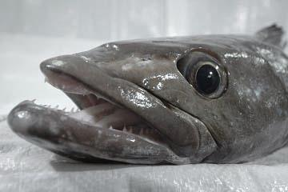
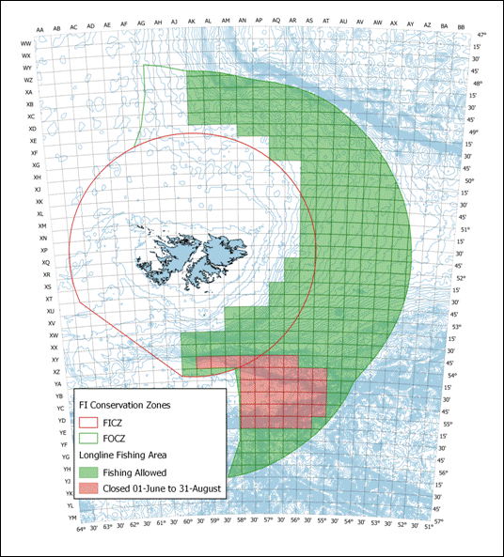
CONSOLIDATED FISHERIES
The Fishery
Established 1994
Initially a 2 vessel fishery
Entered ITQ system 2006
One of the first to enter ITQ
MSC Certification in 2014
Only certified Falklands fishery
Quota set at 1040 mt in 2015
Prior to ITQ limited to 2 vessel fishery
2006 quota set at 1500 mt
2008 quota set at 1200 mt
2015 quota set at 1040 mt
Depths > 600 m

Slide 3
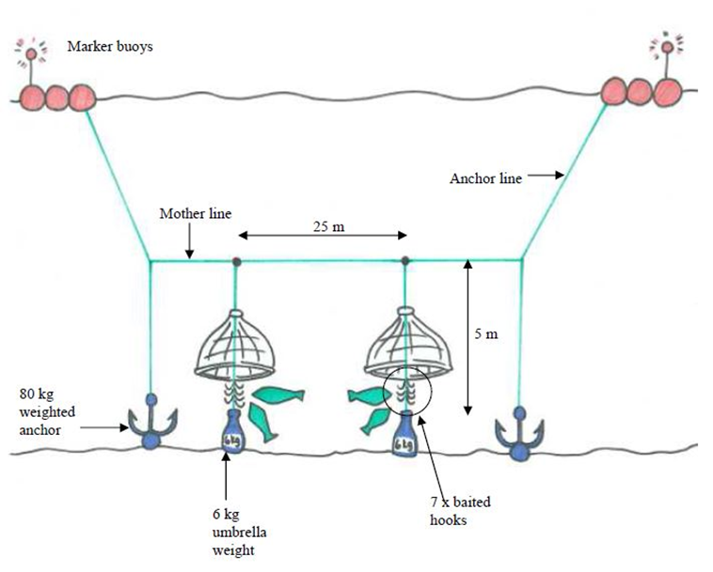
CONSOLIDATED FISHERIES
Fishing System
Umbrella system since July 2007

Slide 4
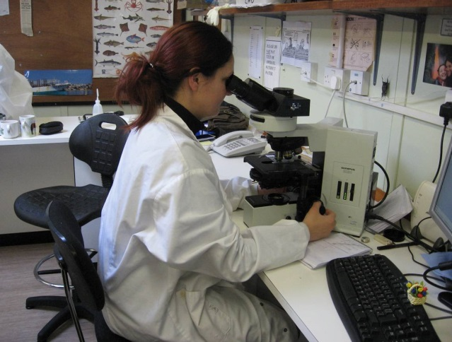
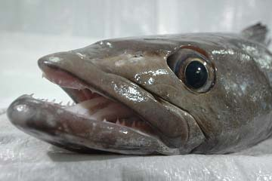

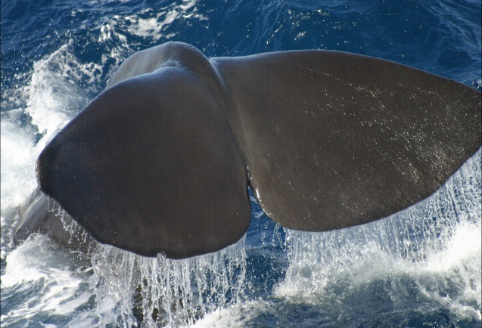
CONSOLIDATED FISHERIES
Is it effective?
No trial that would isolate and compare the effects of whale depredation between the two systems was conducted BUT…..
Average CPUE Up
Bird Mortality Down
Happy Captains

Slide 5
CONSOLIDATED FISHERIES
Depredation History
Reports of adverse whale interaction moving from seasonal to consistent, reported since 2001
CFL Pioneer removed from the Fishery in 2002 due to inability to “out-run” whales.
Killer whales mainly located in NE of the Islands and periodically whereas sperm whales all over the fishery and consistent.

Slide 6
CONSOLIDATED FISHERIES
Depredation History (cont)
CFL funded an investigation into cetacean interactions in 2003. (James Moir Clarke)
An ADD was tested unsuccessfully.
High presence of whales = > CPUE
CPUE not great method for assessing whale interaction, but no other method is better.
Estimated catch loss ≈ 2% 2002-2003
However, field trip estimated 23%

Slide 7
CONSOLIDATED FISHERIES
Depredation Records
Daily interactions recorded by vessel.
Daily estimate of green weight lost. (Whale and scavenger depredation)
Observer sightings and records.
Rate measured in kgs lost.

Slide 8
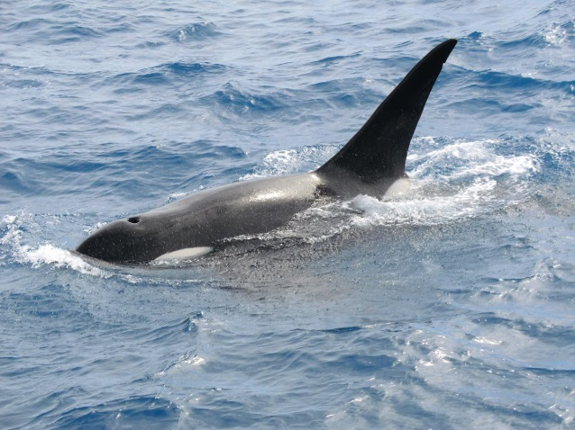
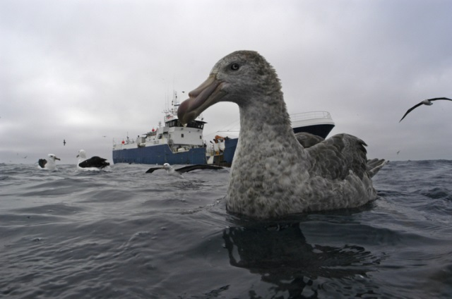
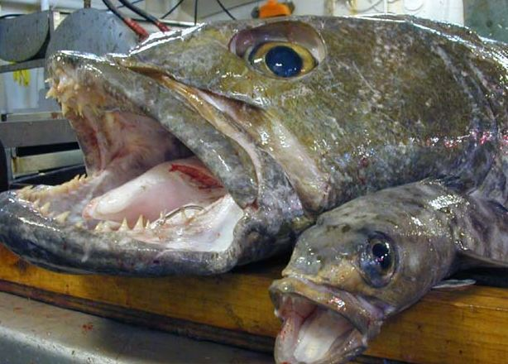
CONSOLIDATED FISHERIES
Quota and Depredation
Estimate of “lost” catch:
Total product weight of line
X
Conversion Factor (1.60)
/
No. of fish on line
=
Average weight per fish
No. Depredated Fish x
Average Weight p/fish =
Added to Total Catch weight

Slide 9
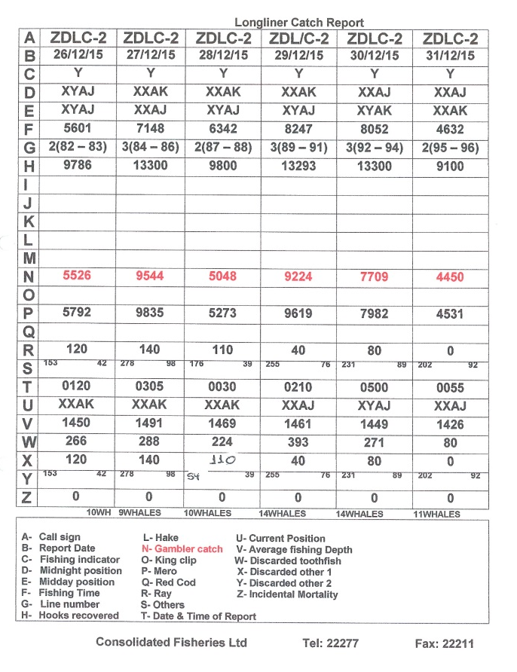
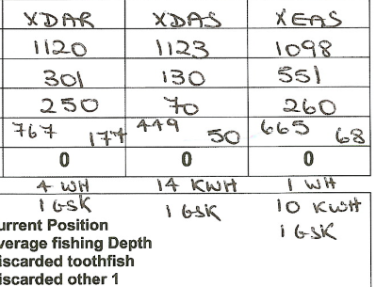
CONSOLIDATED FISHERIES
Daily Catch Reports
Daily Whale sightings recorded and included on Catch reports

Slide 10
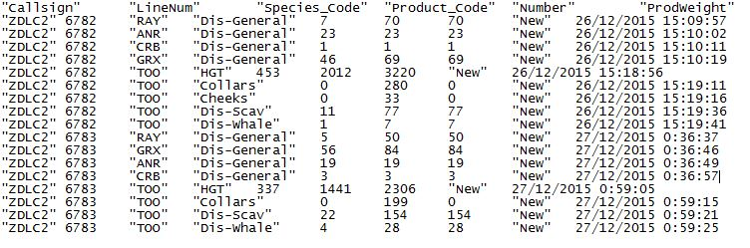
CONSOLIDATED FISHERIES
Electronic Logbook
Dis-General: Non-retained Catches
Dis-Scav: Toothfish Depredated by Scavengers
Dis-Whale: Toothfish Depredated by Whales

Slide 11
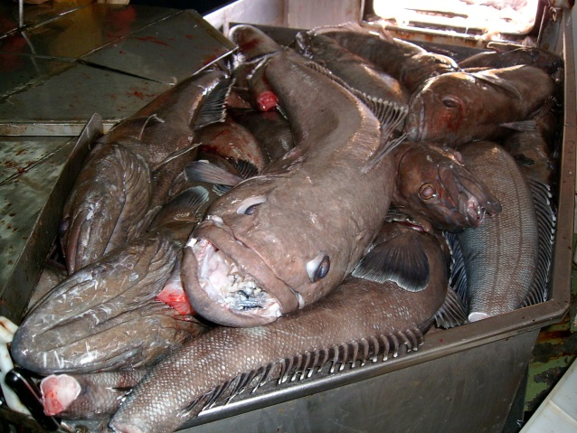
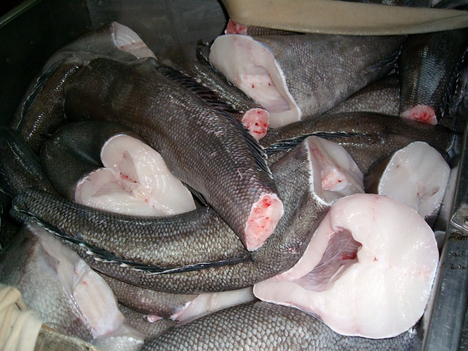
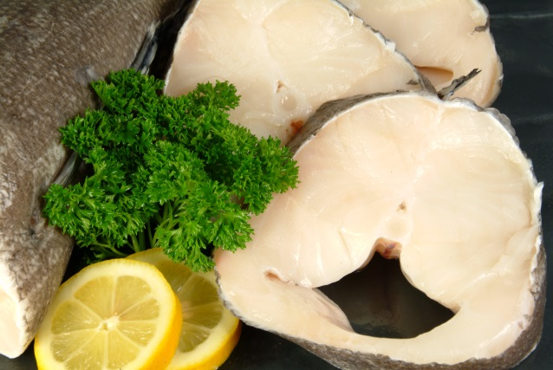
CONSOLIDATED FISHERIES
Whale Sightings 2015
Sperm Whales | 891 | No
Killer Whales | 334 | No
Discards (Kgs) | 35,902 | Kgs
2015 = 3.1%

Slide 12
CONSOLIDATED FISHERIES
Uncertainties
Daily records of discards not always verified by independent observer.
System relies on fish remains being left on hooks: Killer whales often take the lot.
Lots of data, but methodology for analysing it not yet put in place. Work in progress!
Robust methodology for assessing depredation rates not yet developed.

