Slide 1
South African Toothfish
A long Walk to Recovery

Slide 2
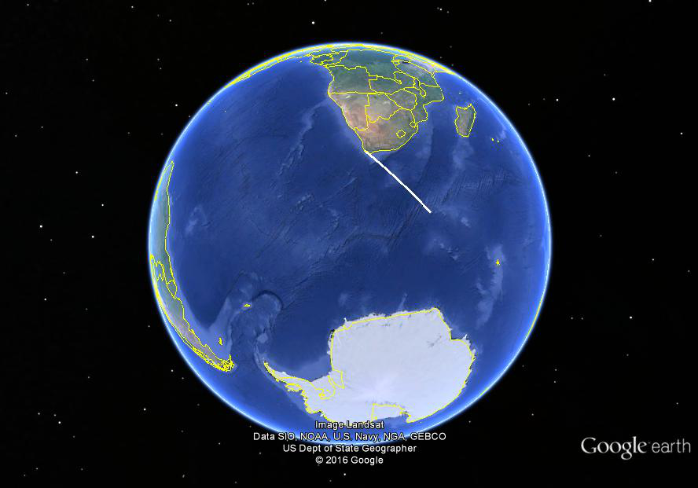

Slide 3
Early 1990s – Nimble poachers, slow officials

Slide 7
Fishing Rights Application Process
Present 5 Rights Holders operated since 1996
10 year rights granted in 2005
Re-applications now underway
A fishery that shows how slowly longlived species take to recover.

