Slide 1
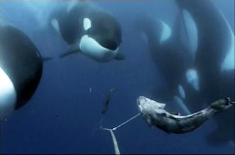
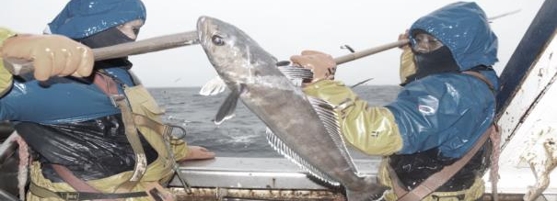
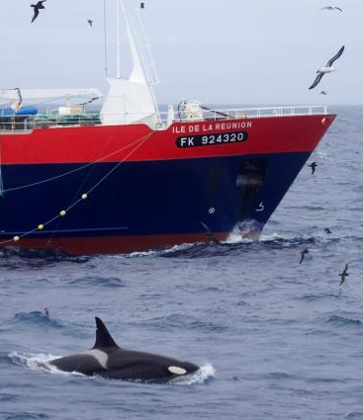
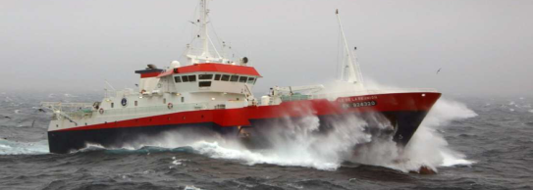
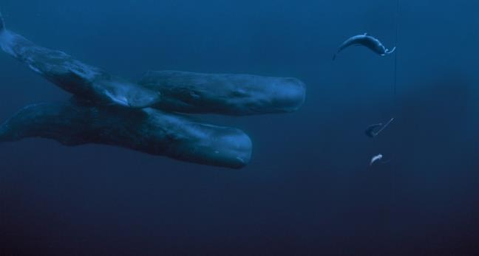

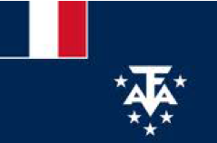
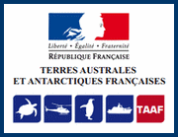


Workshop on depredation – Chile – Session 1
Levels of depredation and trends
Crozet and Kerguelen – French Economic Exclusive Zones
Paul Tixier^{1,2}, Nicolas Gasco³, Christophe Guinet¹
¹ Centre d’études Biologiques de Chizé, ² Réserve Naturelle des Terres Australes Françaises, Terres Australes et Antarctiques Françaises
³ Muséum National d’Histoire Naturelle de Paris

Slide 2
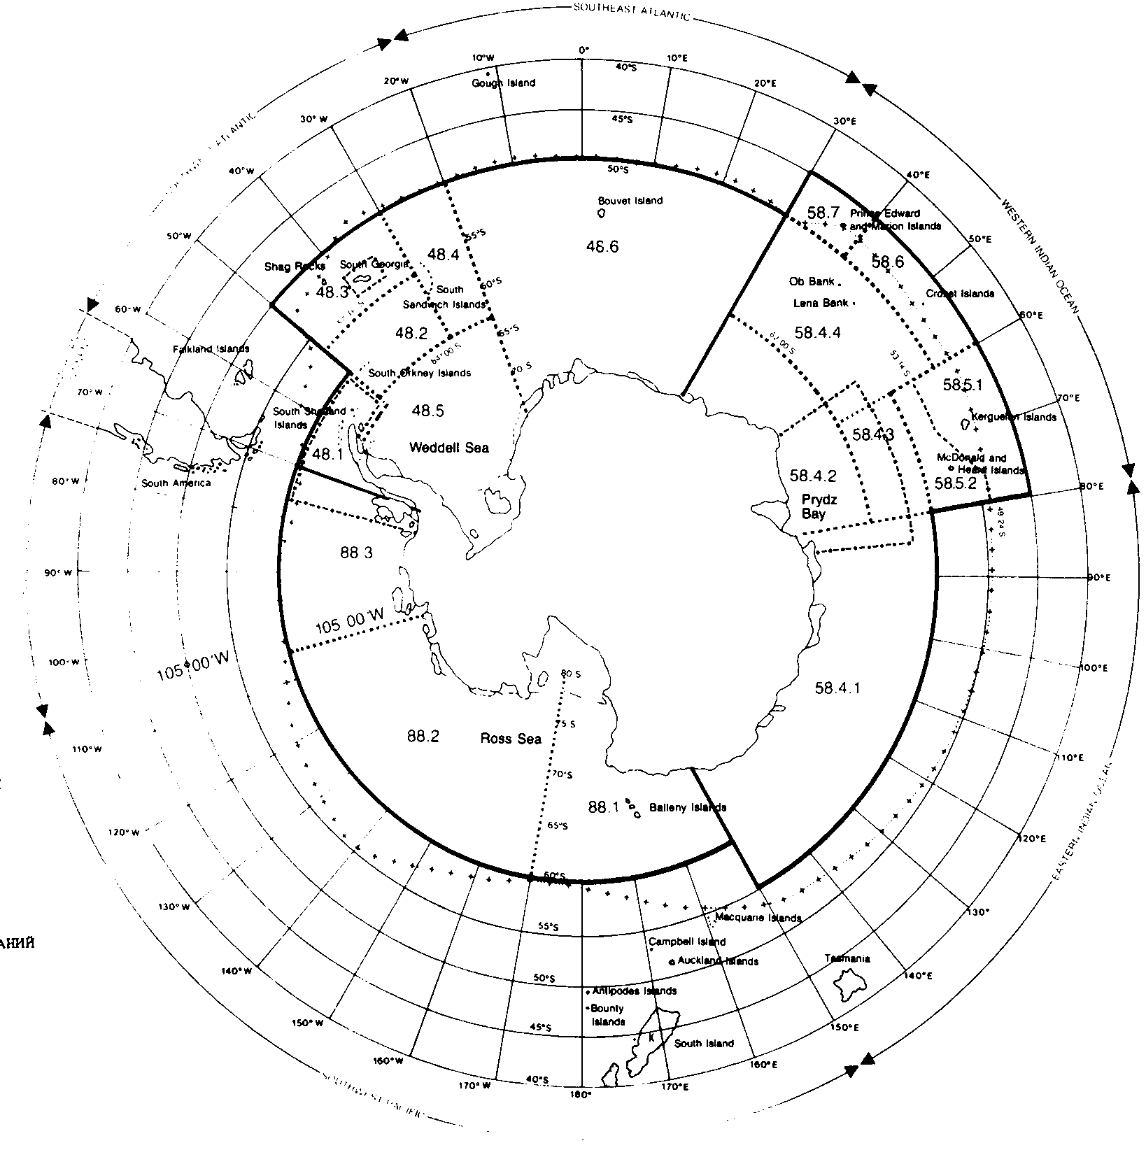
Fishing areas
History
Current situation
Depredation levels
The Crozet and Kerguelen Islands
CROZET ISLANDS
CCAMLR 58.6
KERGUELEN ISLANDS
CCAMLR 58.5.1

Slide 3
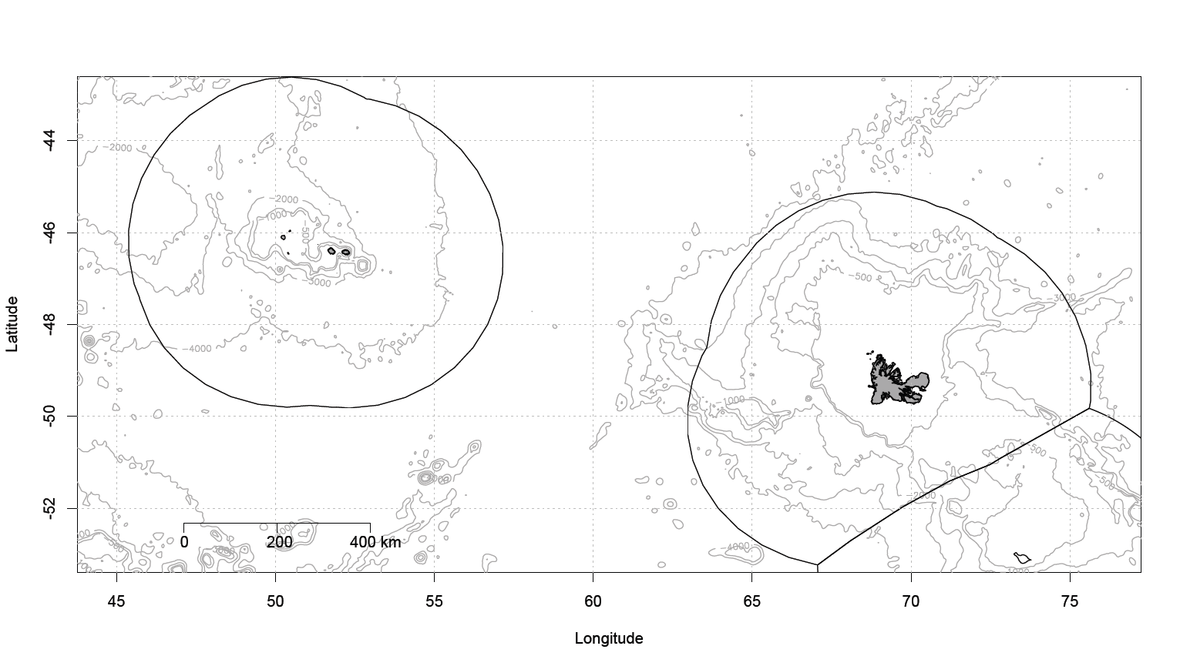
Fishing areas
History
Current situation
Depredation levels
The Crozet and Kerguelen Islands
CROZET EEZ
CCAMLR 58.6
KERGUELEN EEZ
CCAMLR 58.5.1

Slide 4
Fishing areas
History
Current situation
Depredation levels
KERGUELEN
1996
2000
2003
2012
2015
Longlining
Trawling
Illegal activity
CROZET
1996
2000
2003
2012
2015
Longlining
Illegal activity

Slide 5
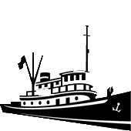
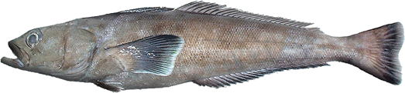
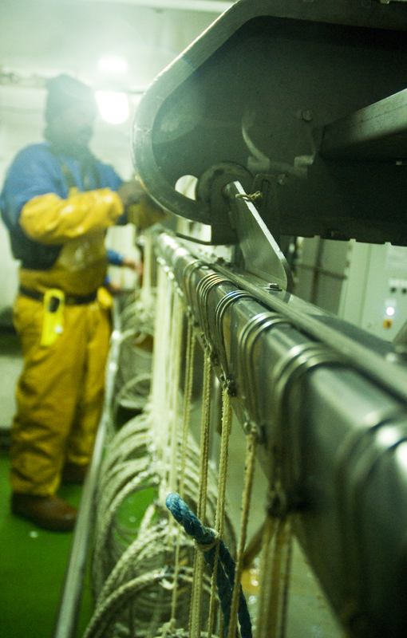
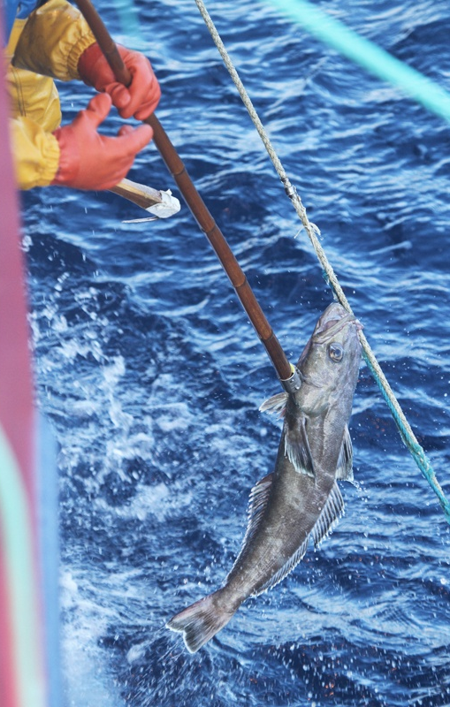
Fishing areas
History
Current situation
Depredation levels
Patagonian toothfish longline fishery
Demersal longlining
Autoline system
7 licensed vessels
100% observer coverage
TAC
Crozet
750 tonnes
Kerguelen
5100 tonnes

Slide 6
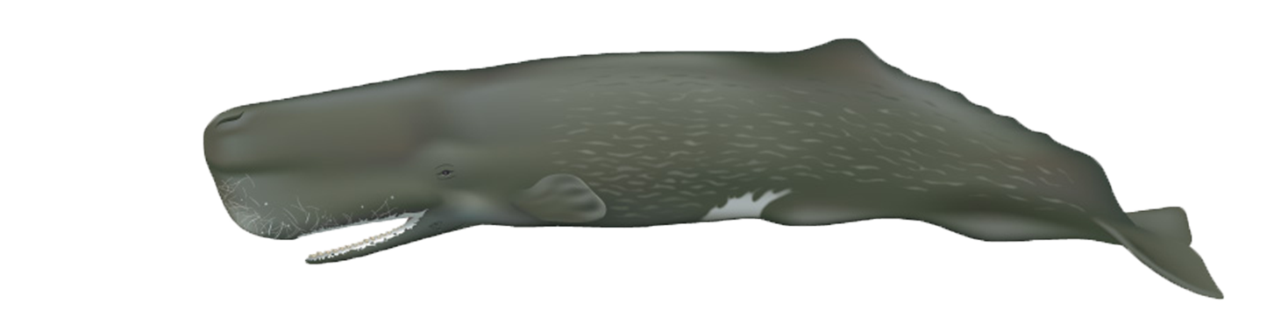
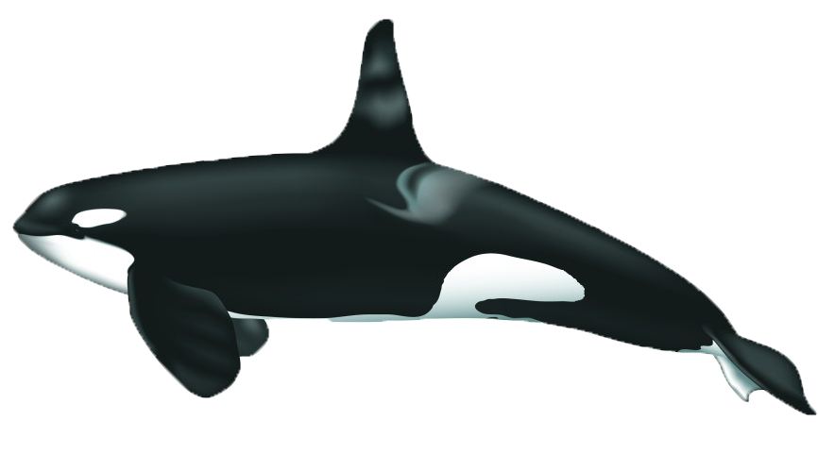
Fishing areas
History
Current situation
Depredation levels
KERGUELEN
1996
2000
2003
2012
2015
Longlining
Trawling
Illegal activity
Depredation
CROZET
1996
2000
2003
2012
2015
Longlining
Illegal activity
Depredation

Slide 7
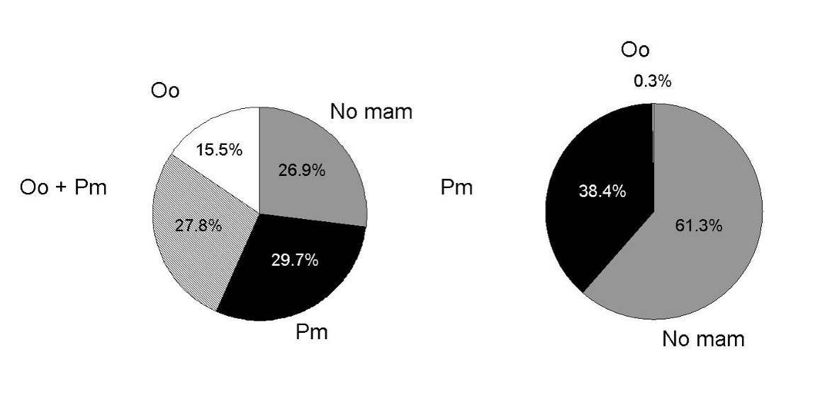
Fishing areas
History
Current situation
Depredation levels
Interaction rate
% of all longline sets
(2003-2014)
Crozet
Kerguelen

Slide 8
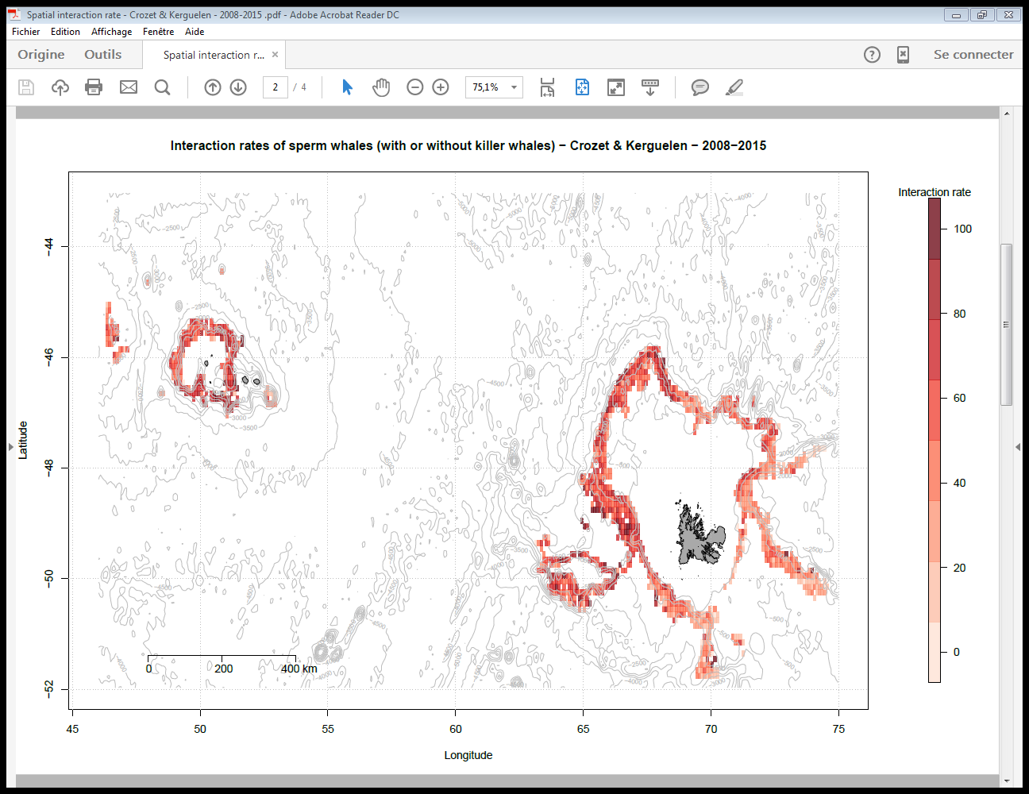
Fishing areas
History
Current situation
Depredation levels
Distribution of interactions
Sperm whales

Slide 9
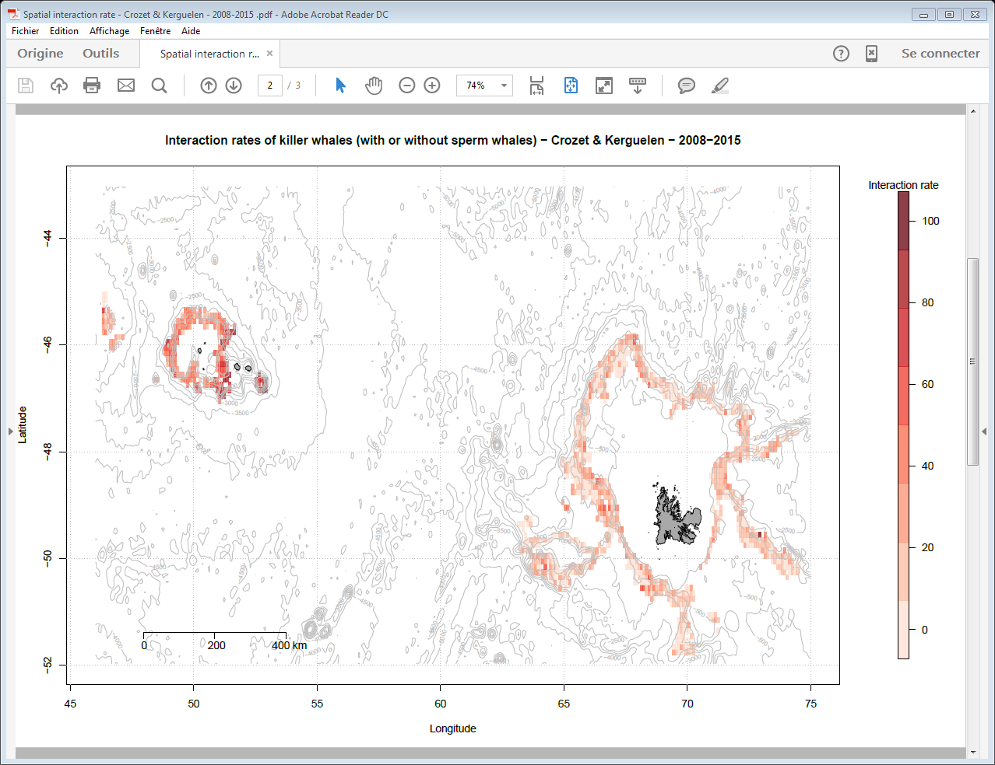
Fishing areas
History
Current situation
Depredation levels
Distribution of interactions
Killer whales

Slide 10
Fishing areas
History
Current situation
Depredation levels
Time series of interaction rates
(% of all longline sets)
Kerguelen
Crozet
Crozet
Kerguelen

Slide 11



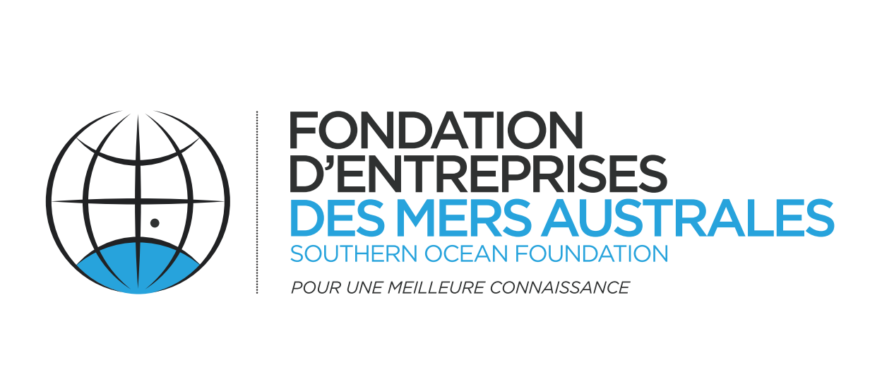

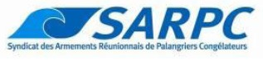
Acknowledgements
CEBC - CNRS
Fundings and Partnership
Terres Australes et Antarctiques Françaises
Réserve Naturelle des TAAF
Muséum National d’Histoire Naturelle de Paris
Armements de pêche à la légine réunionais
Institut Polaire Français
Fondation d’entreprises des mers australes
Coordinators
Dr Christophe Guinet Cédric Marteau Pr. Guy Duhamel Thierry Clot
Data Collection
Fishery observers and field workers of Possession Island – special thanks to Nicolas Gasco
Help in analyses
M. Authier, M. Viviant, C. Barbraud, D. Pardo, D. Pinaud, J. Vacquie Garcia, T. Jeaniard Dudot, P.Monestiez
Photographers
AUBERT Jean Luc; BARRETT-LENNARD Lance; BEILLOEIL; BELBEYC'H Bruno; BERTHET Philippe; BERTRAND Geoffrey; BLANCHARD Pierrick; BOITEAU Christophe;
BONNET Joël; BOST Charles-André; BURLE Marie-Hélène; CARCAILLET Christopher; CARDOT Gilles; CHEVRIER Claude; DE STEPHANIS Renaud; DERVAUX Antoine;
DESMARET Rolland; DESPIN Bernard; DONDELINGER Caroline; DOREMUS Ghislain; DUFRENE Rémy; FERNANDEZ Eric; FOURNIER Jean-Charles; GASCO Nicolas GAUTHIER-CLERC Michel; GOUEDARD Yvon; GUINET Christophe; HANDRICH Yves; HANUISE Nicolas; HOARAU Eric; LANGUENOU Roger; LE CORRE Yann; LEGRAN Jérôme; LEMARCHAN Christian; LEQUETTE Benoît; LERIDON Jean; LEROUX Eric; LESCAROUX Jean-Michel; LOUBON Maxime; MAISON Jérome; MANGIN Stéphane; MANILEVE Patrick; MARECHAL Pierre; MELLEE Jean-Luc; MOURIES Jacques; NOORKHAN Alain; NOYAN Patrick; PAULIN Rémy; PAWLOWSKI Frédéric; PERROT Yohann; PETER Jean; RIDOUX Vincent; RINGOT Frédéric; SCHWEBEL Luc; SORIN Dominique; STENBERGER Ludovic;THERON Franck; TIXIER Paul; VERLAND Henri; VERMANDE Hugues; VILLEMIN Catherine; WEIMERSKIRCH Henri

