Slide 1
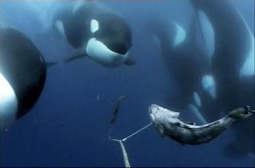
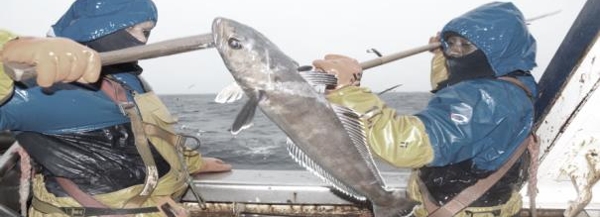
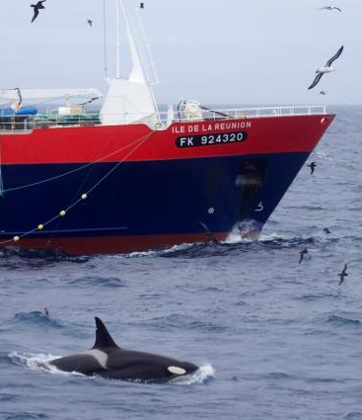
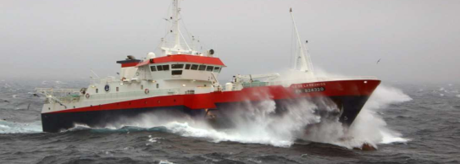
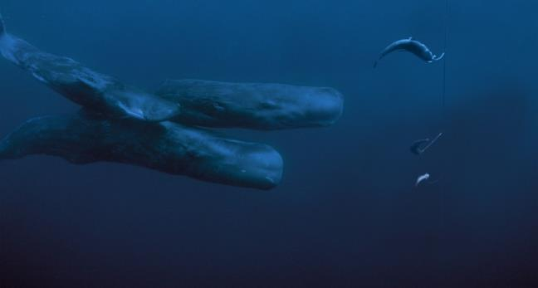





Workshop on depredation – Chile – Session 3
Mitigation by developing knowledge on whales and acting on fishing practice
Combining research on fishing practices and whale ecology to mitigate depredation
Paul Tixier^{1,2}, Nicolas Gasco³, Christophe Guinet¹
¹ Centre d’études Biologiques de Chizé, ² Réserve Naturelle des Terres Australes Françaises, Terres Australes et Antarctiques Françaises
³ Muséum National d’Histoire Naturelle de Paris

Slide 2
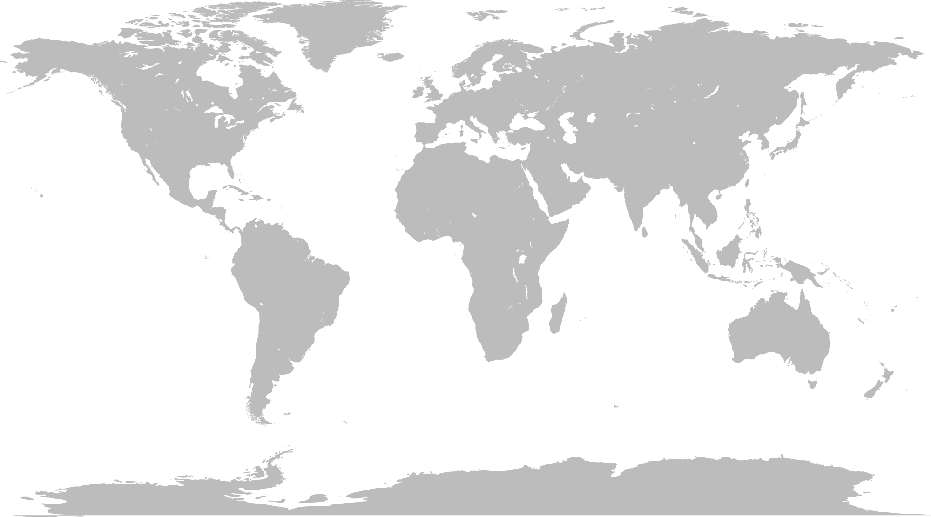
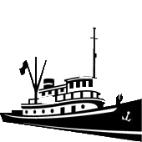
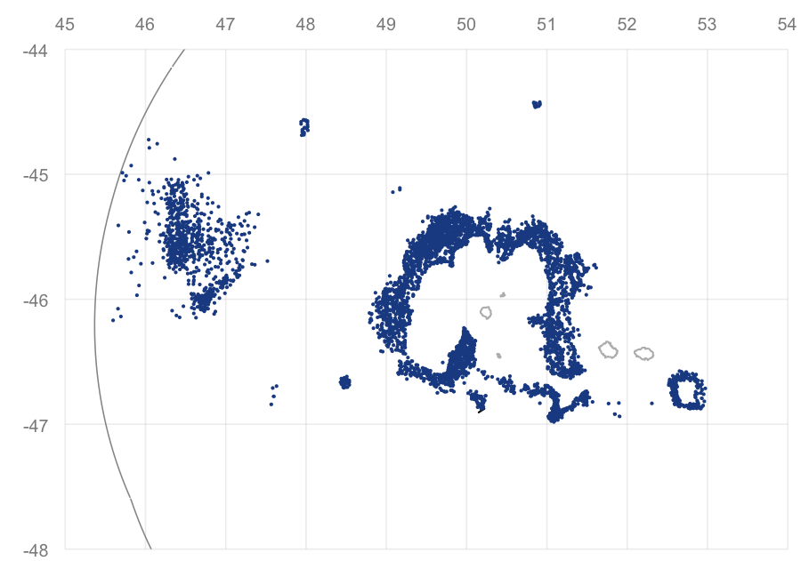
Area and data
Technical approach
Behaviour: vessels
Behaviour: whales
Ongoing study
Study area: the Crozet EEZ
N
Crozet islands
Cochons Is.
Possession Is.
Est Is.
EEZ
100 km

Slide 3
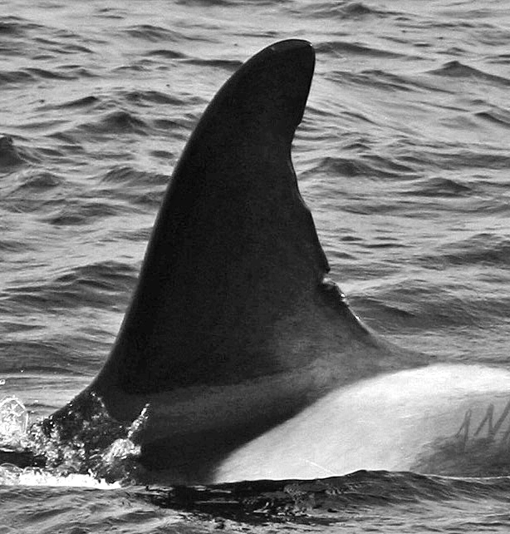
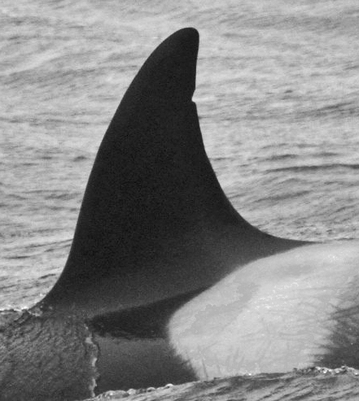
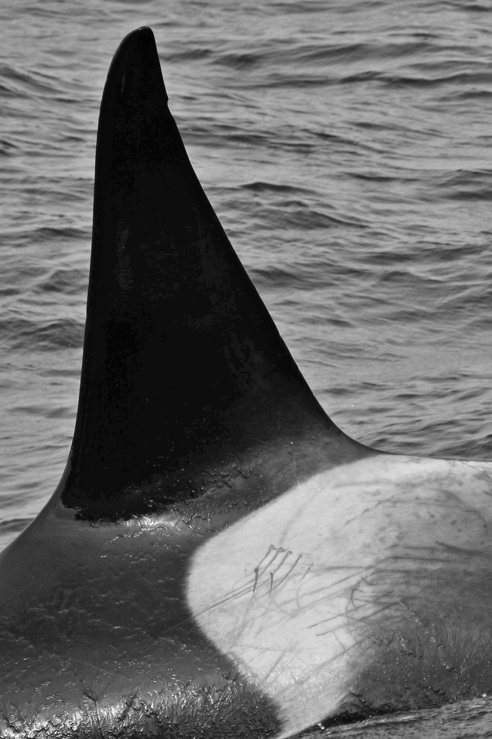
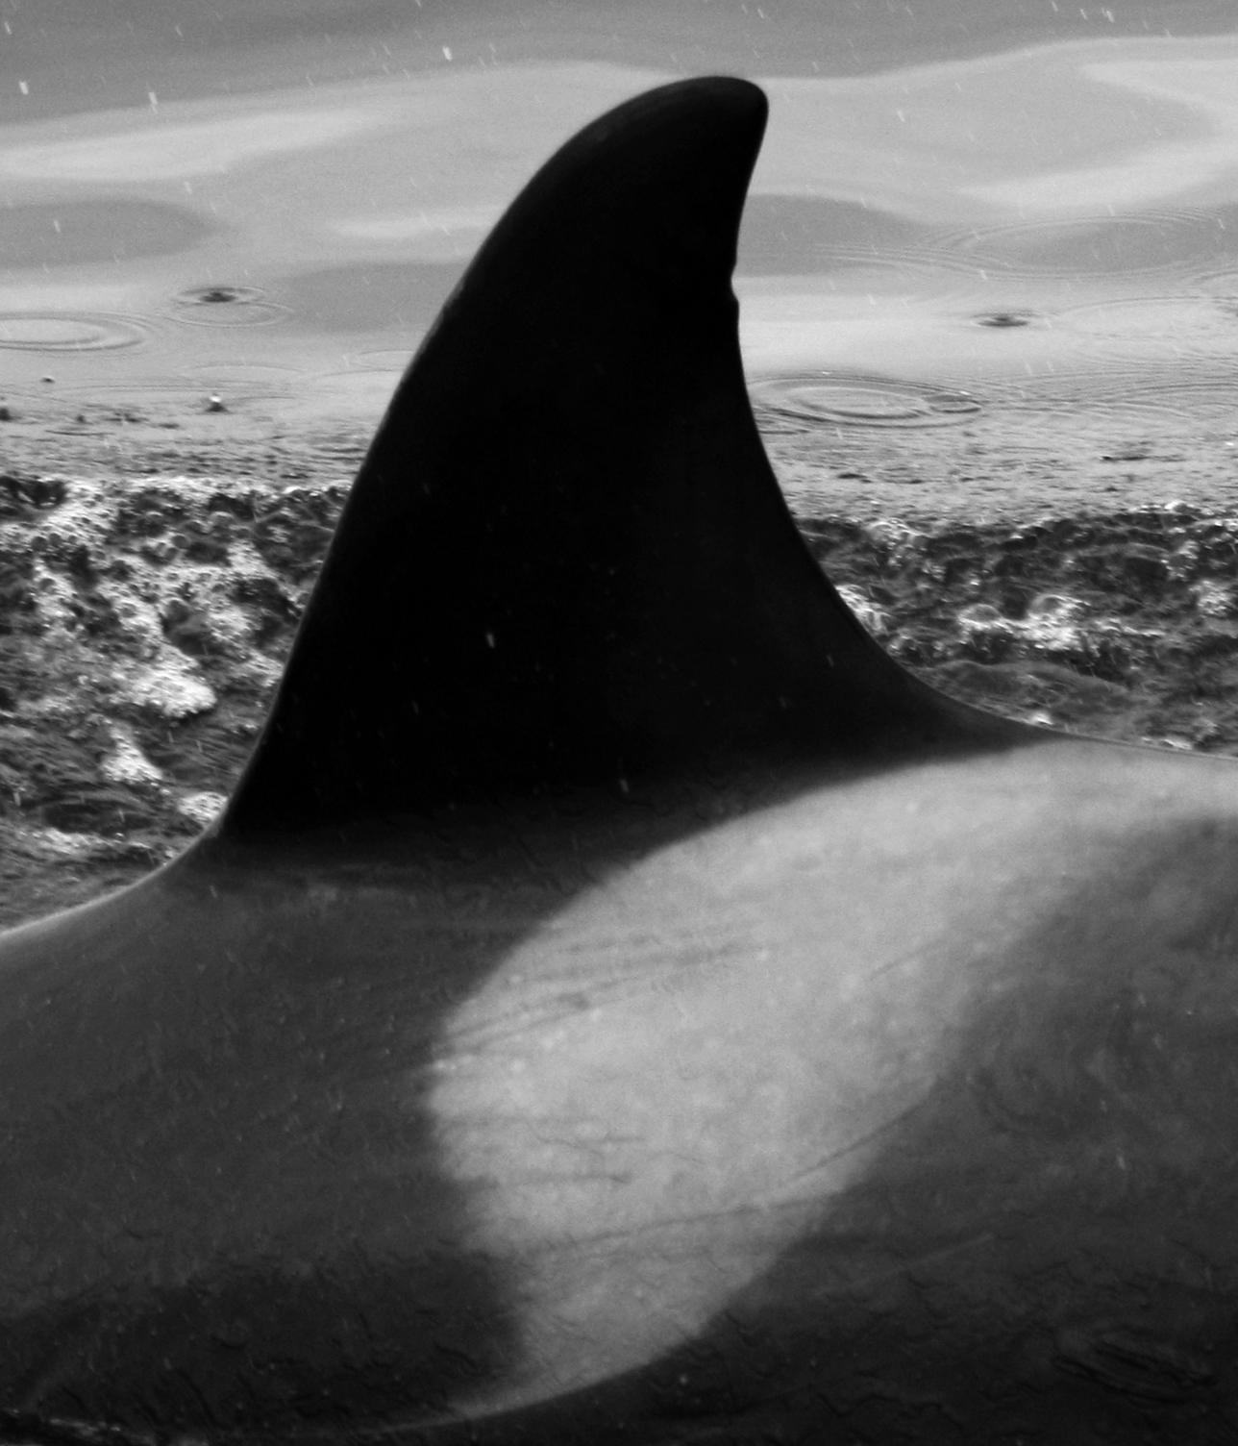
Area and data
Technical approach
Behaviour: vessels
Behaviour: whales
Ongoing study
Extensive datasets
Full access to fishing data
Monitoring of whale population
Vessel | Line | Date | Lat | Long | Nb Hooks (H) | Length (m) | Catch (kg) | Presence Killer whale | Presence Sperm whale | Hauling speed (H.min⁻¹)
A | 5 | 12/02/05 | 45,49 | 49,66 | 8800 | 9000 | 619,5 | 0 | 1 | 40.3
A | 6 | 12/02/05 | 45,48 | 49,80 | 8500 | 9000 | 1496,25 | 0 | 0 | 36.2
A | 7 | 13/02/05 | 45,55 | 49,66 | 9000 | 9500 | 140 | 1 | 1 | 30.1
B | 13 | 26/09/06 | 45,41 | 50,09 | 9000 | 9500 | 446,25 | 0 | 1 | 23.2
B | 14 | 27/09/06 | 45,43 | 50,10 | 8800 | 9200 | 77,875 | 1 | 0 | 46.8
C | 33 | 03/03/07 | 49,62 | 73,10 | 8500 | 8800 | 142,625 | 1 | 0 | 55.9
C | 34 | 04/03/07 | 46,34 | 49,08 | 8500 | 8800 | 1221,5 | 0 | 0 | 44.0
C016
2003-2010
C017
2003-2011
C023
2003-2011
C149
2007-2011
Fishing data collected by fishery observers since 2003
Photo-identification data
Solutions to reduce depredation
Technical approach
Behavioral approach

Slide 4
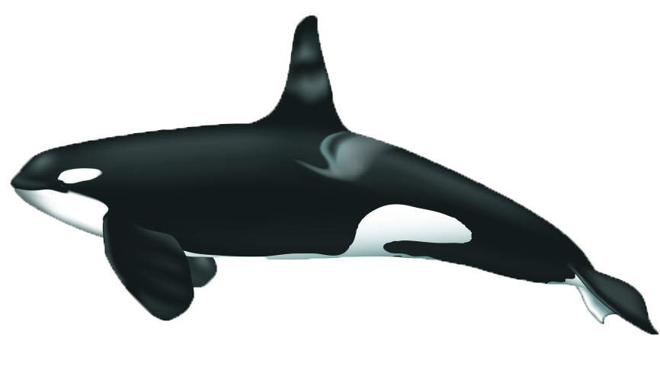
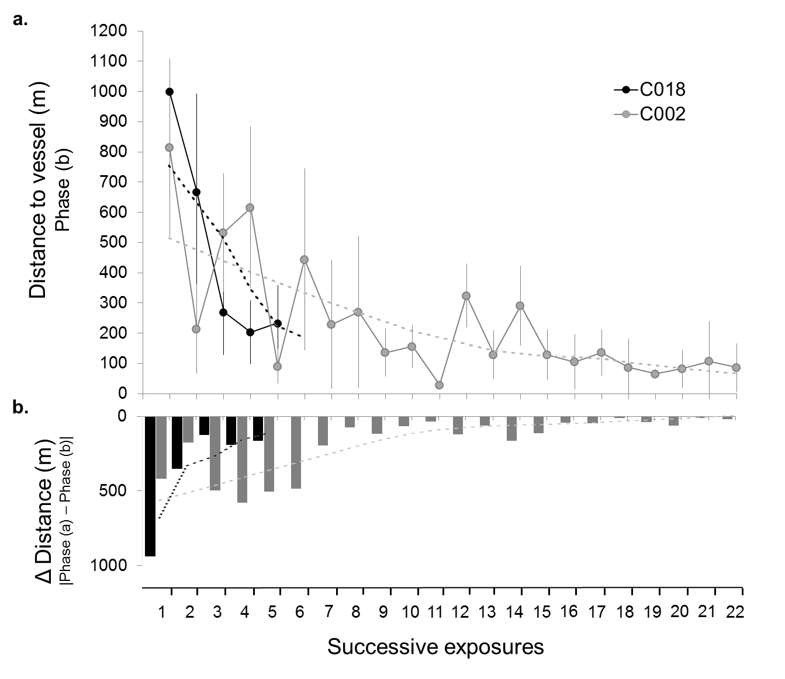
Area and data
Technical approach
Behaviour: vessels
Behaviour: whales
Ongoing study
Test of a marketted Acoustic Harrassment Device
195 dB re 1 μPa 6.5 kHz
1 m from the source
Habituation after successive exposures
Tixier, P., Gasco, N., Duhamel, G., Guinet, 2015.. ICES Journal of Marine Science.

Slide 5
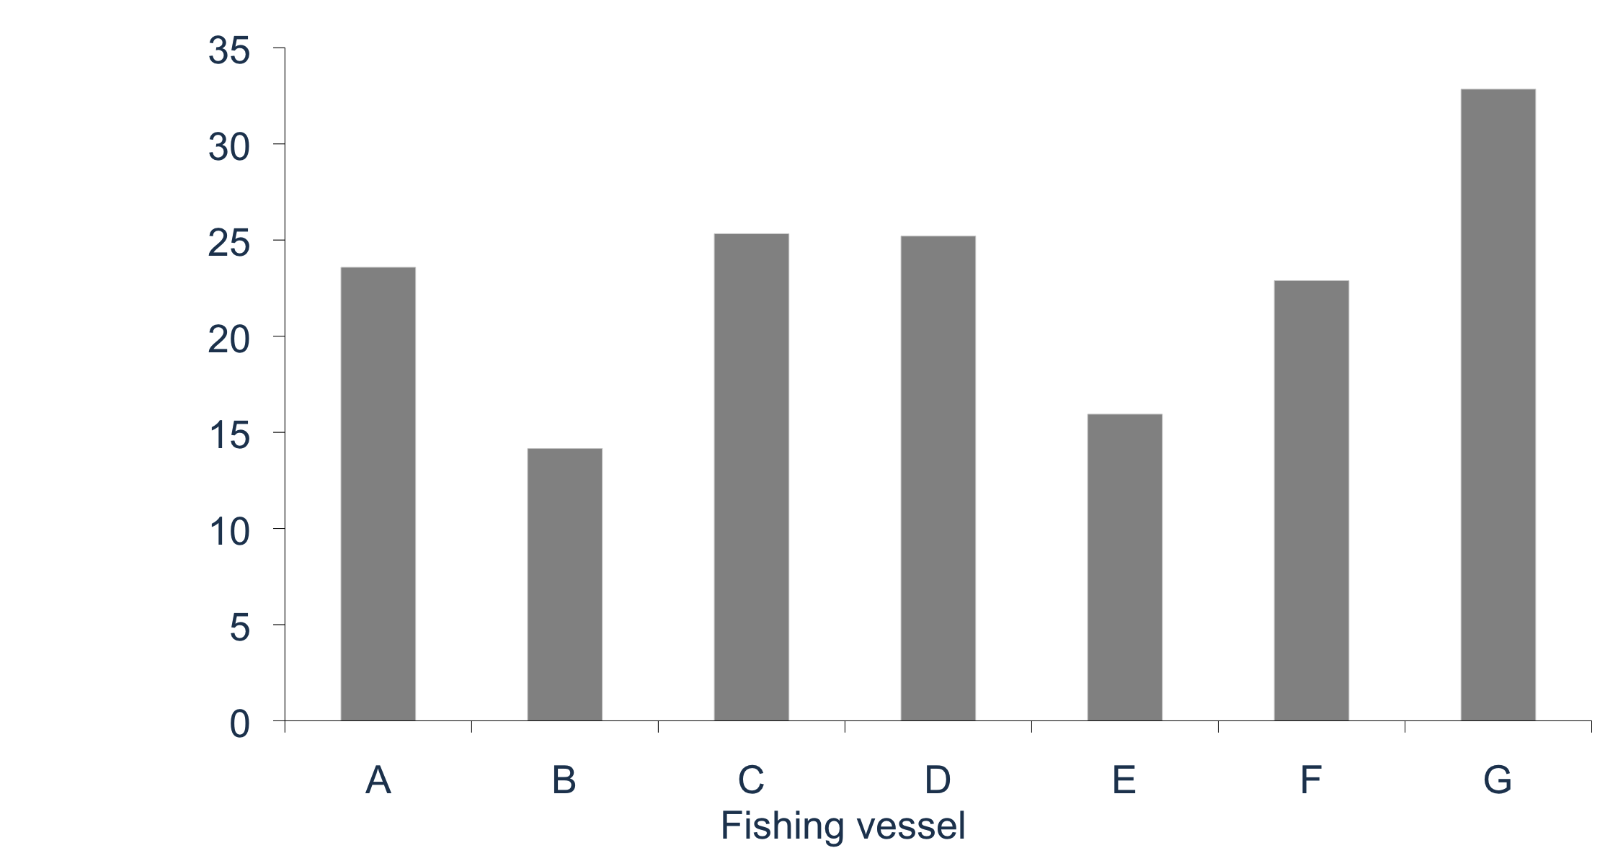
Area and data
Technical approach
Behaviour vessels
Behaviour: whales
Ongoing study
Great differences of interaction rate with killer whales between vessels
Interaction rate with killer whales
(% of longlines)

Slide 6
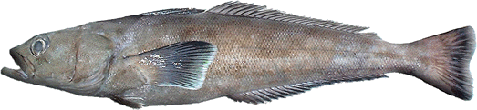
Area and data
Technical approach
Behaviour vessels
Behaviour: whales
Ongoing study
Test of 3 operationnal variables
Length of lines
Hauling speed
Distance travelled
Shorter longlines may prevent killer whales from depredating great number of hooks
Greater speed may reduce the number of fish removed within 0-400m depths
The further a vessel moves the more likely killer whales will lose it
Generalized Linear Mixed Models on both CPUE and Interaction rate with killer whales
Random effect = batch of longline sets hauled successively in same area
Auto-correlation term in the batch

Slide 7
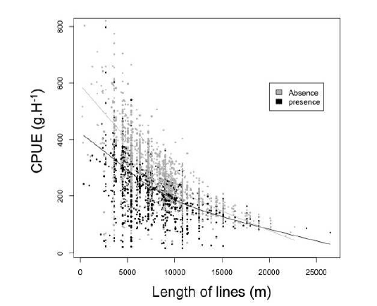
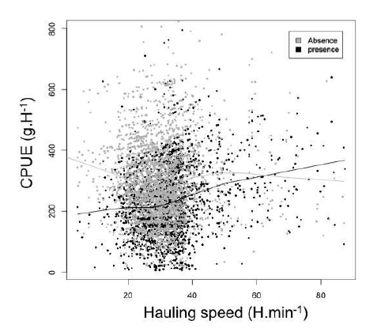
Area and data
Technical approach
Behaviour vessels
Behaviour: whales
Ongoing study
Length of longlines
Hauling speed
Absence
Presence
Short lines: < 5,000 m
CPUE with killer whales > 300 g.Hook⁻¹
High hauling speed > 50 Hooks.min⁻¹
CPUE with killer whales > 300 g.Hook⁻¹
Especially significant when whales arrive after hauling started
Especially significant in highly productive areas
Limited time for the whales to remove great number of fish

Slide 8
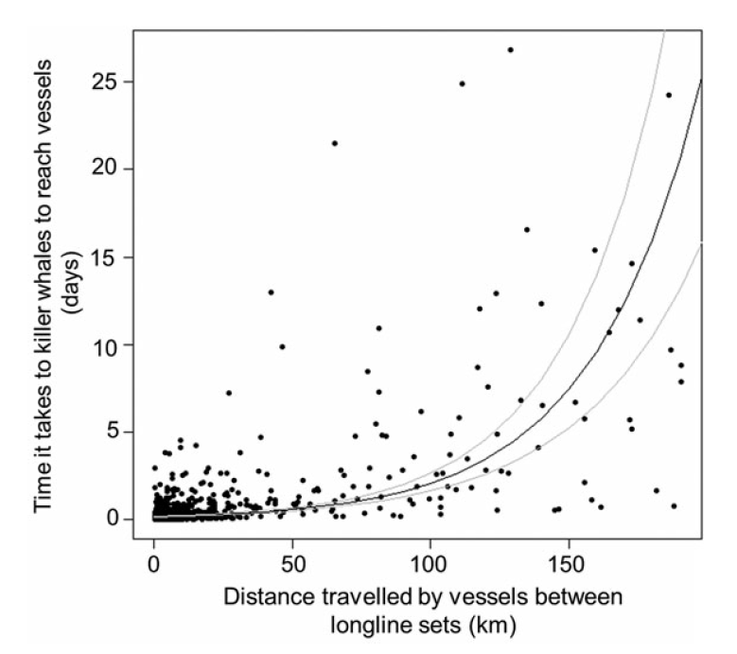
Area and data
Technical approach
Behaviour vessels
Behaviour: whales
Ongoing study
Distance travelled between sets
Vessels leaving an area with killer whale presence
If travel distance < 50 km
High probability of having the same whales in the new area
If travel distance > 100 km
Vessels can operate without killer whales for >3days
P. Tixier, N. Gasco, C. Guinet, ICES Journal Marine Science, 2015

Slide 9
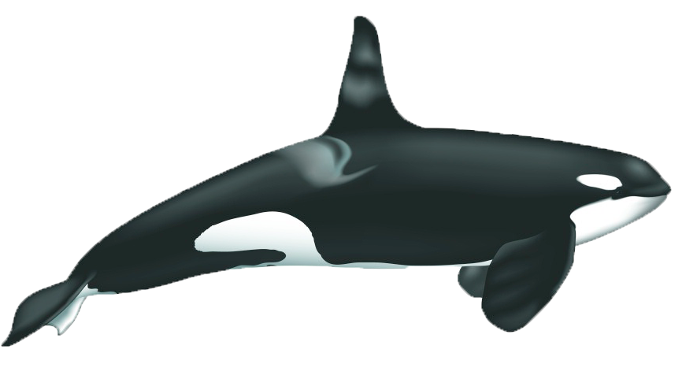
Area and data
Technical approach
Behaviour vessels
Behaviour: whales
Ongoing study
Factor
Hauling speed
Length of lines
Distance travelled
(+) on CPUE with killer whales
(-) on CPUE with killer whales
(-) on probability of interaction with killer whales
Effect
> 50 Hook.min⁻¹
CPUE > 300 g.Hook⁻¹
< 5000 meters
CPUE > 300 g.Hook⁻¹
Travel distance > 100 km
No killer whale
for > 3days
Recommendation

Slide 10
Area and data
Technical approach
Behaviour vessels
Behaviour: whales
Ongoing study
Efficacy of changing fishing practice
2009: Results converted to recommendations to fishing vessels
Preliminary analyses on the efficiency of these recommendations to reduce killer whale depredation
Changes in fishing behavior before and after 2009
Vessels A & B
Respected all recommendations
Significant effects on CPUE and Interaction rate

Slide 11
Area and data
Technical approach
Behaviour vessels
Behaviour: whales
Ongoing study
Efficacy of changing fishing practice
2009: Results converted to recommendations to fishing vessels
Preliminary analyses on the efficiency of these recommendations to reduce killer whale depredation
Changes in fishing behavior before and after 2009
Vessels F & G
↓ distance travelled
↑ Interaction rate
↓ CPUE

Slide 12
Area and data
Technical approach
Behaviour vessels
Behaviour whales
Ongoing study
Behavioural approach: killer whales
Spatio-temporal patterns of killer whale depredation
Seasonality
Distribution
Seasonal variations of depredation
Spatial variations of interaction rates

Slide 13
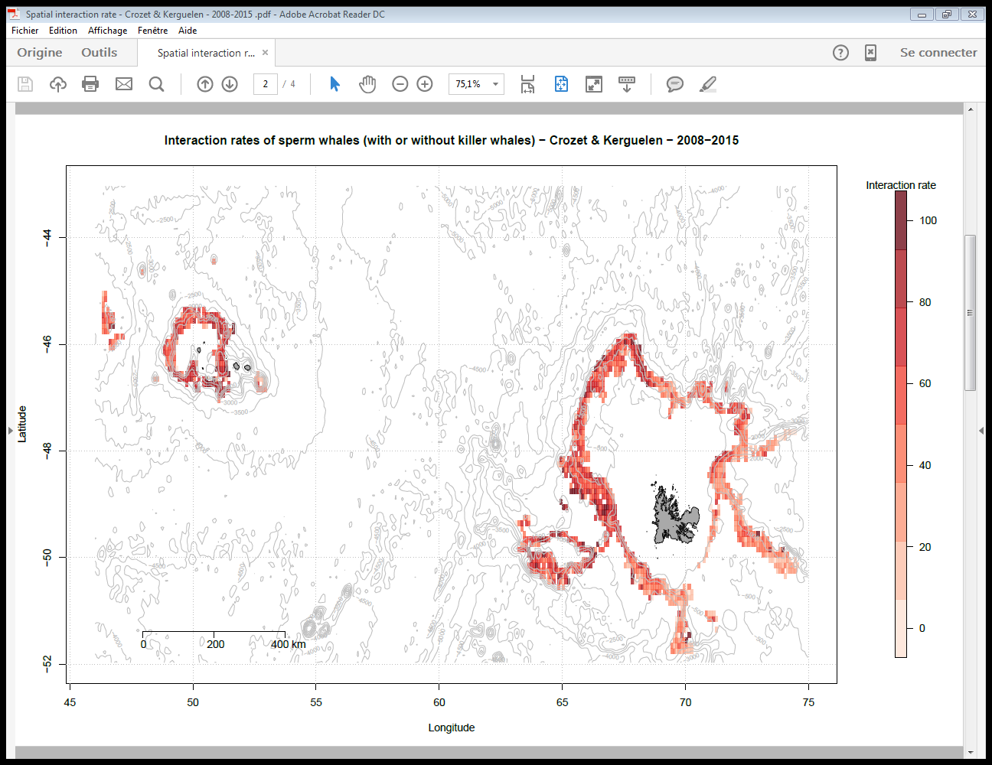
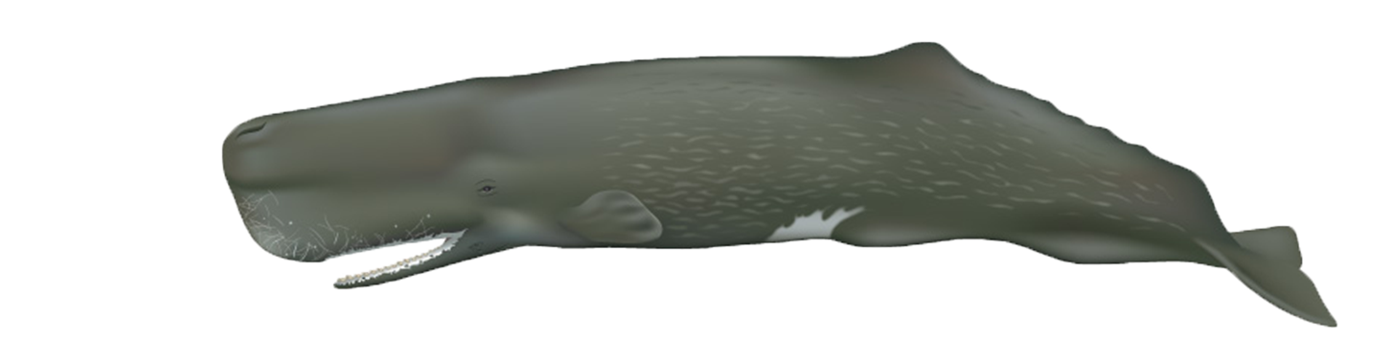
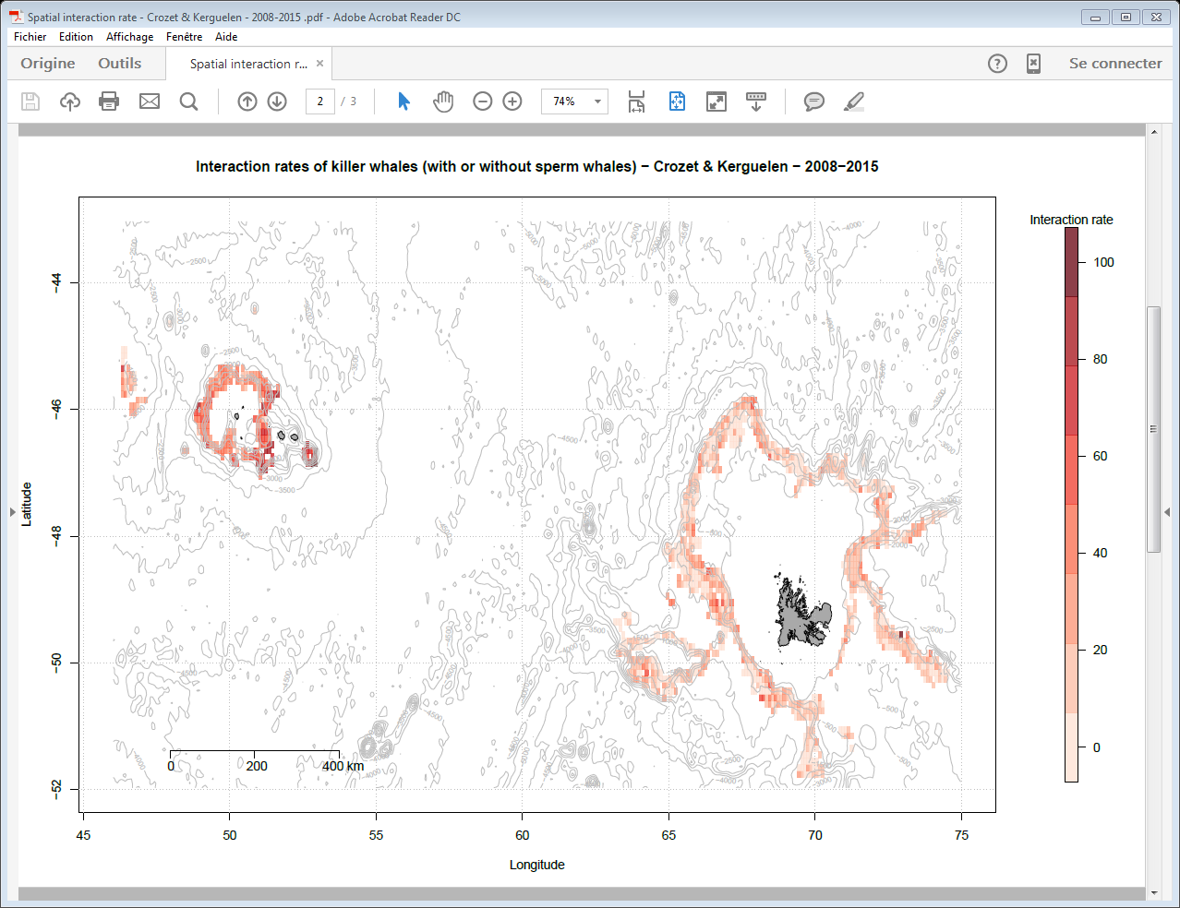
Area and data
Technical approach
Behaviour vessels
Behaviour whales
Ongoing study
Distribution of interactions
% of depredated sets

Slide 14
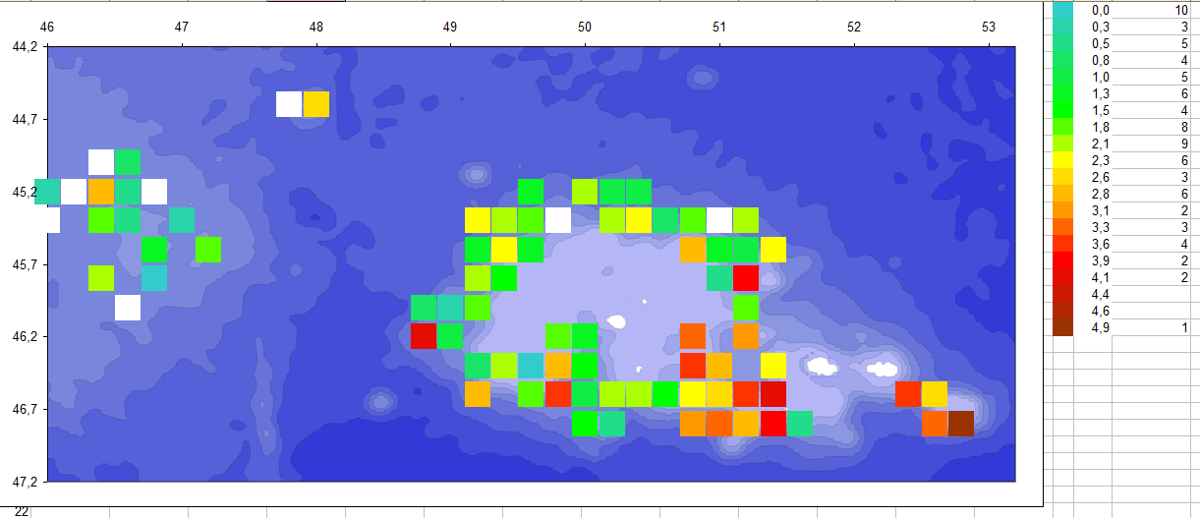
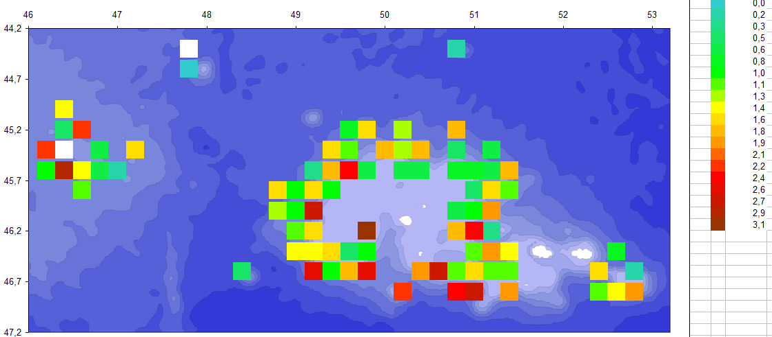
Area and data
Technical approach
Behaviour vessels
Behaviour whales
Ongoing study
Distribution of interactions
Mean number of individuals per depredated set

Slide 15
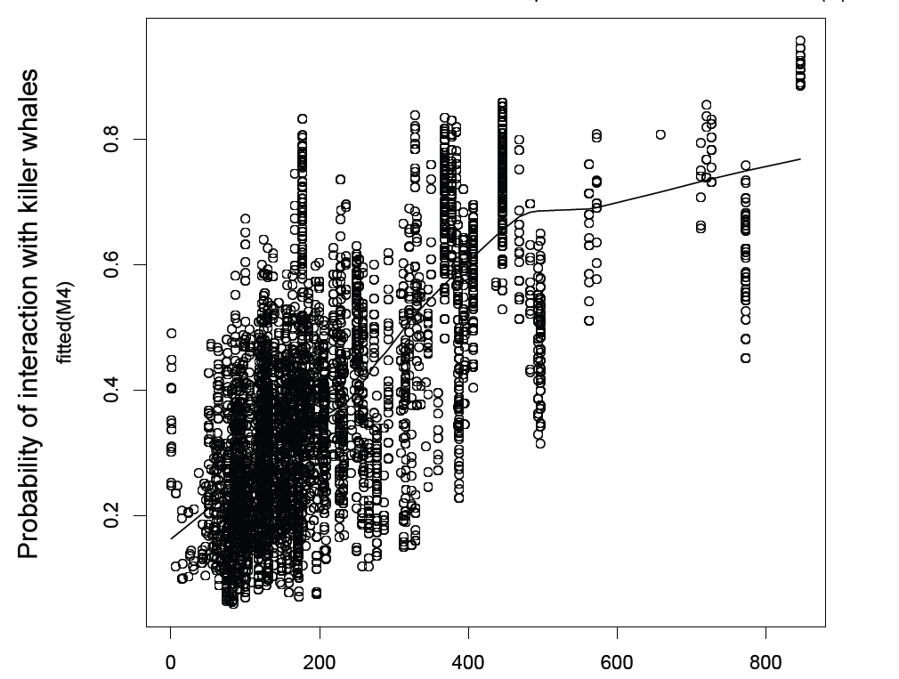
Area and data
Technical approach
Behaviour vessels
Behaviour whales
Ongoing study
Distribution of interactions
Negative correlation with the depth at which longlines are set
Positive correlation with toothfish density
Whales may be naturally distributed on the insular shelf closer to islands
Whales are more likely to depredate on productive fishing grounds
P. Tixier, N. Gasco, C. Guinet, ICES Journal Marine Science, 2015

Slide 16
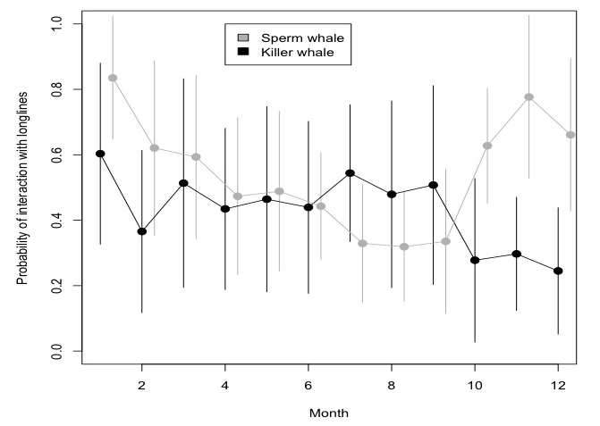
Area and data
Technical approach
Behaviour vessels
Behaviour whales
Ongoing study
Seasonality
Probability of interaction with longlines
Oct – Dec
Lower interaction rate
Month
P. Tixier, N. Gasco, G. Duhamel, C. Guinet, CCAMLR Science, 2010

Slide 17
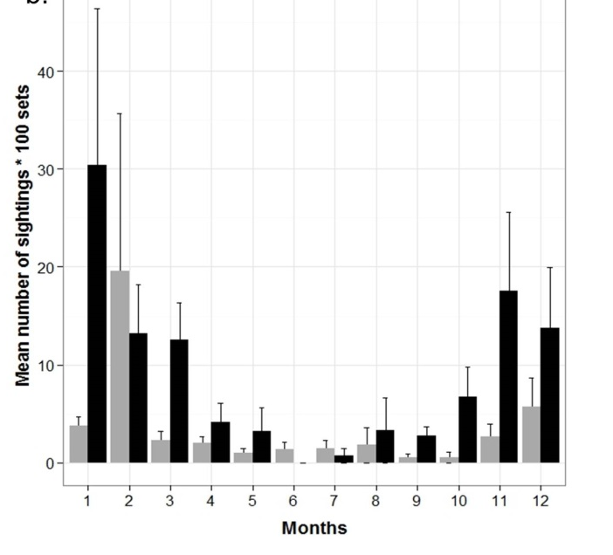
Area and data
Technical approach
Behaviour vessels
Behaviour whales
Ongoing study
Seasonality
Kerguelen
Crozet
May - September
Lower interaction rate
Labadie, G., Tixier, P., Fay, R., Barbraud, C., Gasco, N., Guinet, In Prep. J. Mammalogy.

Slide 18
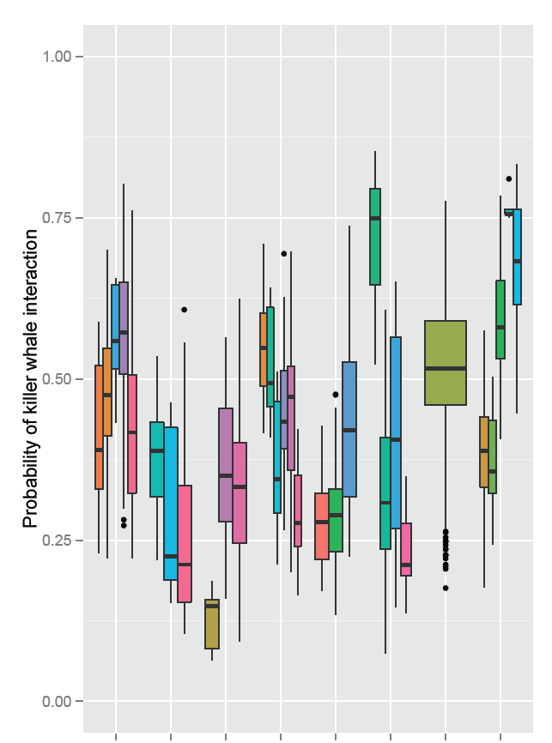
Area and data
Technical approach
Behaviour vessels
Behaviour whales
Ongoing study
Different skippers using the same vessel
Depredation at the skipper level
(Work of Gaëtan Richard – Ph.D. student at CEBC – CNRS)
Great between-skippers variations of the probability of interaction with killer whales
A
B
C
D
E
F
G
H
Vessels

Slide 19
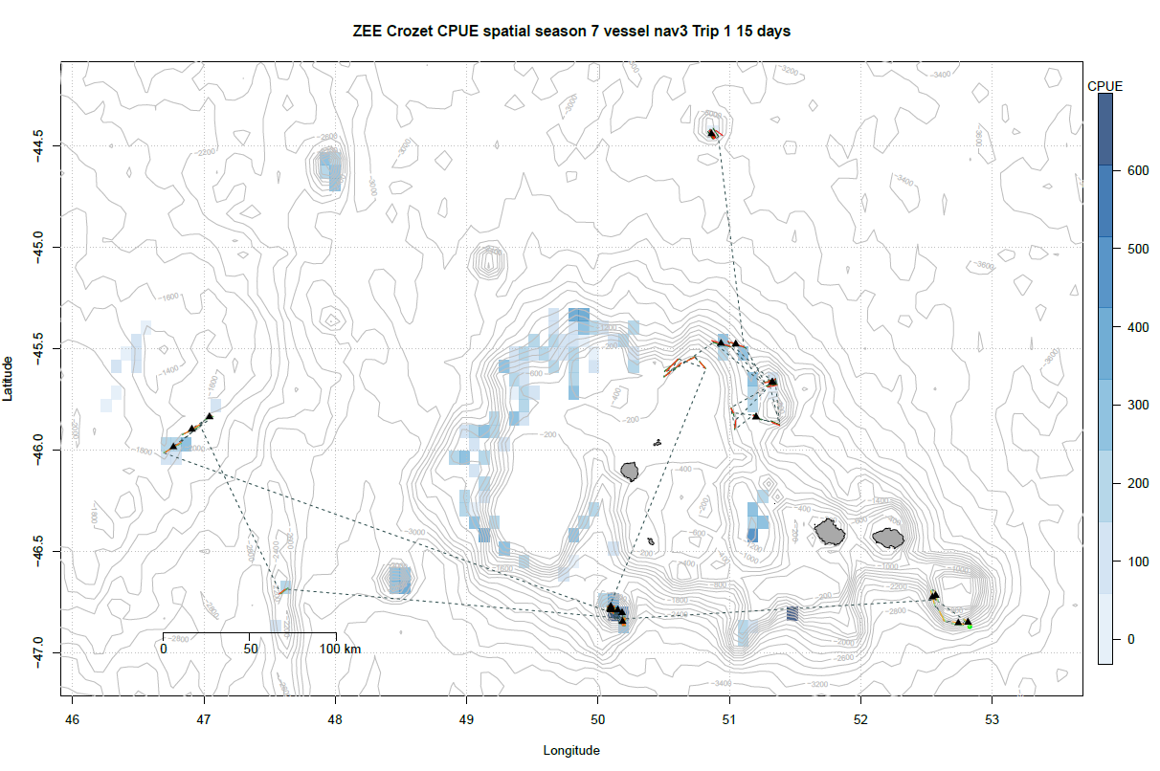
Area and data
Technical approach
Behaviour vessels
Behaviour whales
Ongoing study
CPUE
Leaving a fishing area?
Analysis of the behaviour of 1 skipper – 1 vessel
Optimal foraging theory
=
Maximizing CPUE
Labadie, G., Tixier, P., Fay, R., Barbraud, C., Gasco, N., Guinet, In Prep. J. Mammalogy.

Slide 20
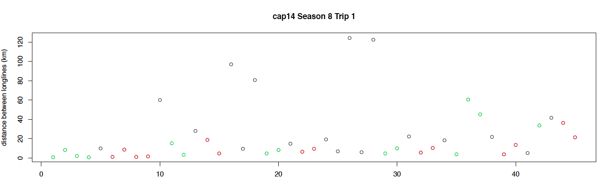
Area and data
Technical approach
Behaviour vessels
Behaviour whales
Ongoing study
Distance between sets (km)
Leaves fishing area
1 fishing session
Successive longline sets
Variables influencing the Decision making process?
Labadie, G., Tixier, P., Fay, R., Barbraud, C., Gasco, N., Guinet, In Prep. J. Mammalogy.

Slide 21
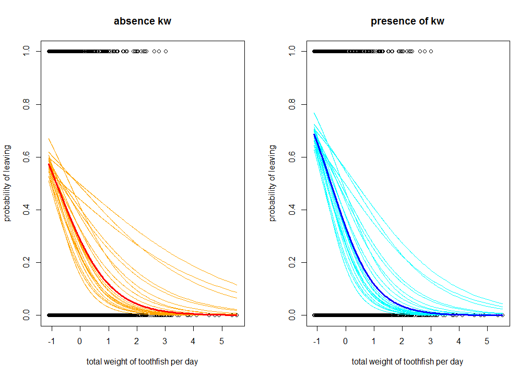
Area and data
Technical approach
Behaviour vessels
Behaviour whales
Ongoing study
between-skippers variations in decision making
Probability of leaving
Probability of leaving
Total weight of toothfish per day
Total weight of toothfish per day

Slide 22
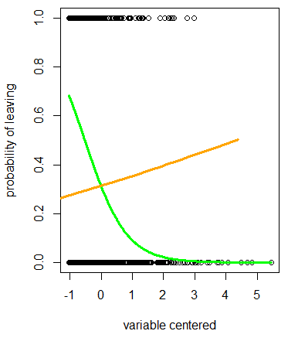
Area and data
Technical approach
Behaviour vessels
Behaviour whales
Ongoing study
between-skippers variations in decision making
Influence of the number of killer whales
Probability of leaving
Total weight of toothfish per day

Slide 23
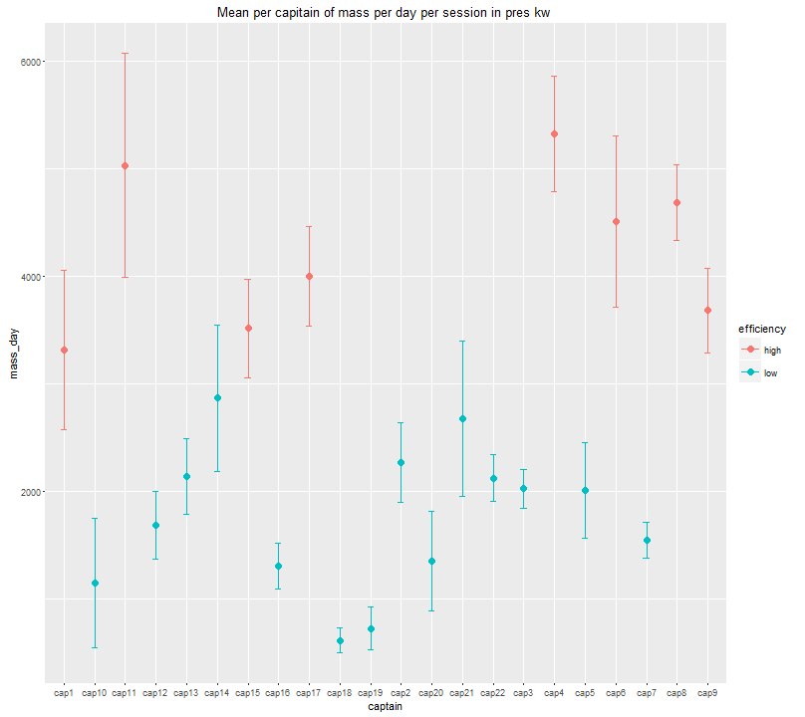
Area and data
Technical approach
Behaviour vessels
Behaviour whales
Ongoing study
Mass of toothfish per day per skipper in presence of killer whales
Variations of efficiency between skippers
Highly efficient skippers
Significant variables:
Longline length
Hauling speed
Depth
Experience

Slide 24






Acknowledgements
CEBC - CNRS
Fundings and Partnership
Terres Australes et Antarctiques Françaises
Réserve Naturelle des TAAF
Muséum National d’Histoire Naturelle de Paris
Armements de pêche à la légine réunionais
Institut Polaire Français
Fondation d’entreprises des mers australes
Coordinators
Dr Christophe Guinet Cédric Marteau Pr. Guy Duhamel Thierry Clot
Data Collection
Fishery observers and field workers of Possession Island – special thanks to Nicolas Gasco
Help in analyses
M. Authier, M. Viviant, C. Barbraud, D. Pardo, D. Pinaud, J. Vacquie Garcia, T. Jeaniard Dudot, P.Monestiez
Photographers
AUBERT Jean Luc; BARRETT-LENNARD Lance; BEILLOEIL; BELBEYC'H Bruno; BERTHET Philippe; BERTRAND Geoffrey; BLANCHARD Pierrick; BOITEAU Christophe;
BONNET Joël; BOST Charles-André; BURLE Marie-Hélène; CARCAILLET Christopher; CARDOT Gilles; CHEVRIER Claude; DE STEPHANIS Renaud; DERVAUX Antoine;
DESMARET Rolland; DESPIN Bernard; DONDELINGER Caroline; DOREMUS Ghislain; DUFRENE Rémy; FERNANDEZ Eric; FOURNIER Jean-Charles; GASCO Nicolas GAUTHIER-CLERC Michel; GOUEDARD Yvon; GUINET Christophe; HANDRICH Yves; HANUISE Nicolas; HOARAU Eric; LANGUENOU Roger; LE CORRE Yann; LEGRAN Jérôme; LEMARCHAN Christian; LEQUETTE Benoît; LERIDON Jean; LEROUX Eric; LESCAROUX Jean-Michel; LOUBON Maxime; MAISON Jérome; MANGIN Stéphane; MANILEVE Patrick; MARECHAL Pierre; MELLEE Jean-Luc; MOURIES Jacques; NOORKHAN Alain; NOYAN Patrick; PAULIN Rémy; PAWLOWSKI Frédéric; PERROT Yohann; PETER Jean; RIDOUX Vincent; RINGOT Frédéric; SCHWEBEL Luc; SORIN Dominique; STENBERGER Ludovic;THERON Franck; TIXIER Paul; VERLAND Henri; VERMANDE Hugues; VILLEMIN Catherine; WEIMERSKIRCH Henri

