Slide 1
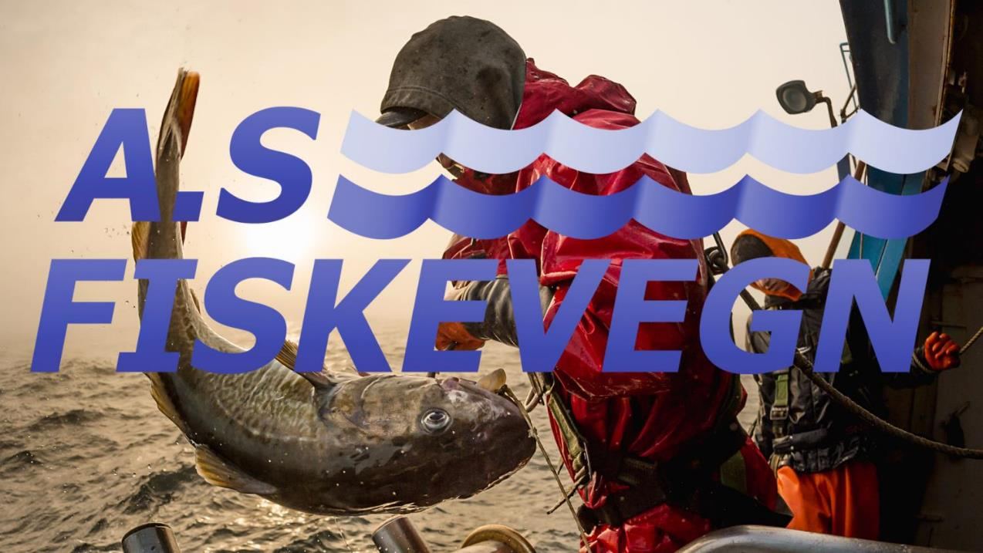
MITIGATION BY DEVELOPING TECHNOLOGICAL SYSTEMS TO REDUCE DEPREDATION
-WHAT HAS BEEN SO FAR-
Pablo Parra Henríquez | Senior Mechanical Engineer | AS FISKEVEGN
COLTO Whale Depredation Workshop – Punta Arenas, Chile, 16-18 March 2016

Slide 2
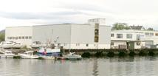
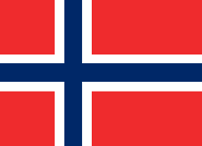
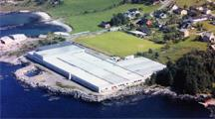

…a bit about AS FISKEVEGN
FISKEVEGN is a leading Scandinavian manufacturer of cords, ropes and fishing equipment.
Ålesund
Flatraket
COLTO Whale Depredation Workshop – Punta Arenas, Chile, 16-18 March 2016

Slide 3
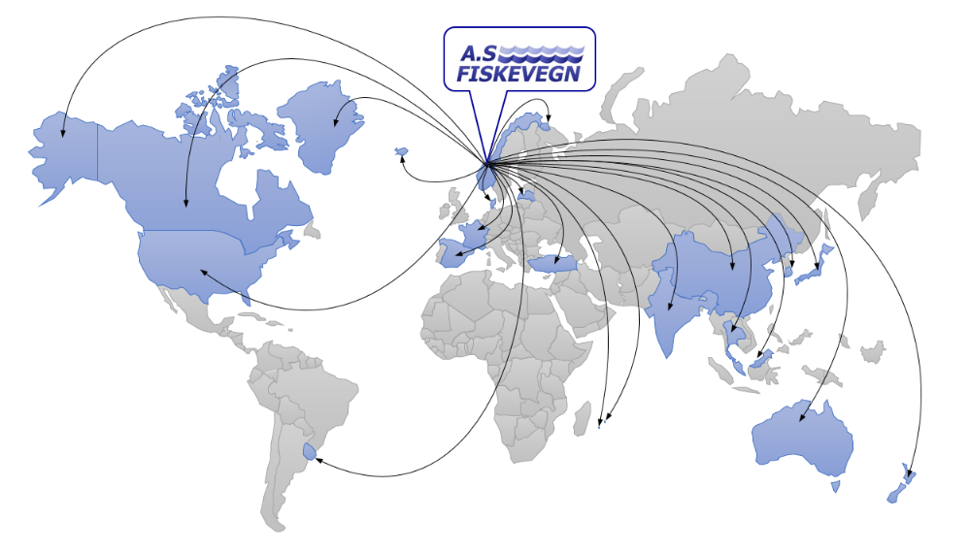
…where we are working?
FISKEVEGN is able to provide services around the world.
COLTO Whale Depredation Workshop – Punta Arenas, Chile, 16-18 March 2016

Slide 4
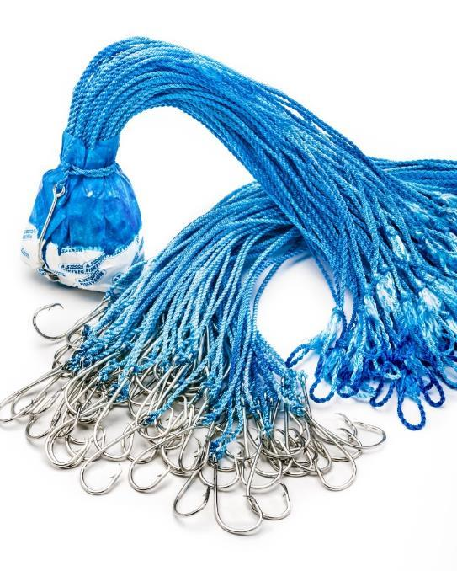
What do we expect from this workshop?
Listen and learn, COLTO is a golden opportunity to discuss challenges and solutions.
To suggest directions (where possible)
To evaluate the feasibility, and market, for emerging new solutions.
To seek collaboration and partnerships
COLTO Whale Depredation Workshop – Punta Arenas, Chile, 16-18 March 2016

Slide 5
Some experiences and insights so far
Fiskevegn’s ‘working titles’ terminology for whale deterrents
WADS – Whale Anti Depredation Systems, hereunder:
Active Deterrents (ADS) – eg. acoustics, light
Catch Protection Systems (CAPS) – eg. Cachalotera, ‘Sago’, ‘Shuttle’
Operational Adaptation Systems (OPAS) – eg. Rapid hauling, noise reduction
Combined Deterrents Systems (CODES) – a multi-pronged strategy combining two or more of the above
COLTO Whale Depredation Workshop – Punta Arenas, Chile, 16-18 March 2016

Slide 6
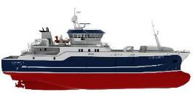
Some experiences and insights so far
Operational Adaptations - Industry experiments
CASE: Hauling velocity increased to avoid whales
We need better understanding of hydrodynamics of line hauling
-more details in the second presentation-
COLTO Whale Depredation Workshop – Punta Arenas, Chile, 16-18 March 2016

Slide 7
Some experiences and insights so far
Industry experiments
CASE: Hauling velocity increased to avoid whales
SOME CONCERNS:
Hydrodynamic issues and gear losses
HSE issues
Whales learn and adapt to the technique
COLTO Whale Depredation Workshop – Punta Arenas, Chile, 16-18 March 2016

Slide 8
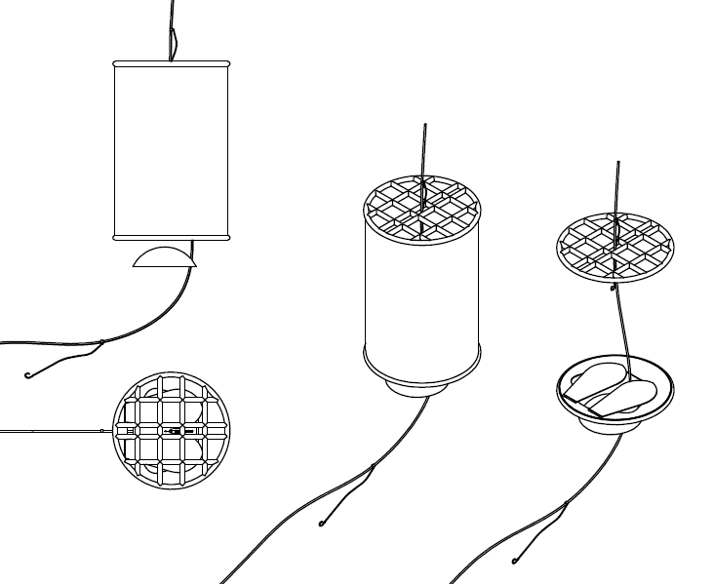
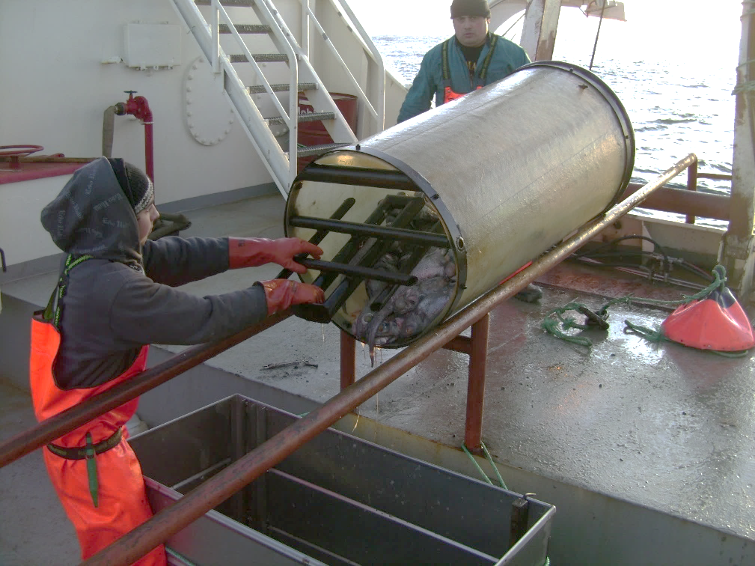
Some experiences and insights so far
Catch Protection Systems - Early SAGO prototype
COLTO Whale Depredation Workshop – Punta Arenas, Chile, 16-18 March 2016

Slide 9
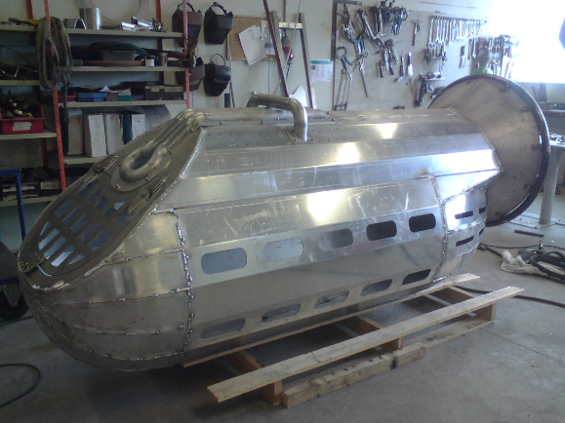
Some experiences and insights so far
First SAGO prototype, built to inventor’s specifications, prior to revisions
COLTO Whale Depredation Workshop – Punta Arenas, Chile, 16-18 March 2016

Slide 10
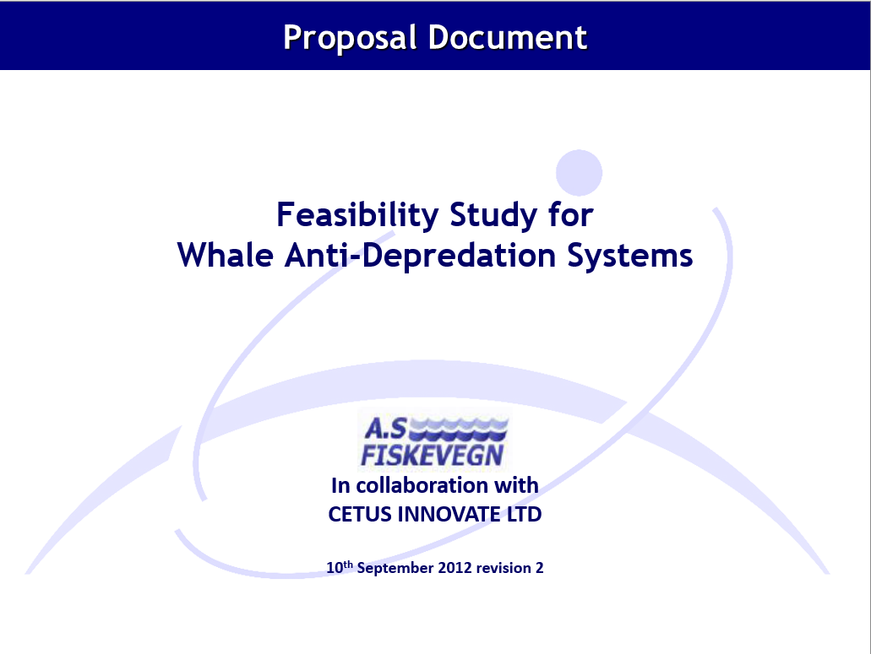
Some experiences and insights so far
Fiskevegn and a team of experts in acoustics, hydrodynamics and marine engineering did an assessment of main directions of “WADS” development in 2012
The workgroup conlcuded:
- Against developing acoustic deterrents
given whale learning capabilities, and that in
order to be effective, sound sources probably
would need to harm the whales
- In favour of detailed exploration of
containment / catch protecion solutions
New: Insights in hydrodynamics are
emerging that may offer useful advice in
combination with operational adaptations
(setting and hauling strategies)
COLTO Whale Depredation Workshop – Punta Arenas, Chile, 16-18 March 2016

Slide 11
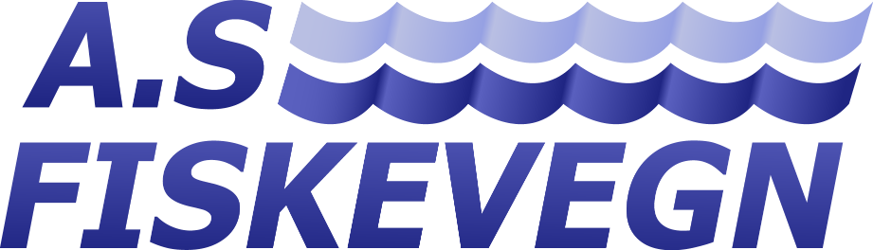
THANK YOU
COLTO Whale Depredation Workshop – Punta Arenas, Chile, 16-18 March 2016

