Slide 1
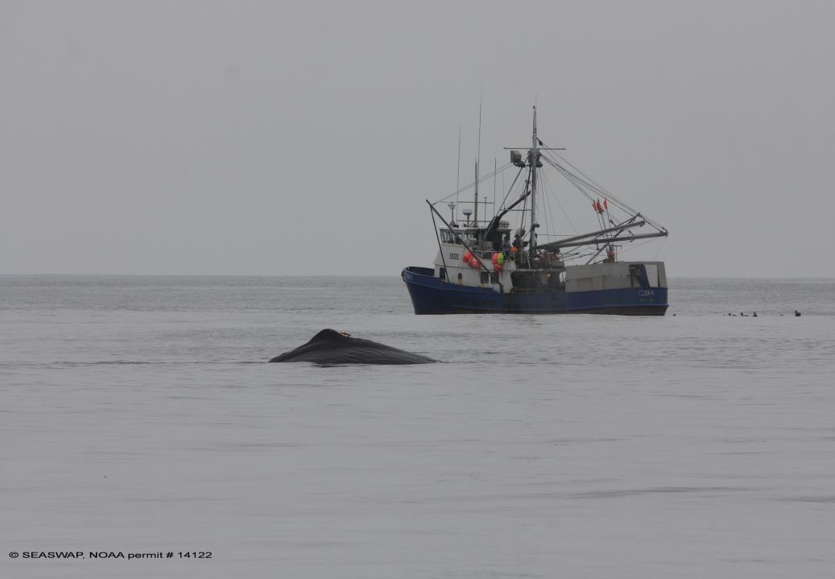
SEASWAP:
Communication Network
& Avoidance as a means for reducing depredation
Presented by Jan Straley
Session 5 & 7 COLTO
On behalf of SEASWAP
Punta Arenas, Chile
Notes:
1235Gypsy

Slide 2




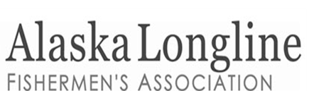
SEASWAP
Southeast Alaska Sperm Whale Avoidance Project
Scientists, fishermen and managers working together to understand depredation and
minimize interactions
Co Authors for this study
Russ Andrews Katy Pendell
Lauren Wild Linda Behnken
Victoria O’Connell Dan Falvey
Aaron Thode
Notes:
In 2003 SEASWAP was formed at the request of fishermen to the state managers of the fishery. Since this time we have come together to study the interactions between sperm whales and the fishery. Co authors are

Slide 3
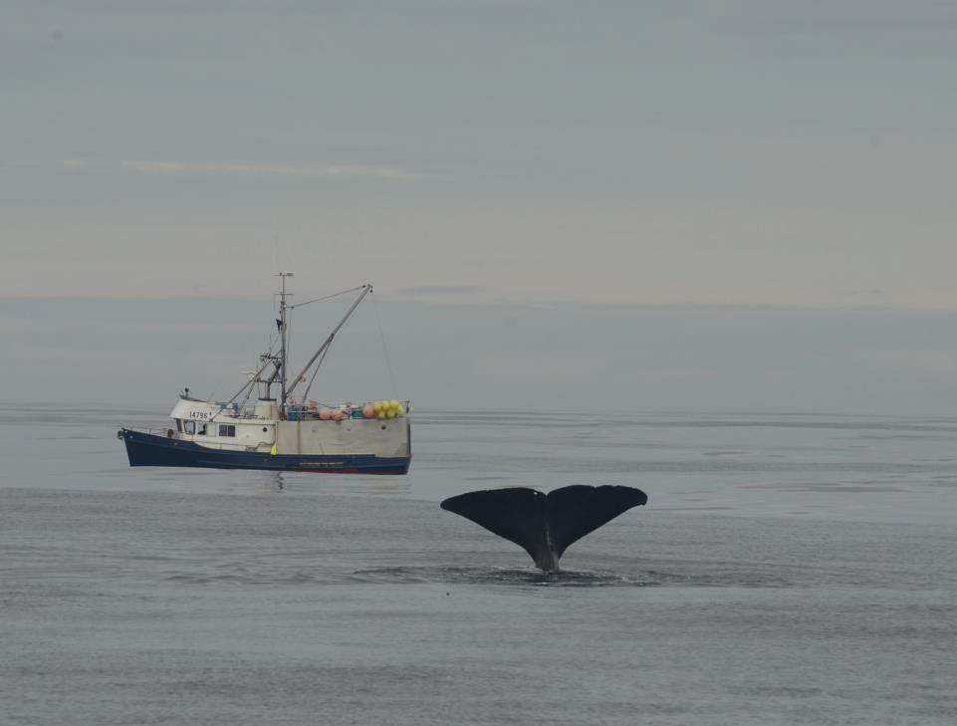
Questions to address:
Are these the same whales each year?
Do they associate?
Can a whales location and timing be predicted?
Notes:
11 whales were documented 10 or more times demonstrating strong site fidelity, returning to the same areas in the GOA in multiple years. 10% of all whales accounted for 33% of all sightings (n= 436) near vessels whales were the most serious depredators returning to same area across years

Slide 4
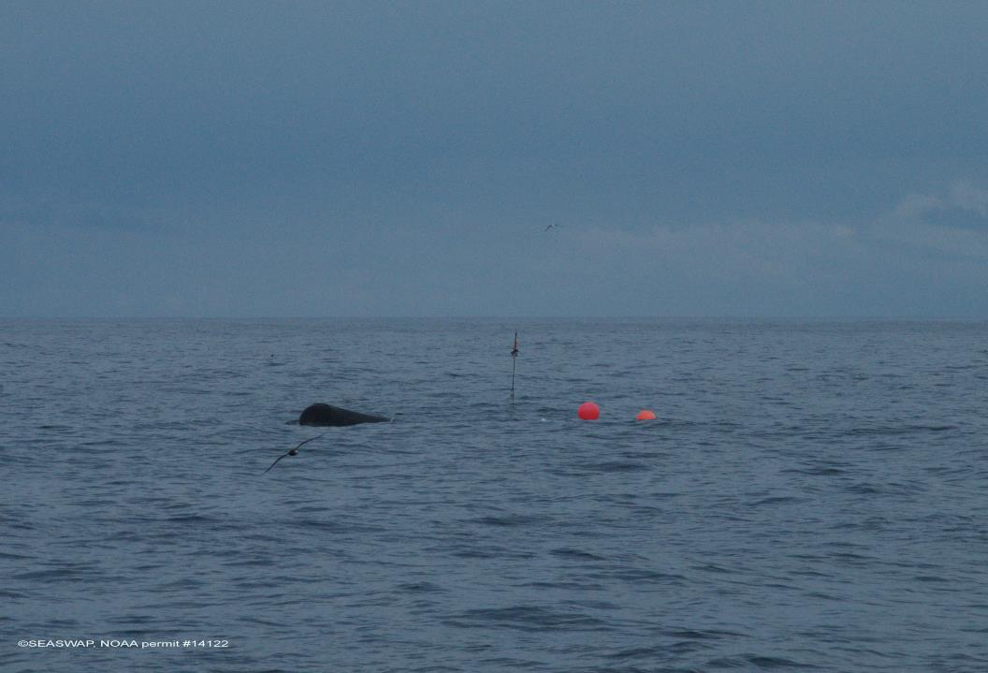
Whale avoidance through near real-time communication network
Steps 1. whales----predictability then 2. network How can this work?
Satellite-tag sperm whales known depredators—predict location over time
Collect whale, environmental, and fisheries data to analyze contributing factors to sperm whale depredation to assess efficacy
Notes:
In the course of understanding depredation we recently began to explore the idea of using avoidance as a way to minimize encounters.
On a local level we are using tags to demonstrate that by knowing where the whales are, we can provide info to fishermen in near-real time so they can avoid those areas when they fish. (then do the Chatham area)
Our tagging work has allowed us to track animals, and a decade of sighting histories can tell us where certain whales are likely to be seen and which whales are most commonly seen near vessels. .

Slide 5
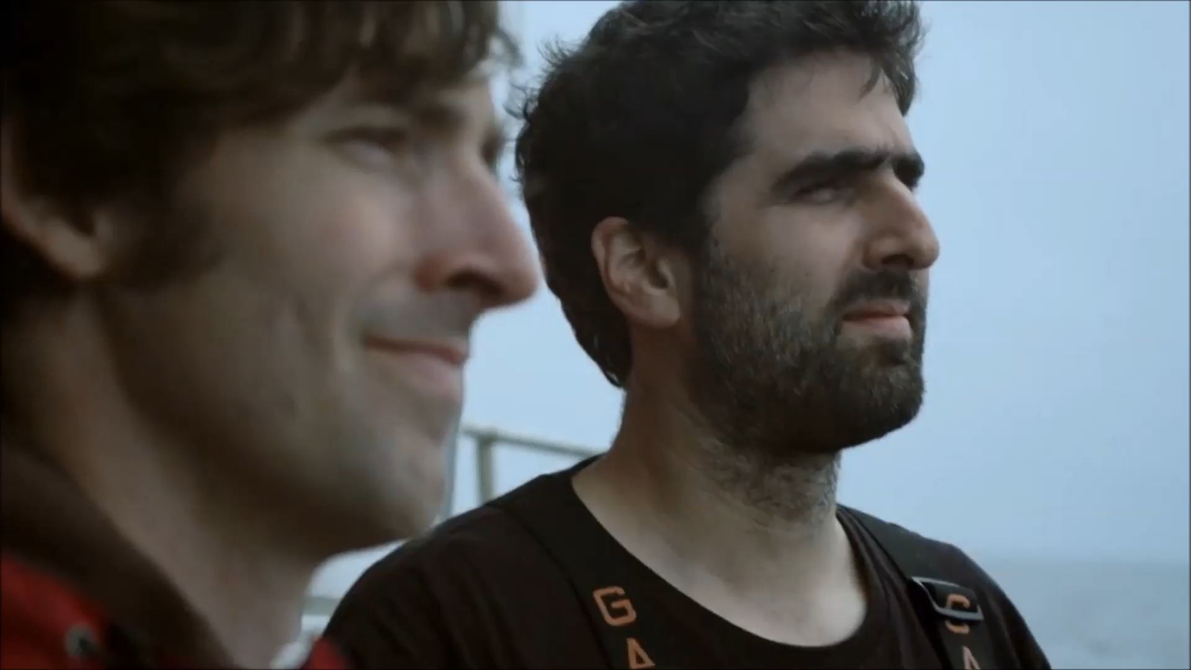
Footage courtesy of BBC Two: Alaska: Earth’s Frozen Kingdom, Spring;
Notes:
I’m not sure I explained that very well, and these things always sound better with a British Accent, so in 2014 we worked with the BBC on film that highlighted this sperm whale – fishermen interaction.
Sperm whale diving down, plucking fish off line

Slide 6
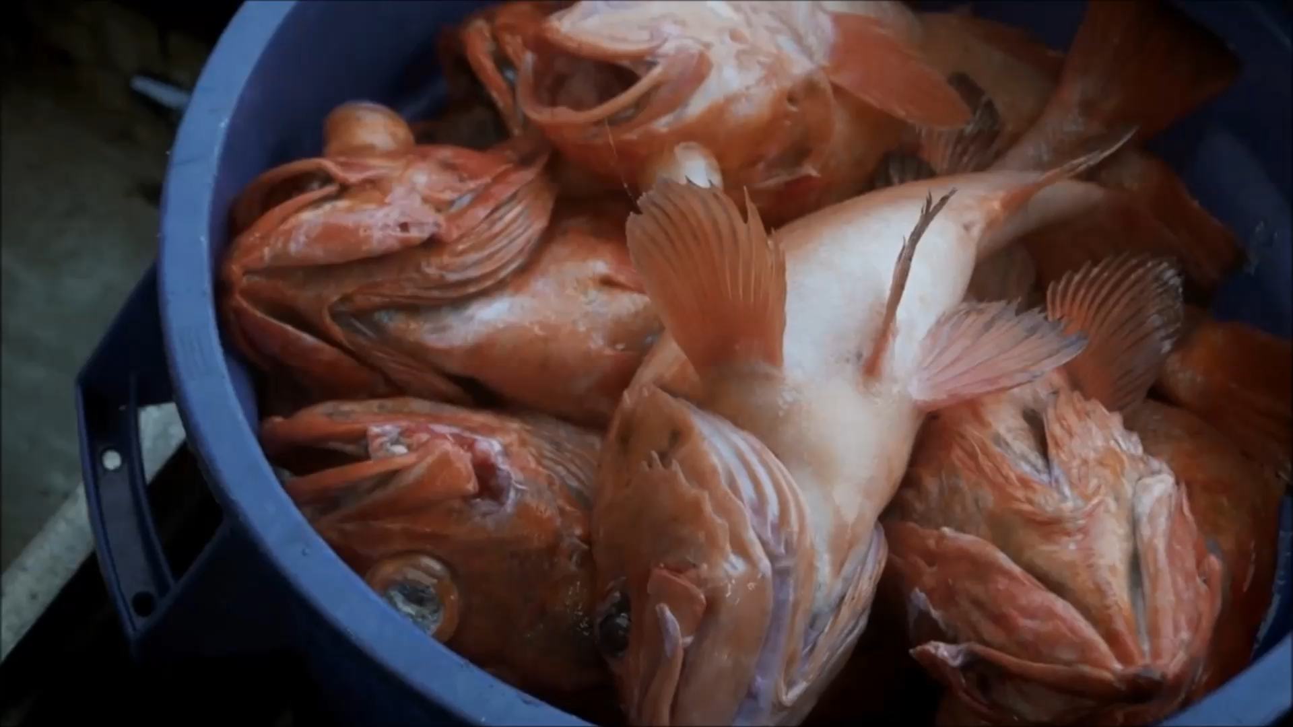
Notes:
Hooks, and heads.

Slide 7
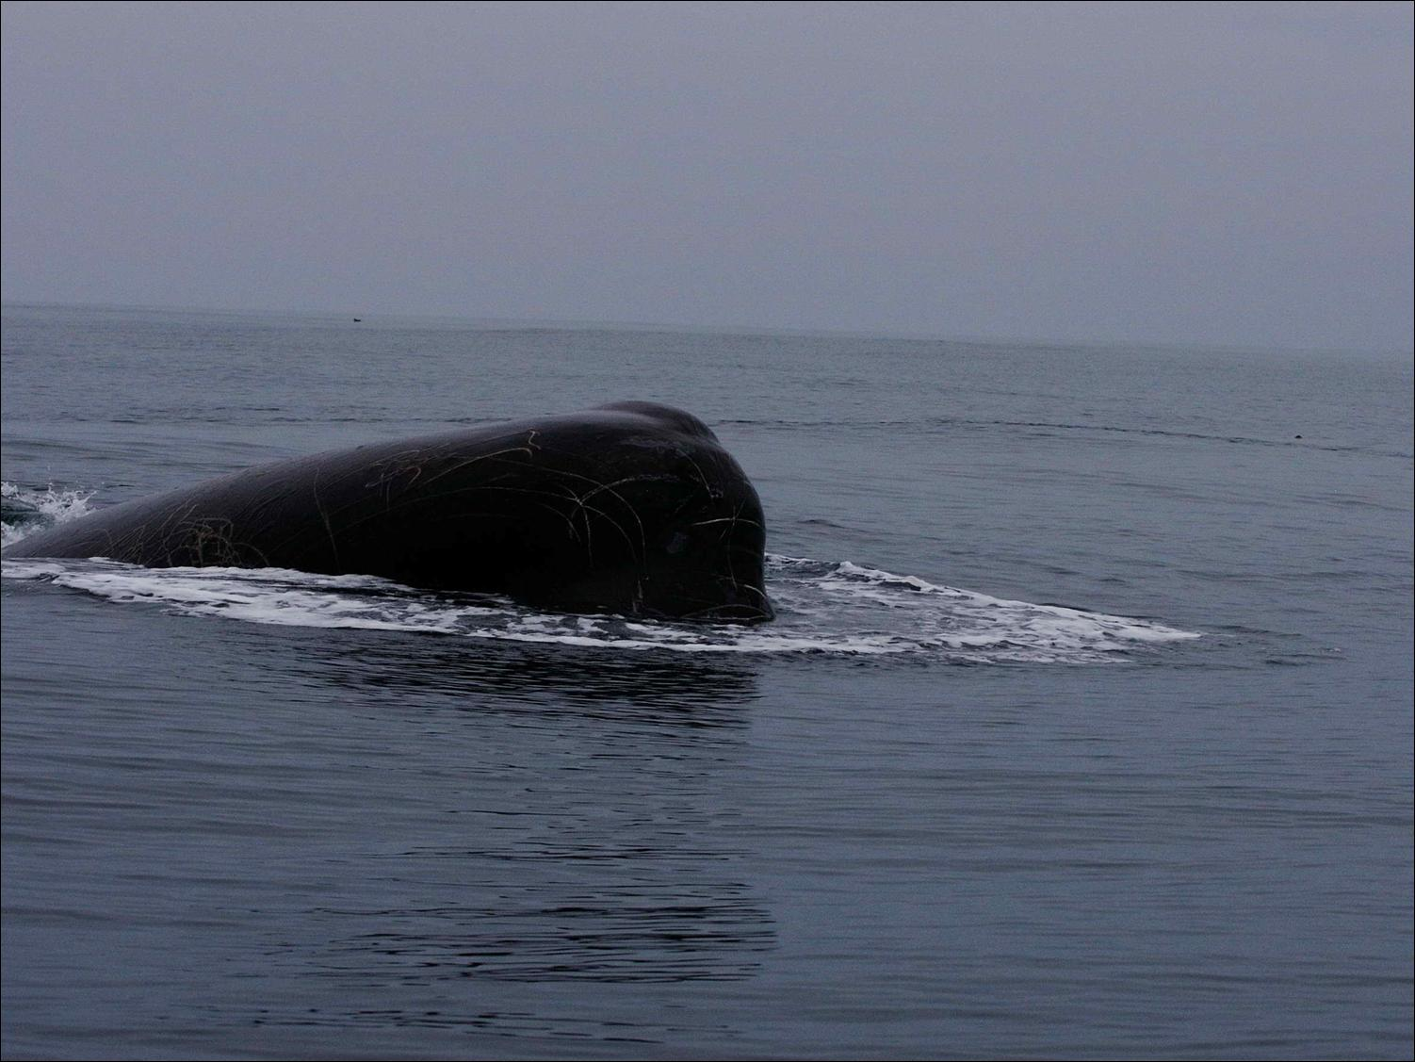
What can we say about adult males?
Male-Male non breeding associations
(from published historical whaling data)
Solitary, nomadic, bachelors, roam widely
True or False?
Notes:
Since this is the conference theme this year I explored past history for information on male male associations
The general pattern for sperm whales is to be born into your mothers group or clan near the equator and stay until you leave as a young adult at 3-15 years and form a group Both groups are defined as gregarious and social. As you reach adulthood in your 20s you leave the male young adult group and move to the higher latitudes and live a solitary life visitng the equatorial waters for breeding. Essentially the non breeding males become monks, allegedly
Today I will provide evidence for male social structure and behavior in the GOA

Slide 8
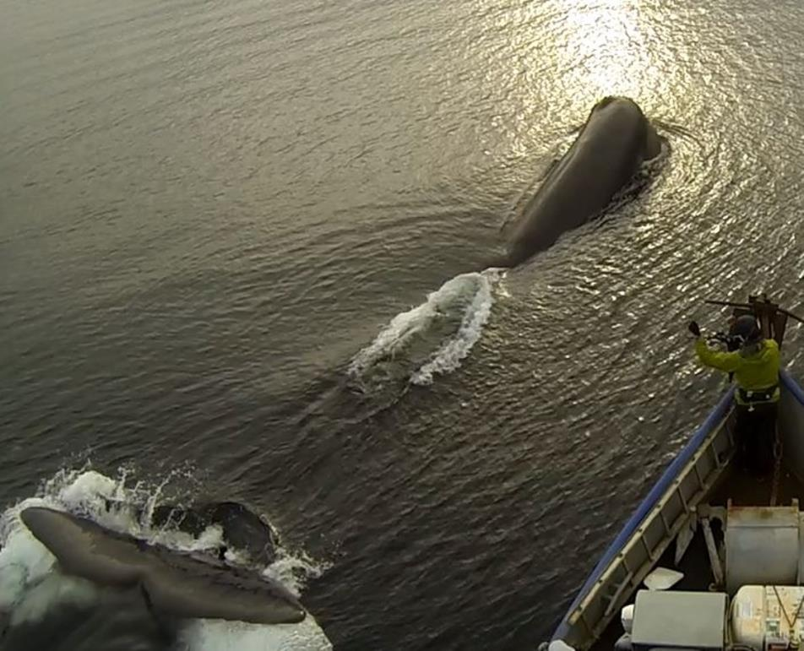
Evidednce of social structure and longterm associations
sighting histories
tagging
Notes:
Aside from using acoustics as a tool to study sperm whale depredation, we are using tracking of sperm whales to explore their movements on small scales around vessels and in the Gulf of Alaska, and in large scales when they leave Alaska
Here is what we did in September in Chatham, tagging two sperm whales that had followed longliners up into Chatham for the black cod fishery there.
[SHOW VIDEO]

Slide 9
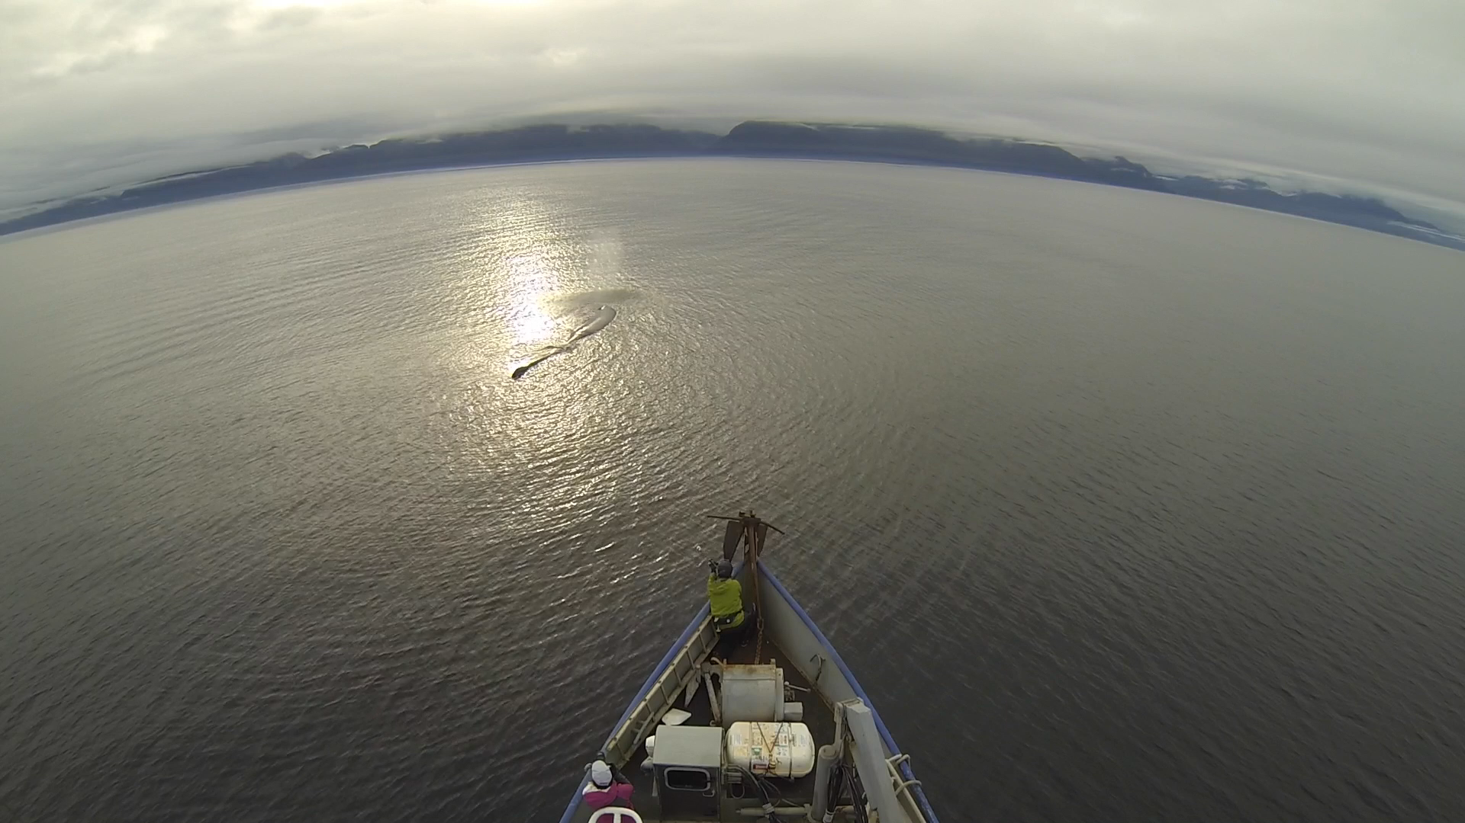
Tagging GOA086 2015
video
Notes:
In the course of understanding depredation we recently began to explore the idea of using avoidance as a way to minimize encounters.
On a local level we are using tags to demonstrate that by knowing where the whales are, we can provide info to fishermen in near-real time so they can avoid those areas when they fish. (then do the Chatham area)
Our tagging work has allowed us to track animals, and a decade of sighting histories can tell us where certain whales are likely to be seen and which whales are most commonly seen near vessels. .

Slide 10
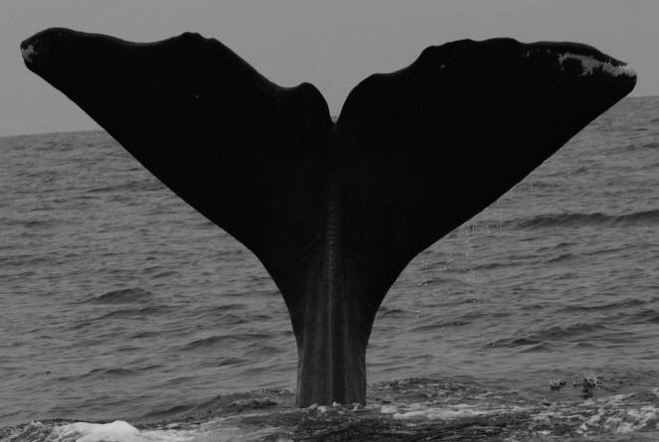
Photo-identified
Using trailing
edge of flukes
Notes:
The frequent presence of sperm whales around vessels provided an opportunity to study associations among whales across seasons and years.

Slide 11
Discovery Curve 2003 to 2014
N = 116 sperm whales identified
50
0
100
50
0
Cumulative tally of whales
Effort in Days
Effort = 207 days
(yearly mean=17.25; SD=8.93)
2003 2014
Notes:
During 207 days of effort (yearly mean=17.25; SD=8.93), 116 sperm whales were photographically identified from 2003 to 2014.

Slide 12
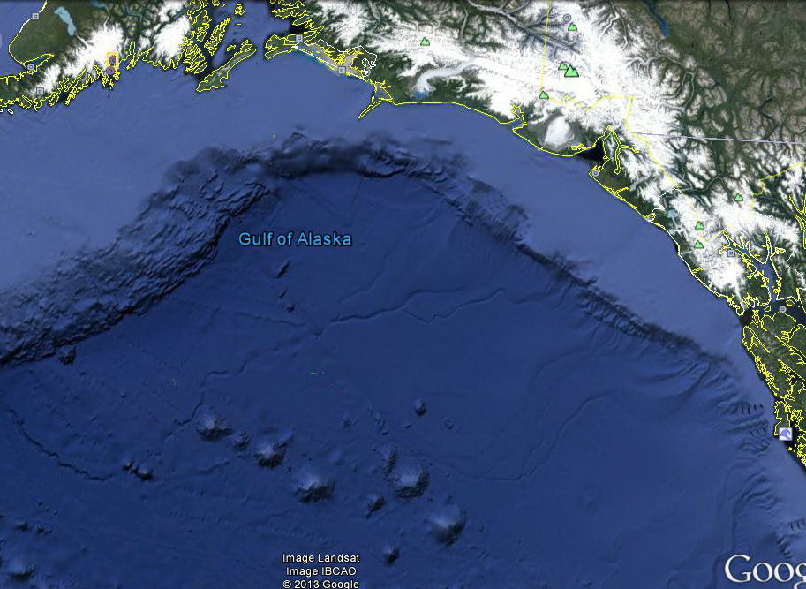
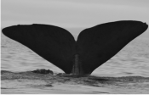





GOA-026 seen near vessels 19 times in
9 of 12 years of study
Known as Jack the Stripper
Notes:
An Example is goa 26

Slide 13
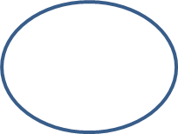
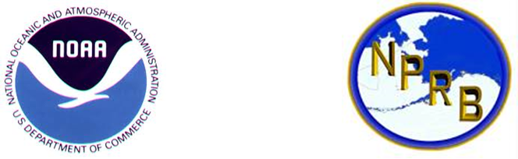


Long-term association indexes for pairs
Whale | GOA-010 | GOA-012 | GOA-026 | GOA-042 | GOA-047
GOA-010 | 10
GOA-012 | - | 12
GOA-026 | .29 | - | 19
GOA-042 | .04 | .08 | - | 15
GOA-047 | .17 | - | .18 | - | 19
GOA-057 | - | - | .07 | .04 | .04
GOA-085 | - | .15 | .03 | - | .20
GOA-109 | .05 | - | - | .09 | .17
Methods
Photographs/sightings of individual whales and near real-time satellite tracking to document:
whale associations
behaviors
foraging hotspots
An association index (SOCPROG2.4) resulted in strong associations (67% to 100%) for 11 pairs of whales
Discovery Curve: How much do we know about the population in our study area?
2013 Discovery curve (cumulative total) of sperm whales for the Gulf of Alaska (N=111).
Leveling of the curve since 2009 shows fewer new
sperm whales are being identified each year
Association: How often are whales seen together?
Whale | GOA-010 | GOA-012 | GOA-026 | GOA-042 | GOA-047 | GOA-057 | GOA-085 | GOA-109
GOA-010 | 10
GOA-012 | - | 12
GOA-026 | .29 | - | 21
GOA-042 | .04 | .08 | - | 15
GOA-047 | .17 | - | .18 | - | 18
GOA-057 | - | - | .07 | .04 | .04 | 10
GOA-085 | - | .15 | .03 | - | .20 | .08 | 18
GOA-109 | .05 | - | - | .09 | .17 | - | .04 | 10
Table 1. Indices of association between whales sighted more than 10 times (N=8).
Along the diagonal, in non-shaded cells, are the number of times each whale was sighted (range 10 to 21) from 2003 to 2013.
To understand if these whales are sighted together regularly we calculated an association index α = x/(x+yi+yj); where x = number of times when two whales were seen near the same vessel; yi = the number of times whale i and yj = the number of times whale j, was seen.
(Whitehead, H. 2008. Precision and power in the analysis of social structure using associations. Animal Behavior 75: 1093-1099.)
GOA-026, GOA-047 and GOA-085 were seen most often;
6 whales had high association indices (blue cells);
GOA-010 and GOA-026 were seen most often together
Acknowledgements:
Madison Kosma for the background image of this poster. Jen Cedarleaf for database and catalog management. Research authorized under NOAA scientific research permit number 14122 and IACUC issued to J. Straley
For more information contact: jmstraley@uas.alaska.edu
Notes:
To understand if these whales are sighted together regularly (and not random) we calculated an association index α = x/(x+yi+yj); where x = number of times when two whales were seen near the same vessel; yi = the number of times whale i and yj = the number of times whale j, was seen.
An association index (SOCPROG2.4) resulted in strong associations (67% to 100%) for 11 pairs of whales.
lthough these are single males, some appear to have long term associations. These patterns may exist for areas they frequent across years.
(Whitehead, H. 2008. Precision and power in the analysis of social structure using associations. Animal Behavior 75: 1093-1099.)

Slide 14
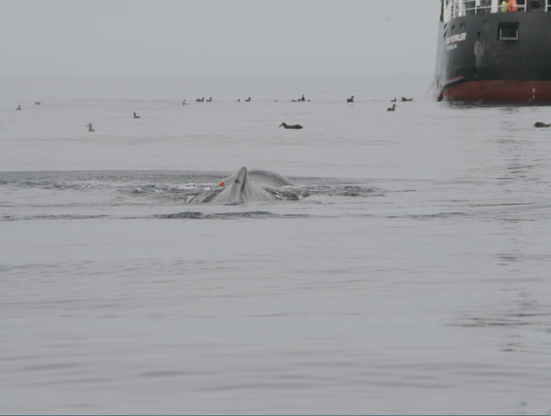
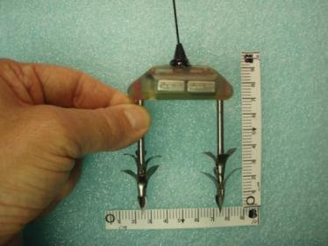
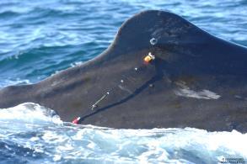
Site fidelity and Long term Associations:
Satellite tags
Notes:
Sat tags provided a way to assess associations without vessel influence

Slide 15
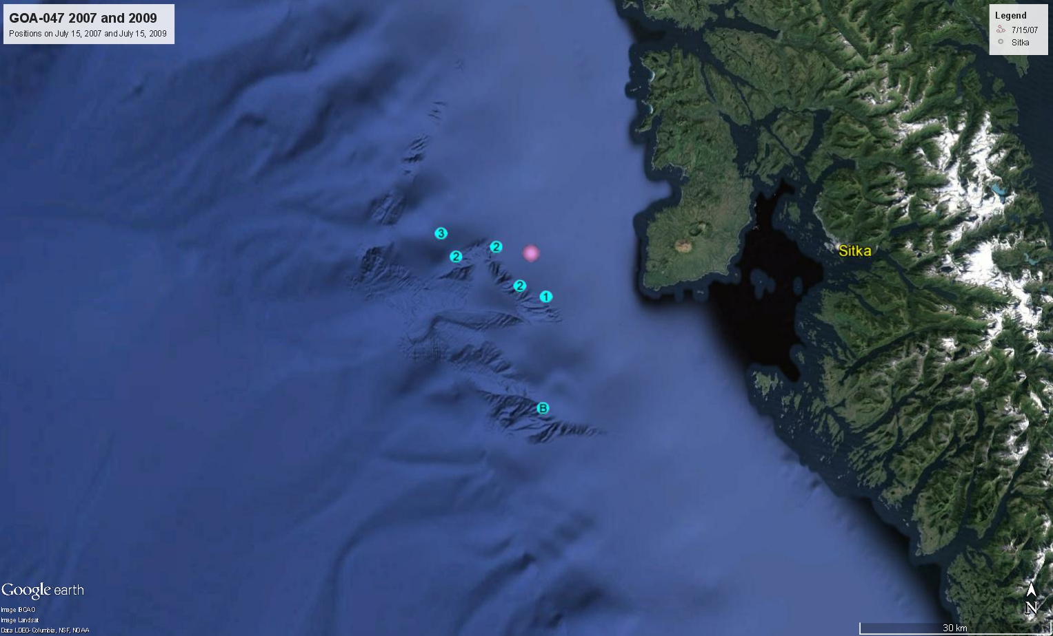
GOA-047 sat tagged same location
2007 and 2009
Whale Tagged June each year
2007 transmitted 3 D
2009 stayed in area 3+ months
Notes:
GOA-047 documented site fidelity. He was tagged in 2007 and 2009 in nearly the same location
Tag 2007 transmitted 3 days but in 2009 GOA 47 stayed in the study area over 3 months

Slide 16
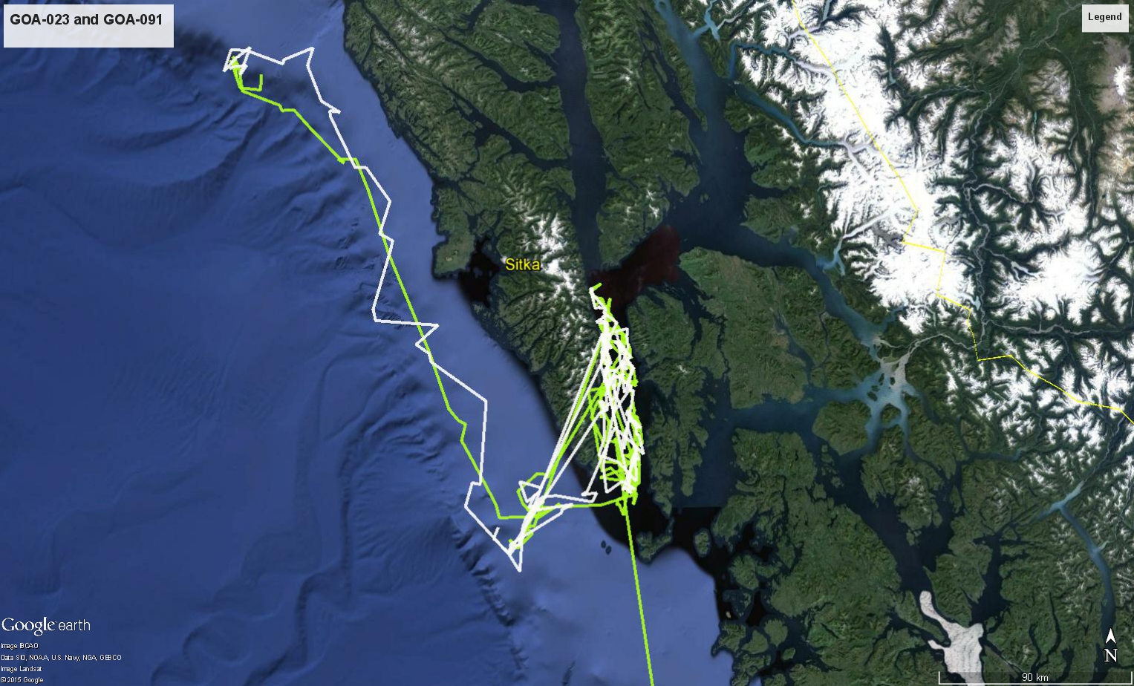
GOA-091 and GOA-023
2010
Whales tagged 17 August
― GOA-091 ( D)
― GOA-023 ( D)
Notes:
In 2010 these two whales were tagged with no fishing vessel presence. The traveled in tandem but not close together for over two months documenting Site fidelity and association

Slide 17
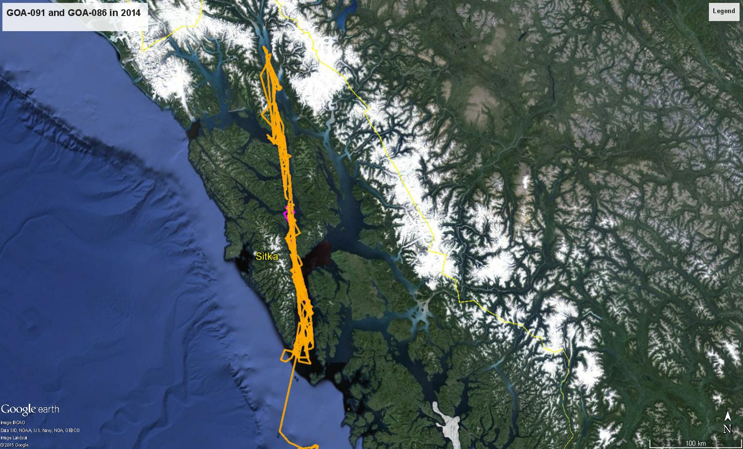
GOA-091 and GOA-086 and GOA-023
2014
Whales tagged 16 Sept 14
― GOA-091 6 days
― GOA-086 4 months
GOA-023 NOT TAGGED BUT documented until late October (30+ days)
Notes:
In 2014 two whales were tagged in Chatham Strait of three whales who were associating in the same area. GOA91’s tag stopped transmitting after 6 days but GOA-86 spent all fall and most of the winter in upper Lynn Canal.
Swsat27 GOA-091 SWsat27_GOA-091 16-Sep-2014 18:04 to 22-Sep-2014 18:52
SWsat26 GOA-086 SWsat26_GOA-086 16-Sep-2014 17:14 to 27-Feb-2015 15:03 (164 days)

Slide 18
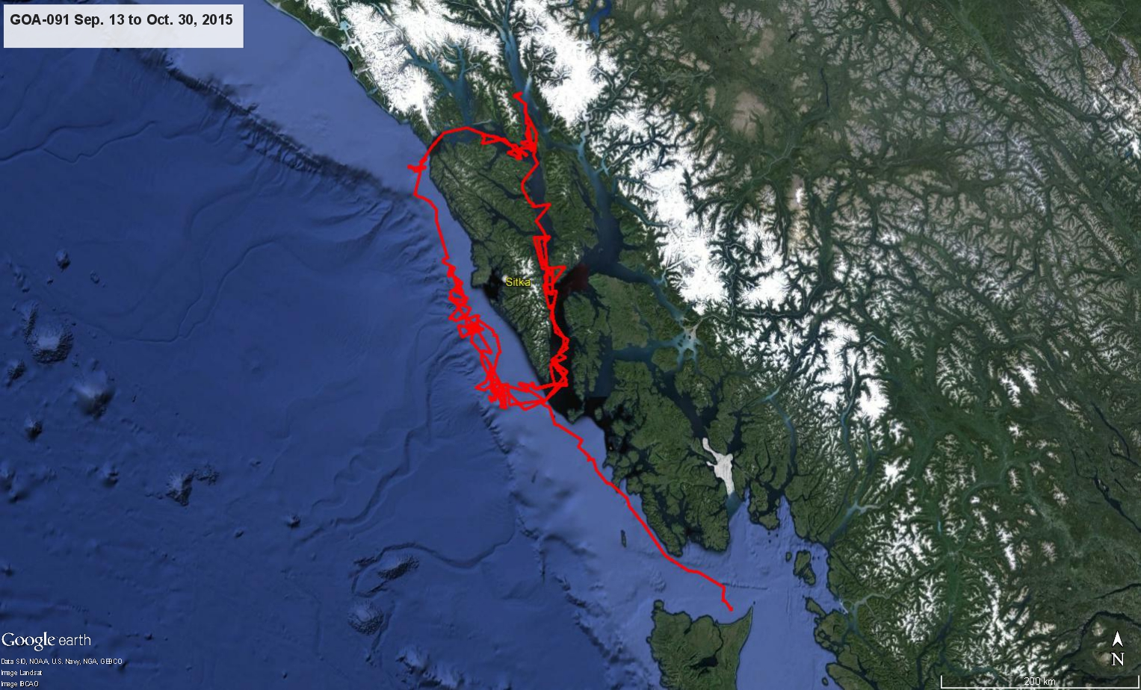
GOA-091 and GOA-023
2015
― GOA-091 in 2015
-GOA-091 in area
30+ days
GOA-023 not tagged
Documented associating for
14 days
Notes:
SWsat26 GOA-086 SWsat26_GOA-086 16-Sep-2014 17:14 to 27-Feb-2015 15:03 (164 days)
SWsat28 GOA-091 SWsat28_GOA-091 13-Sep-2015 13:26 to 30-Oct-2015 12:38 (47 days)

Slide 19
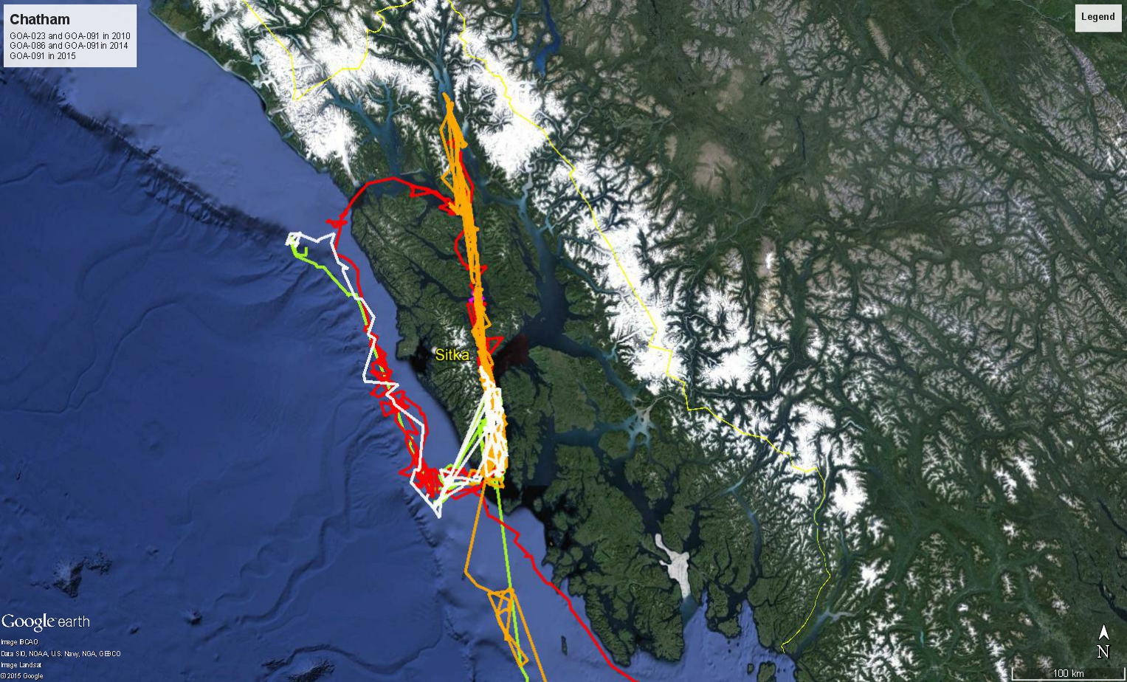
Summary of site fidelity and associations
from satellite tags
― GOA-023 (2010)
― GOA-091 (2010)
― GOA-091 (2014)
― GOA-086 (2014)
― GOA-091 (2015)
Notes:
All whales showed site fidelity and associations with and without vessel influence across three years. Three whales demonstrated close association over days, months and years in the high latitudes

Slide 20
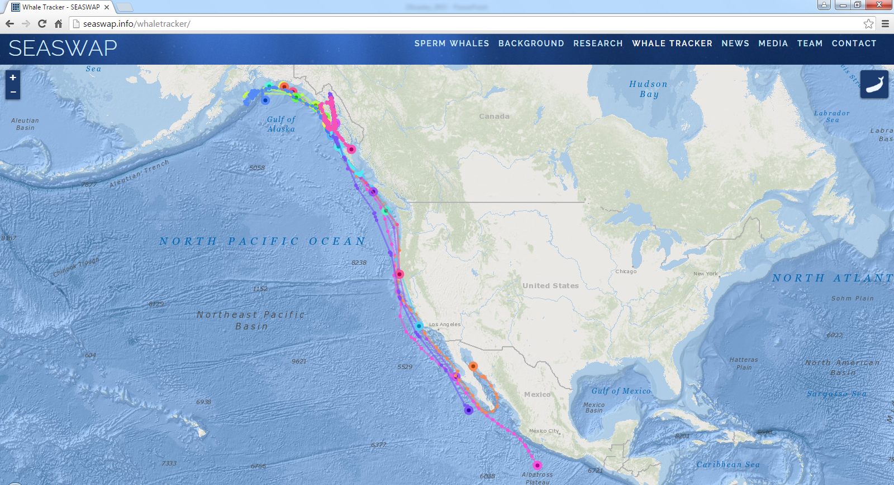
Notes:
4 Tagged whales departed alone with no seasonal pattern. Clearly, male sperm whales have complex social structures, not always roaming alone across higher latitudes. identifying and tracking the whales primarily responsible for depredation will guide SEASWAP in developing a sperm whale avoidance network for fishermen.

Slide 21
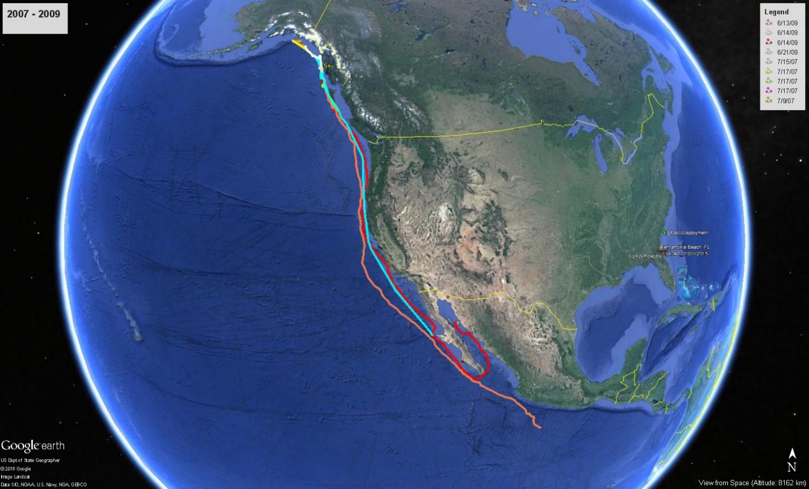

Slide 22
Summary
Site fidelity and residency times were similar or exceeded published results from other areas
Males have long term associations. These patterns may exist for areas they frequent across years. Differs from other areas.
Documentation of areas used by whales would give fishermen an option to avoid fishing at times or in places that whales are predicted to be present.

Slide 23

Acknowledgements
All the fishermen who contributed to every aspect of SEASWAP
All Research was conducted under authorized NOAA scientific research permit to J. Straley and UAF IACUC.
Funders
Notes:
Clearly, male sperm whales have complex social structures, not always roaming alone across higher latitudes. identifying and tracking the whales primarily responsible for depredation will guide SEASWAP in developing a sperm whale avoidance network for fishermen.

