Slide 1
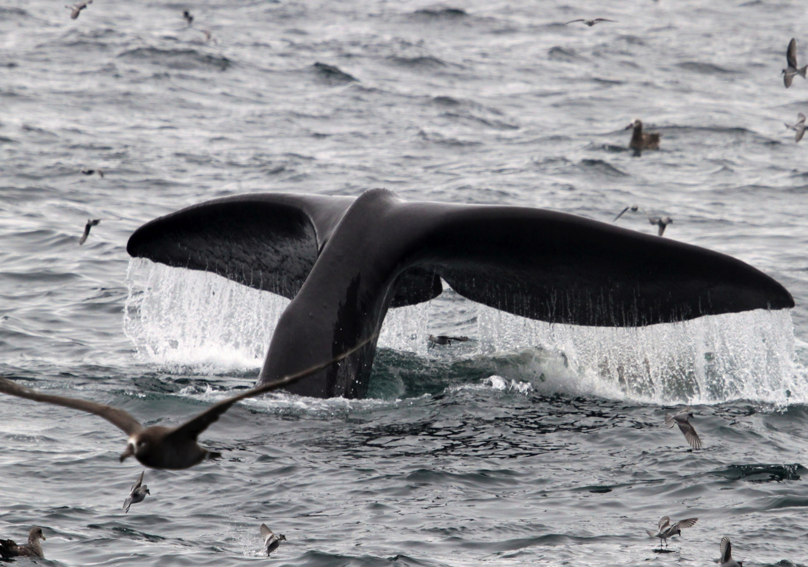


Whale depredation and
the federal perspective
Megan J. Peterson (NMFS)
Dana Hanselman (NMFS)

Slide 2
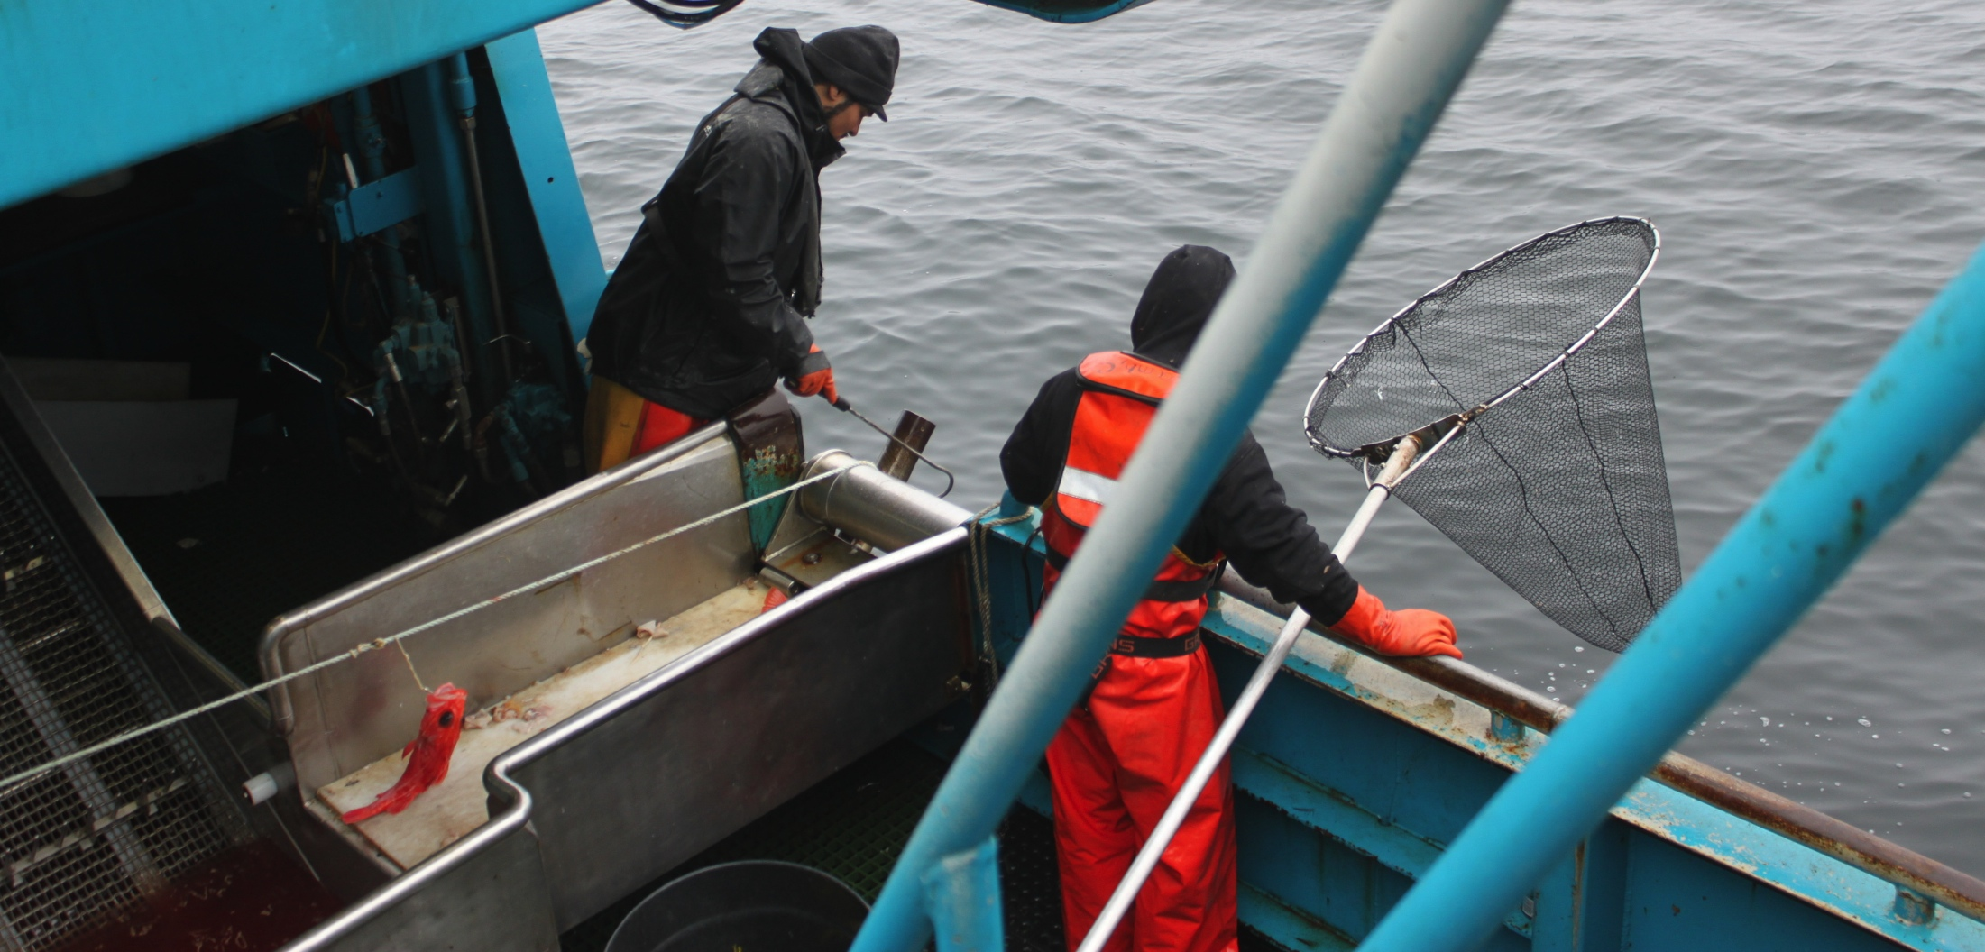
Data collection
Depredation and the federal sablefish stock assessment
Notes:
Using CPUE as an index of abundance assumes that catch is proportional to the product of fishing effort, density and the catchability coefficient (proportion of stock removed relative to effort)

Slide 3
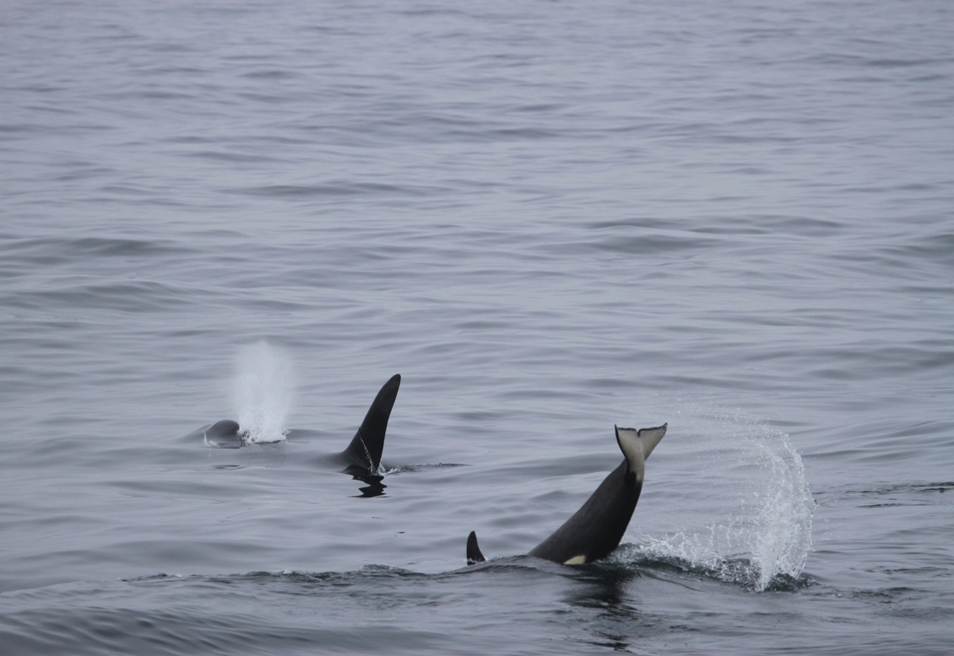
Data collection
Longline survey (100% monitored)
Commercial fishery (partial observer coverage)
Logbook data (vessels > 60 ft)
Notes:
From the federal perspective, we have 3 primary data sources to work with.
these are all fundamentallhy pretty different in monitoring rates and how information is collected
I’ll talk in more detail later in Session 7 about the independent studies in session 7.

Slide 4
Data collection
NMFS longline survey (100% monitored)
Commercial fishery (partial observer coverage)
  Tracking presence of whales and evidence of damaged gear or fish
  Investigating sperm whale presence as a proxy for depredation (Hanselmen et al. In Prep)
Notes:
Let me first focus on the longline survey and the commercial fishery –
The main difference here is the coverage rate- with the survey 100% of sets are monitored.
Conversely, with the observer data historically only 1/3 of sets monitored on vessels > 60 feet and less than 120 feet. 100% sets monitored on vessels > 125ft.
And in both cases, the scientists or observers are there to count fish first- document depredation second if possible. Priorities are in the fish factory when the fish is being tallied and processed.

Slide 5
Presence
Pres & evidence
Hanselmen et al. In Prep
Notes:
Fig. 5. Estimates of sperm whale depredation for stations with evidence of depredation (solid circles) and stations with whale presence but no evidence of depredation (open squares). Estimates are shown for area-specific ME.2 models and the across-area ME.2 model (i.e., “All areas” dataset).
We’ve also looked at this with the commercial fishery – found similar results

Slide 6
Data collection
Logbook data
  Historically, NMFS logbooks did not track depredation
  Proposed rule to modify to track presence of whales and evidence of damaged fish/hooks
Notes:
IPHC has done some work using their logbook data

Slide 7
Notes:
The rule applies to operators of
o all catcher/processors
o catcher vessels 60 ft (18.3 m) or greater length overall (LOA) using longline or pot gear
o catcher vessels less than 60 feet LOA using longline pot gear.

Slide 8
Notes:
The rule applies to operators of
o all catcher/processors
o catcher vessels 60 ft (18.3 m) or greater length overall (LOA) using longline or pot gear
o catcher vessels less than 60 feet LOA using longline pot gear.

Slide 9
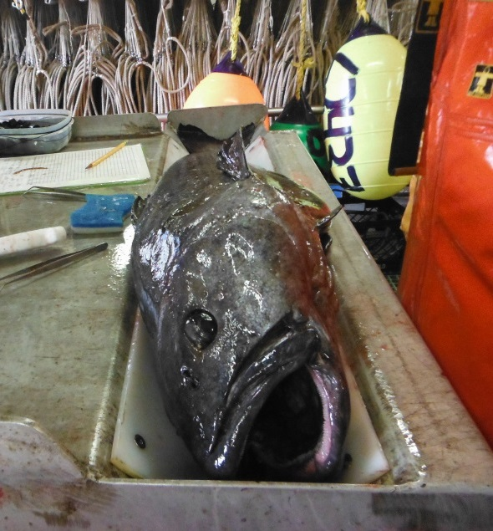
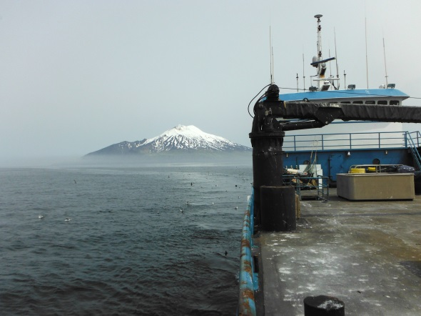
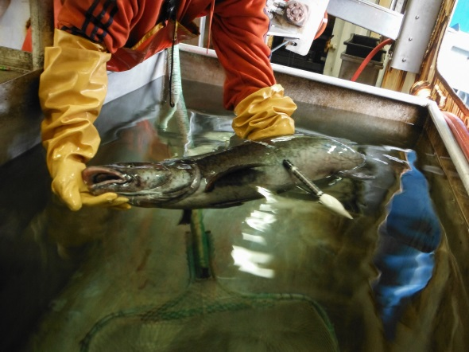
2. NMFS Sablefish Stock Assessment
Trawl survey
Longline survey
Commercial fishery
Depressing biomass estimates due to artificially low catches
Unaccounted for sablefish mortality due to whales
Notes:
The sablefish stock in Alaska is assessed annually by fitting an age structured model to longline and trawl survey data and commercial catch data.
2/3 data sets used to develop abundance indices are heavily impacted by sperm whales and killer whales.
So just how severe is this issue?
Standard data in the stock assessment include: historic and current abundance, fishing mortality, survey selectivity and catchability.

Slide 10
NMFS Longline Survey
Notes:
This shows all the stations surveyed- I’ts iimportant to note that depredation
Each year, the NMFS longline survey boats gets hit pretty hard by killer whale and sperm whale depredation.
And this is the current problem, and we are now working on ways to integrate depredation into the sablefish stock assessment. And this is actually part of my current post-doc.

Slide 11
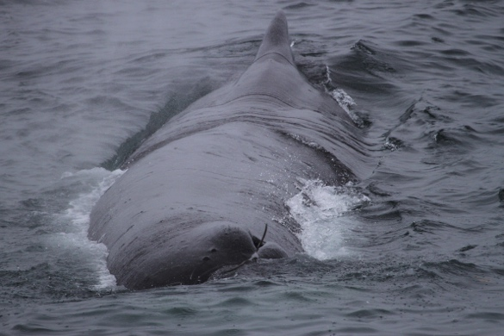
Longline survey – sperm whales
CPUE ⬇ 7% - 20%
Notes:
. There were significant (P ≤ 0.05) increasing trends across years for sperm whale presence among CGOA and EY/SE stations,

Slide 12
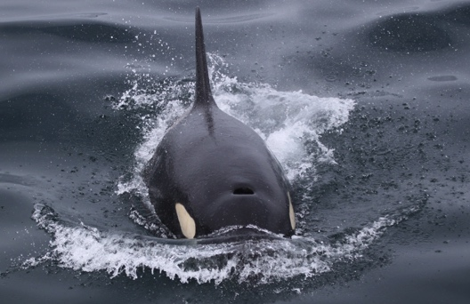
Longline survey – killer whales
CPUE ⬇ 54% - 72%
Notes:
Obviously BS hardest hits, increasing trends again in all 3 show a moderate increase.

Slide 13
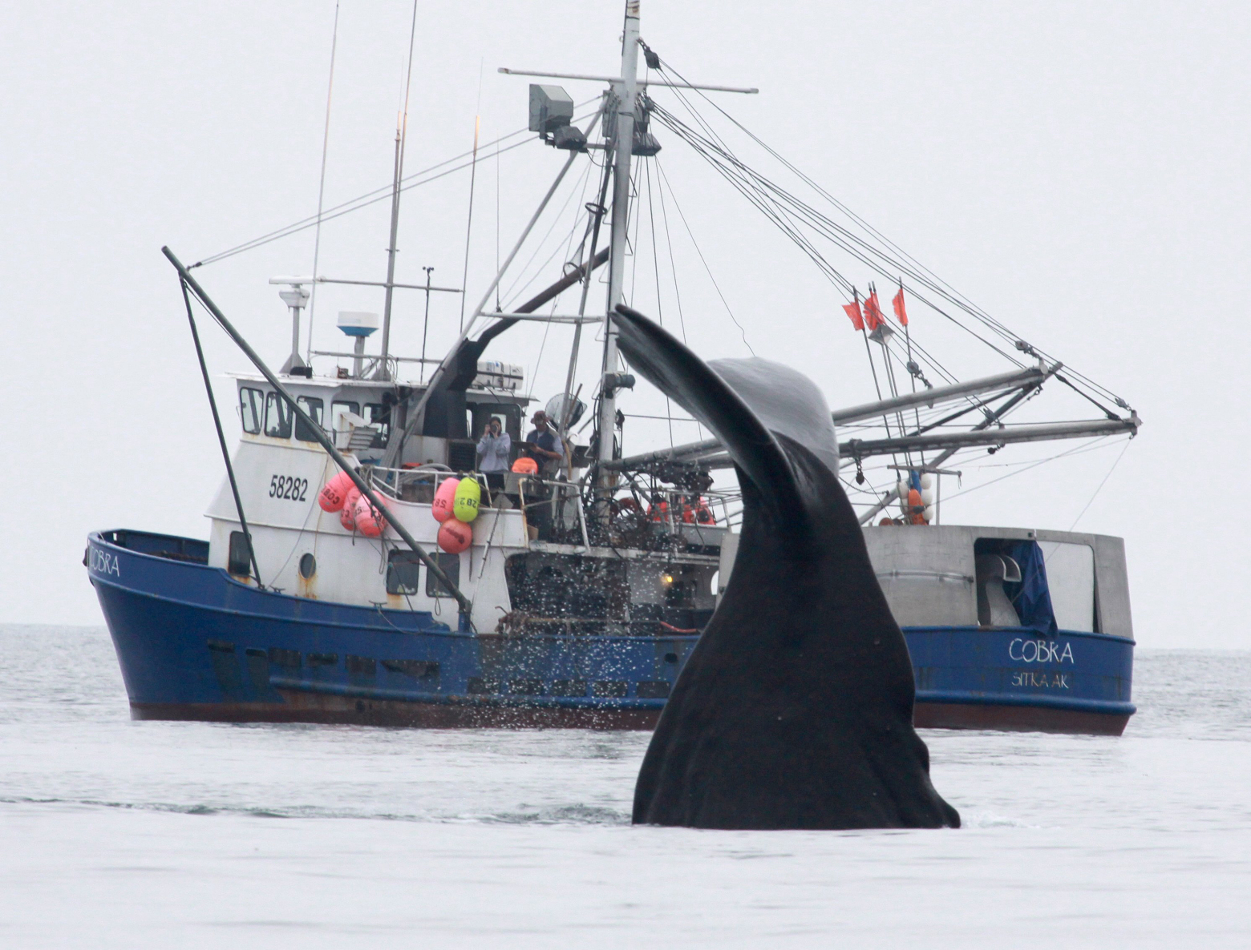
NMFS Sablefish Assessment
Stations depredated by killer whales (BS, AI, WGOA) are dropped from the stock assessment
  Some years over 50% of sets depredated in the Bering Sea
Stations depredated by sperm whales are included in the stock assessment
  May be reducing accuracy of assessment
©SEASWAP

Slide 14
Longline survey - sperm whales
Catch inflated (~14%) according to estimated CPUE reduction
Figure Credit: Dana Hanselman
*Doesn’t address unaccounted for sablefish mortality due to sperm whale depredation on the commercial fishery
Notes:
Correcting for sperm whale depredation in the stock assessment resulted in an increase in estimated female spawning biomass of 3-4% in the terminal year, which would yield an 8% higher quota recommendation
We first had to estimate removals from the commercial sablefish fishery.

Slide 15
Commercial fishery 1995-2014
BS, AI, WGOA (n=19,921 sets)
CGOA, WY, SE (n=16,443 sets)
Notes:
BSAI 19,921
GOA 16,443

Slide 17
Modeling sperm whale depredation
# sets depredated = β₀ + sable_catch + vessel_length + (lat,long) + ε
Catch lost (mt) = pred proportion sets depredated/grid * catch/grid * CPUE ⬇
Pred proport depred
Pred catch lost (mt)

Slide 19
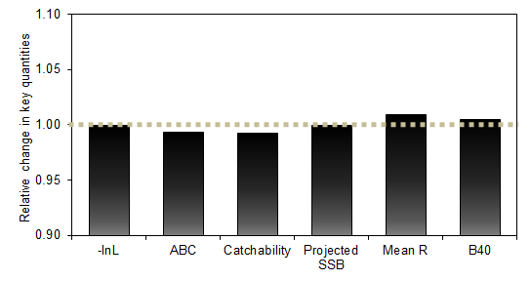
Commercial fishery – sperm & killer whales
Sablefish removals due to whale depredation added to fixed gear catch (~6500 mt 1995-2014)
*Additional mortality due to whale depredation has a minimal effect on the stock assessment
Notes:
annual fishing mortality dev estimates

Slide 20


Commercial fishery (1995-2014)
log(sable_CPUE)= β₀ + dep + depth + (lat,long) + jul + gren_CPUE + hal_CPUE + year + vessel +ε
 | Predicted CPUE Reductions (GAMM) | Proportion Sets Impacted
Central Gulf | 24% ± 8% | 2%
West Yakutat | 26% ± 10% | 3%
Southeast Outside | 29% ± 14% | 2%
Bering Sea | 46% ± 10% | 11%
Aleutians | 58% ± 16% | 3%
Western Gulf | 68% ± 12% | 2%

