Slide 1


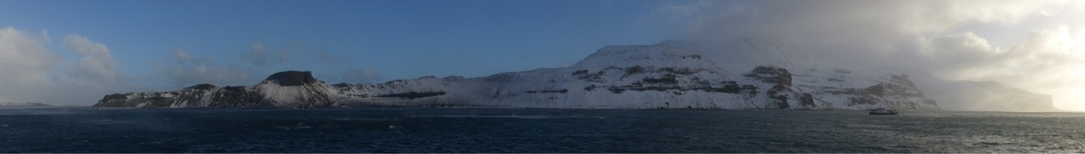
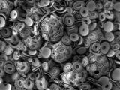
COLECTING DATA ON DEPREDATION IN TOOTHFISH FISHERIES
COLTO DEPREDATION WORKSHOP 2016

Slide 2
WHAT ARE THE QUESTIONS?
What depredates toothfish?
Where, when, how often?
Does it matter for fishery efficiency?
Does it matter for stock status?
Does it matter for the predators?

Slide 3
WHERE, WHEN, HOW OFTEN?
Data Stream | Utility
Presence only | Distribution maps, trends?
Presence/absence | Distribution maps, correlation with environmental or operational data
Numbers sighted | Distribution maps, correlation with environmental or operational data
Sighting/resighting | Population size, turnover, demographic structure, movement

Slide 4
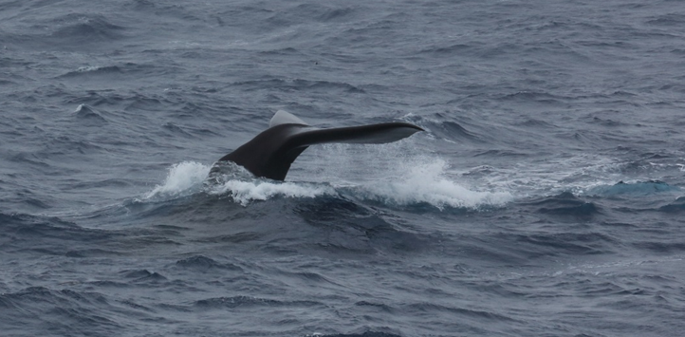
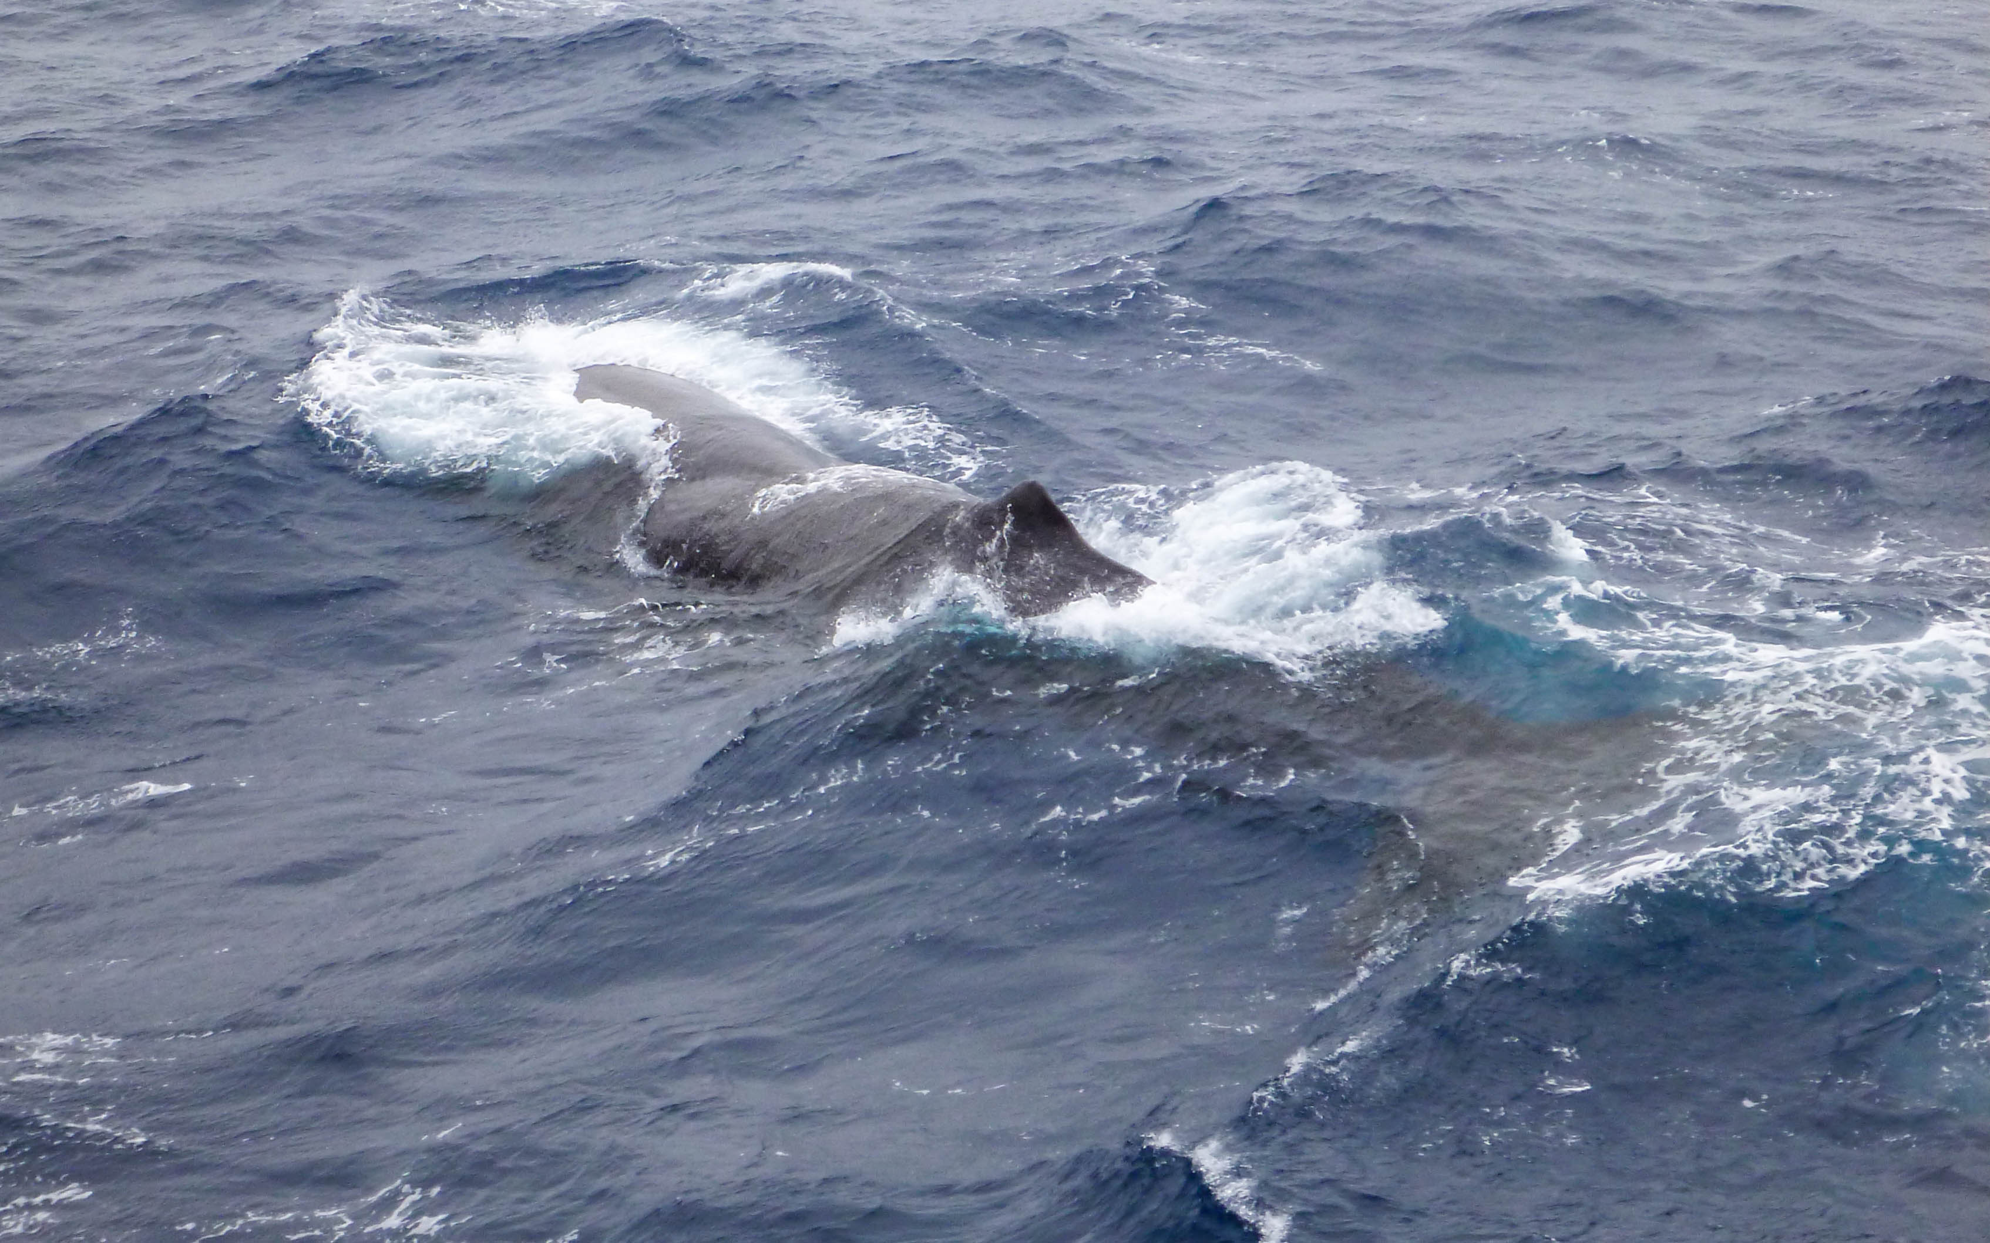
WHERE, WHEN, HOW OFTEN?
Sperm whale
Physeter macrocephalus

Slide 5
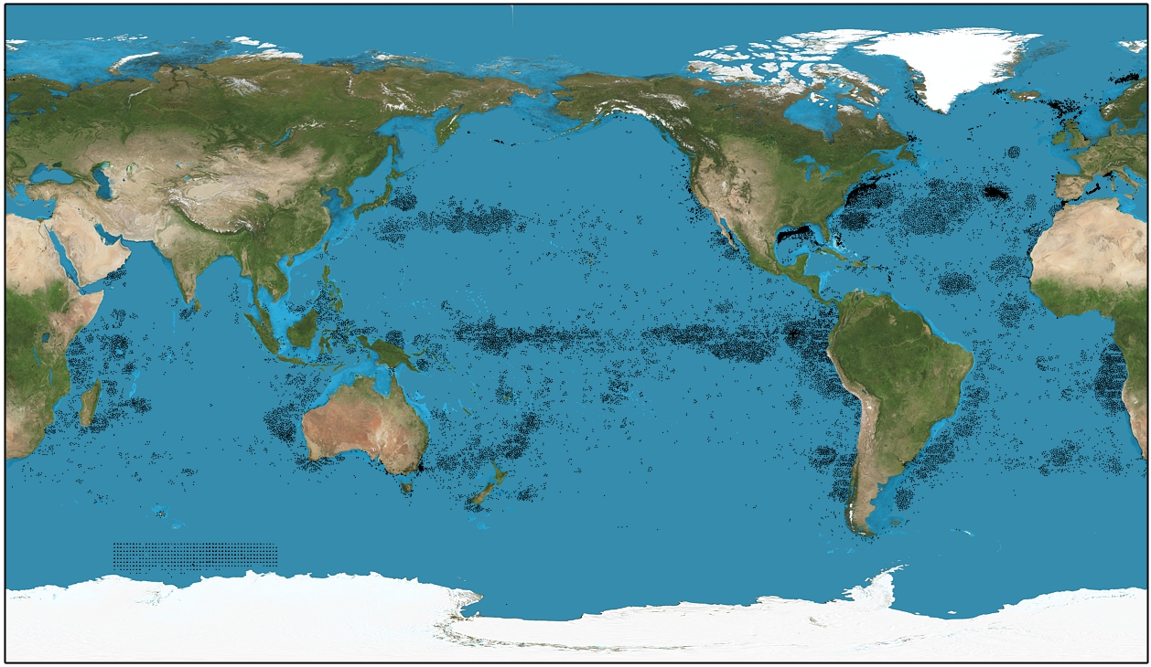
Sperm whale sightings and harvest

Slide 6
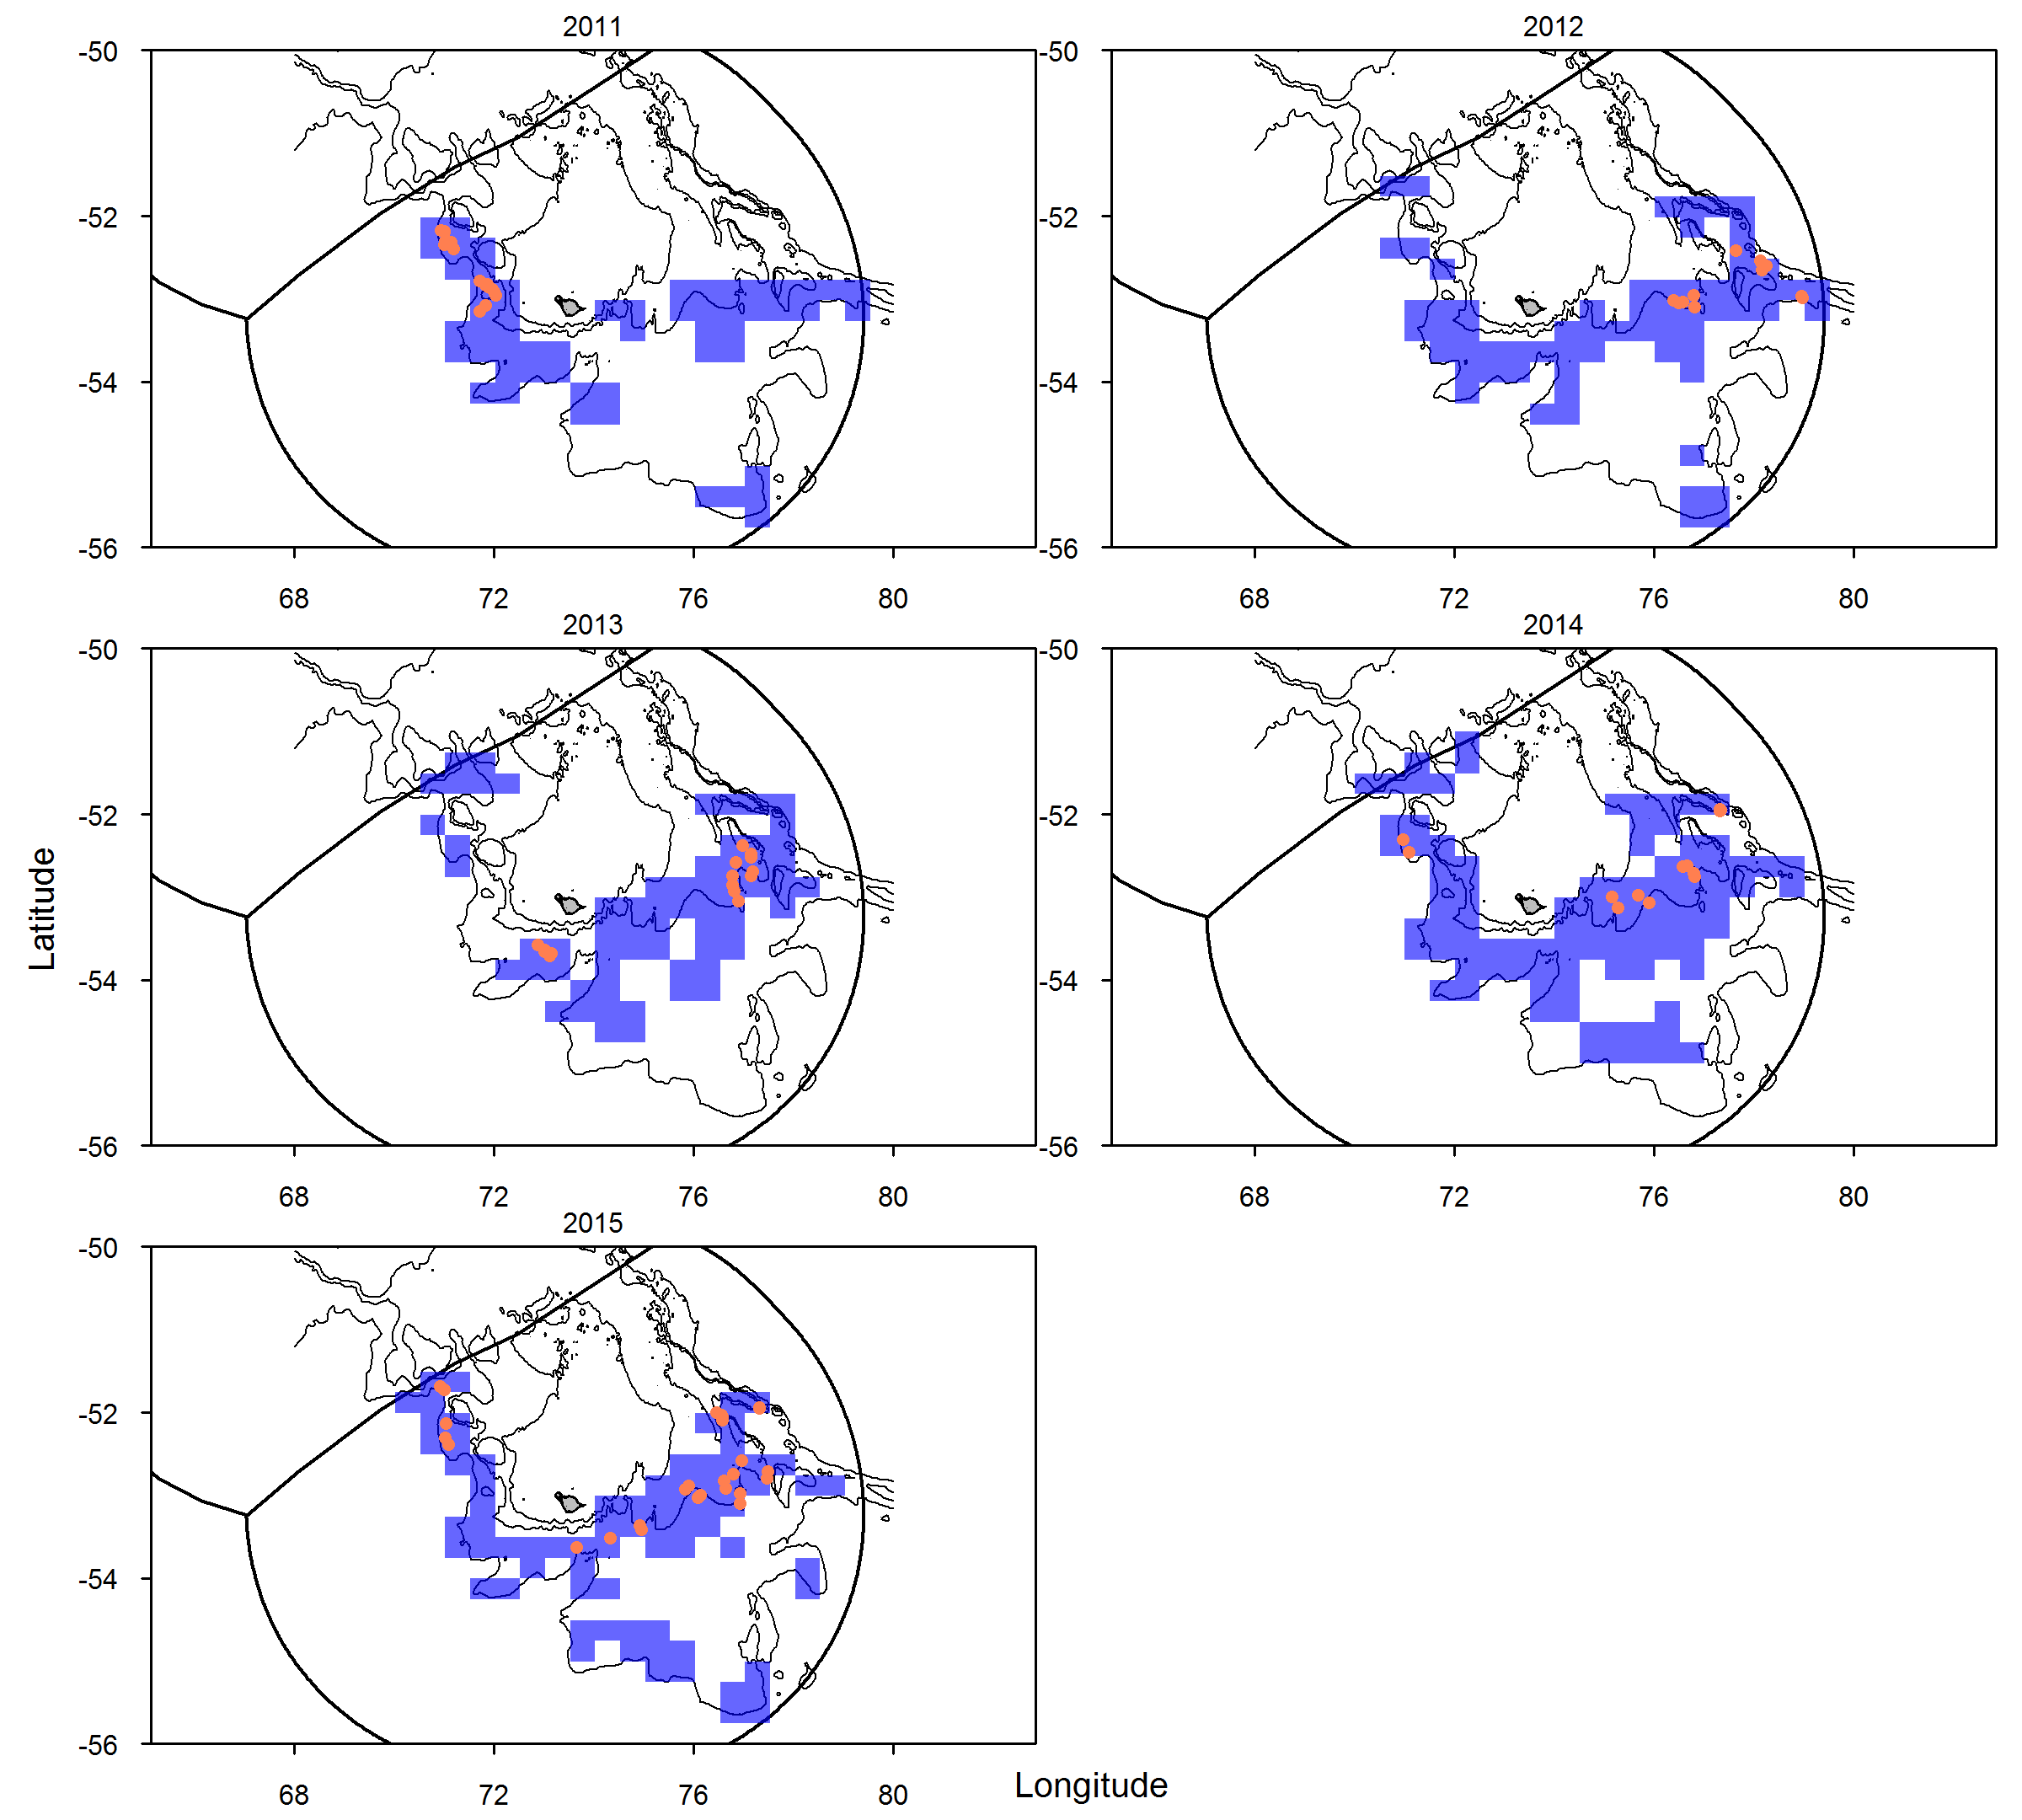
Sightings vs Effort
88% during May-June
<3% of lines

Slide 7
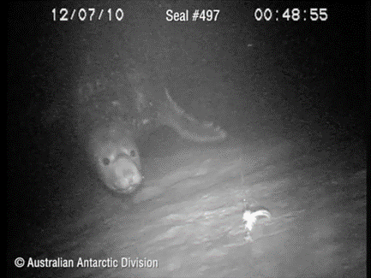
DOES IT MATTER FOR THE PREDATORS?
Elephant seal
Mirounga leonina

Slide 8
DOES IT MATTER FOR THE PREDATORS?

Slide 9
DOES IT MATTER FOR THE PREDATORS?
Interactions Vs Lifecycle
Adult and juvenile males may not be as important to the
recovery of the seal population as females.
Therefore sex of seals is important to collect

Slide 10
WHAT ARE THE QUESTIONS?
They will depend on each circumstance
At least presence/absence, all the time, everywhere
Once patterns analysed, data collection
can become more focussed (if needed)

