Slide 1


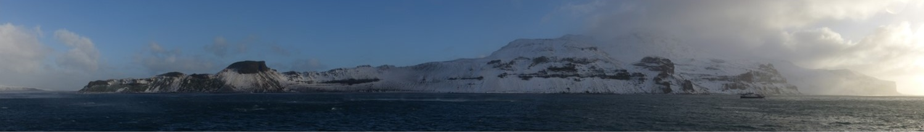

INCLUDING DEPREDATION IN STOCK ASSESSMENTS
COLTO DEPREDATION WORKSHOP 2016

Slide 2
WHAT ARE THE QUESTIONS?
What depredates toothfish?
Where, when, how often?
Does it matter for fishery efficiency?
Does it matter for stock status?
Does it matter for the predators?

Slide 3
WHAT IS A STOCK ASSESSMENT?
Harvest Strategy:
Ensure enough fish survive to breed (MSY)
Ecosystem-Based Harvest Strategy:
Ensure enough fish survive to breed
Ensure enough fish to support predators
Ensure enough fish to eat prey species

Slide 4
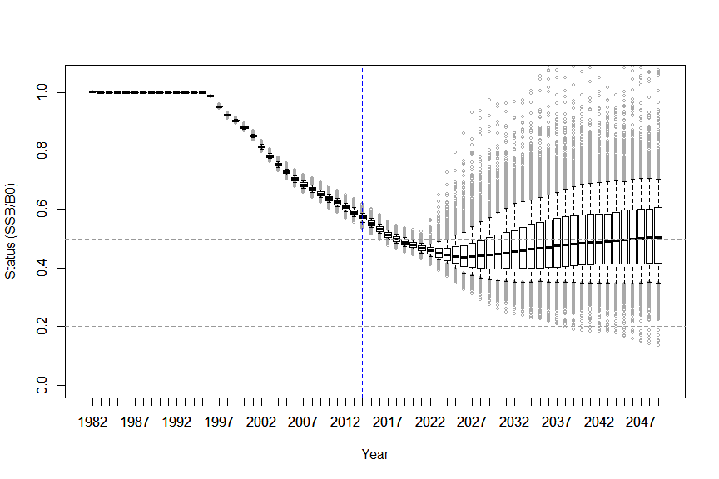
WHAT IS A STOCK ASSESSMENT?
CCAMLR OBJECTIVES
50% ESCAPEMENT
<10% CHANCE OF BEING <20% ESCAPEMENT

Slide 5
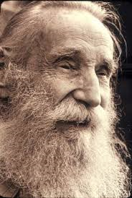

WHAT IS A STOCK ASSESSMENT?
:)#
“Reality”
Model

Slide 6
WHAT IS A STOCK ASSESSMENT?
Index of abundance
Surveys
Tag recaptures
CPUE time series
CAUTION – CPUE based assessments can create an incentive to over-estimate depredation

Slide 7
WHAT IS A STOCK ASSESSMENT?
Population Dynamics Model
Spawning Stock
Recruits

Slide 8
WHAT IS A STOCK ASSESSMENT?
Population Dynamics Model
Spawning Stock
Feeding
Growth
Mortality
Maturation
Movement
Spawning
Fertilization
Dispersal
Feeding
Growth
Mortality
Settlement
Recruits

Slide 9
WHAT IS A STOCK ASSESSMENT?
Population Dynamics Model
Spawning Stock
Growth
Mortality
Maturation
?
Recruits

Slide 10
WHAT IS A STOCK ASSESSMENT?
Population Dynamics + Fishery Model
Spawning Stock
Removals by age
and sex
Recruits

Slide 11
WHAT IS A STOCK ASSESSMENT?
Spawning Stock
Growth
Mortality
Maturation
Catch at age/sex
Selectivity
Catch rate?
Tag recoveries?
Recruits

Slide 12
WHAT IS A STOCK ASSESSMENT?
UNFISHED STATE

Slide 13
WHAT IS A STOCK ASSESSMENT?
FISHDOWN

Slide 14
WHAT IS A STOCK ASSESSMENT?
PROJECTION

Slide 15
WHICH PARAMETERS ARE IMPACTED?
Spawning Stock
Growth
Mortality
Maturation
Catch at age
Selectivity
Catch rate?
Tag recoveries?
Recruits

Slide 16
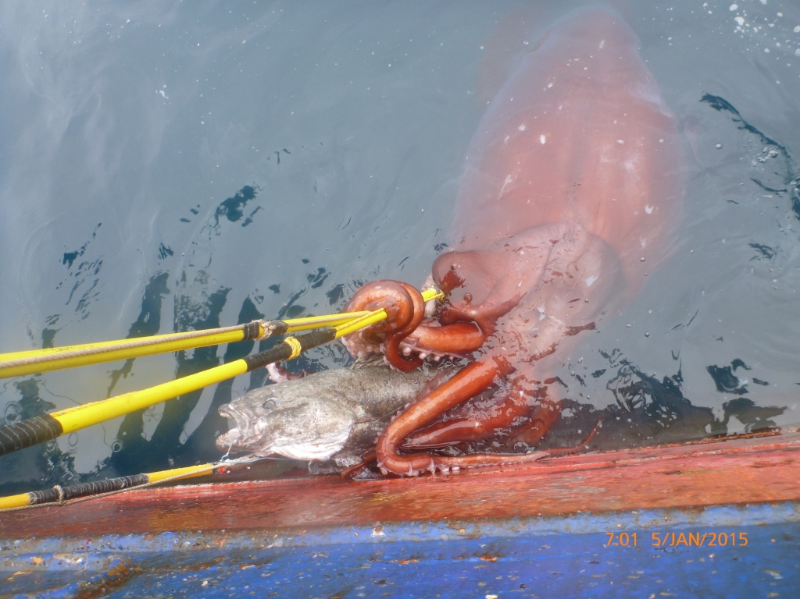
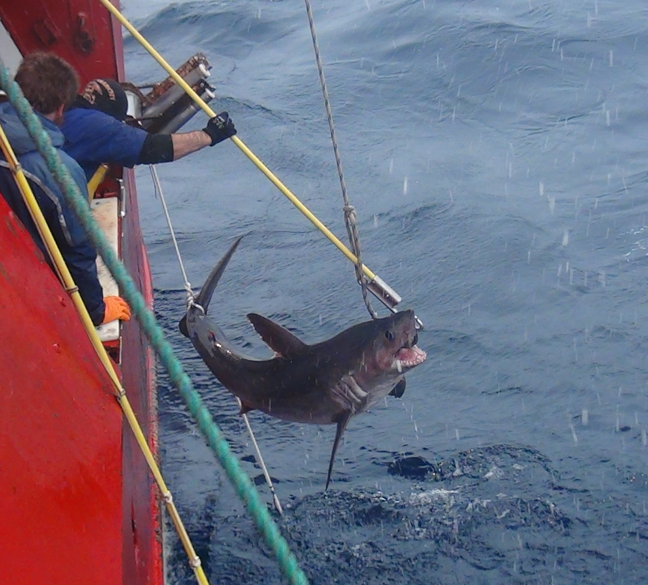
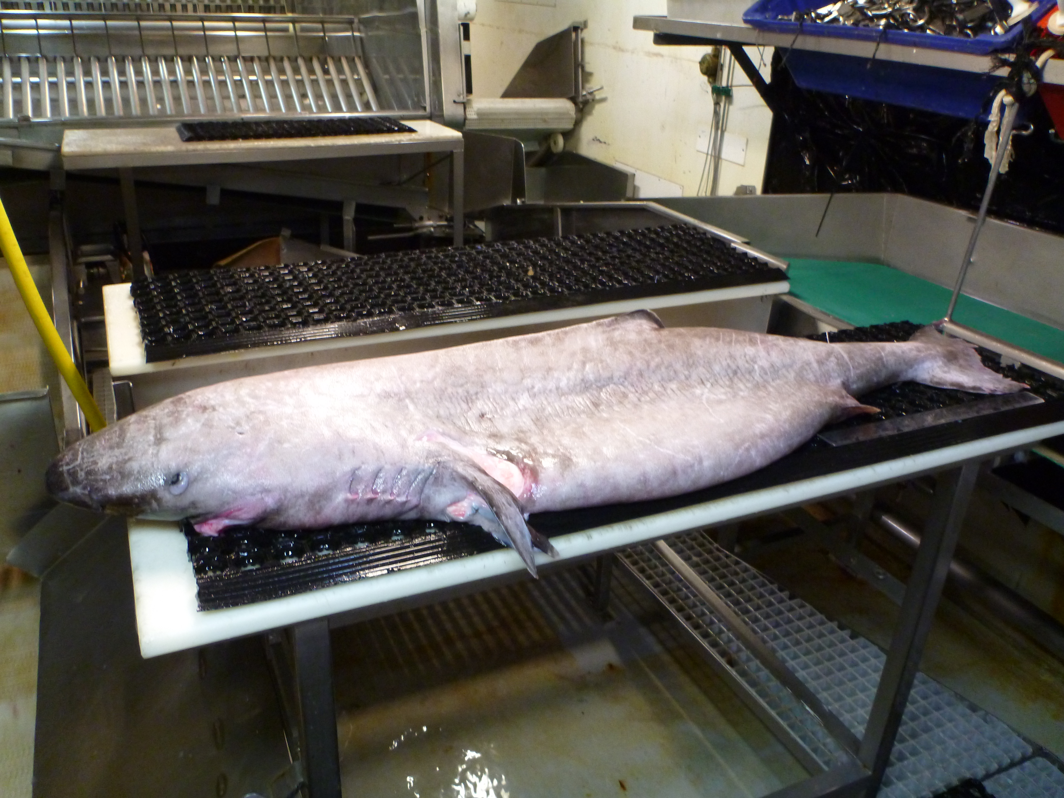
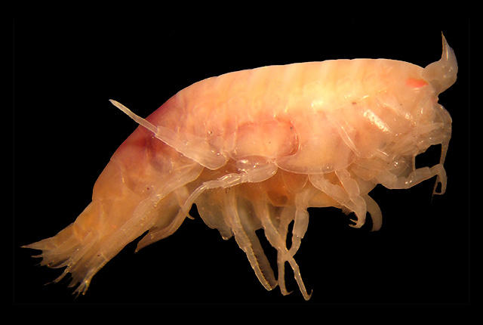
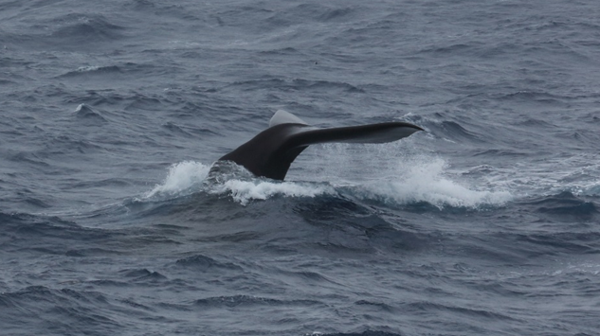
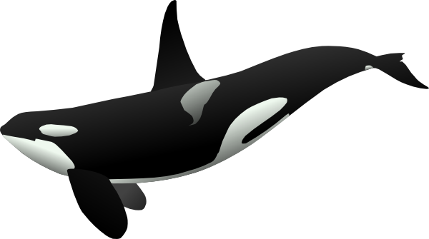
TYPES OF DEPREDATION
“FACILITATED”
“OPPORTUNISTIC”

Slide 17
TYPES OF DEPREDATION?
“FACILITATED”
Could be included as
part of the natural mortality,
if the fish are part of the
diet.
“OPPORTUNISTIC”
Could be modelled as
a separate ‘fleet’ with its
own catch, selectivity etc..

