Slide 1
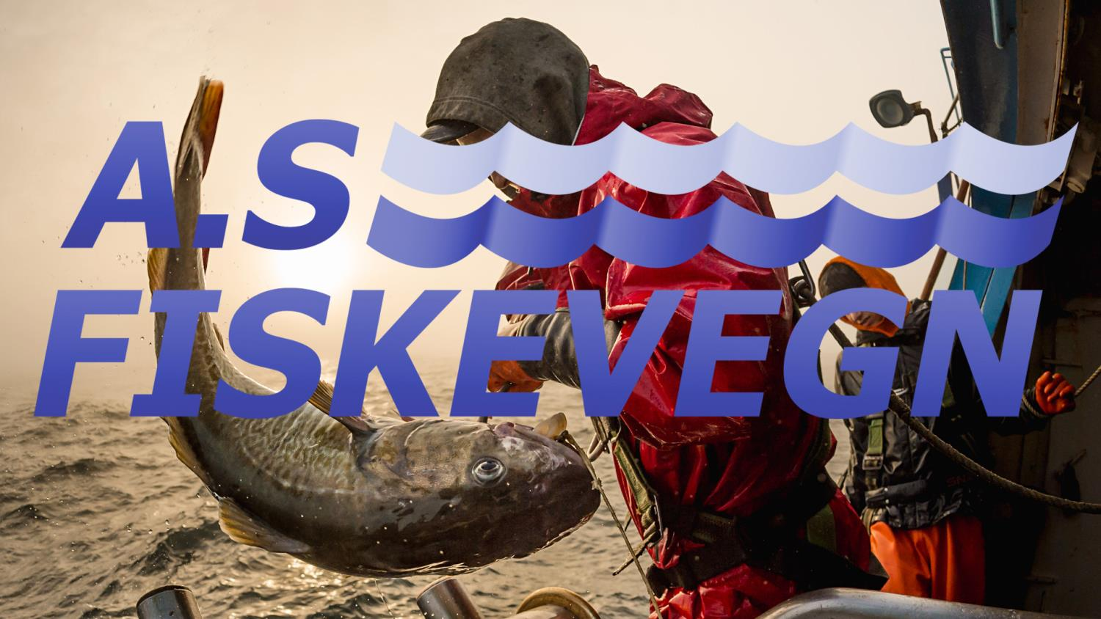
DIRECTIONS FOR FUTURE TECHNOLOGICAL DEVELOPMENTS
-THE NEXT STEPS-
Pablo Parra Henríquez | Senior Mechanical Engineer | AS FISKEVEGN
COLTO Whale Depredation Workshop – Punta Arenas, Chile, 16-18 March 2016

Slide 2
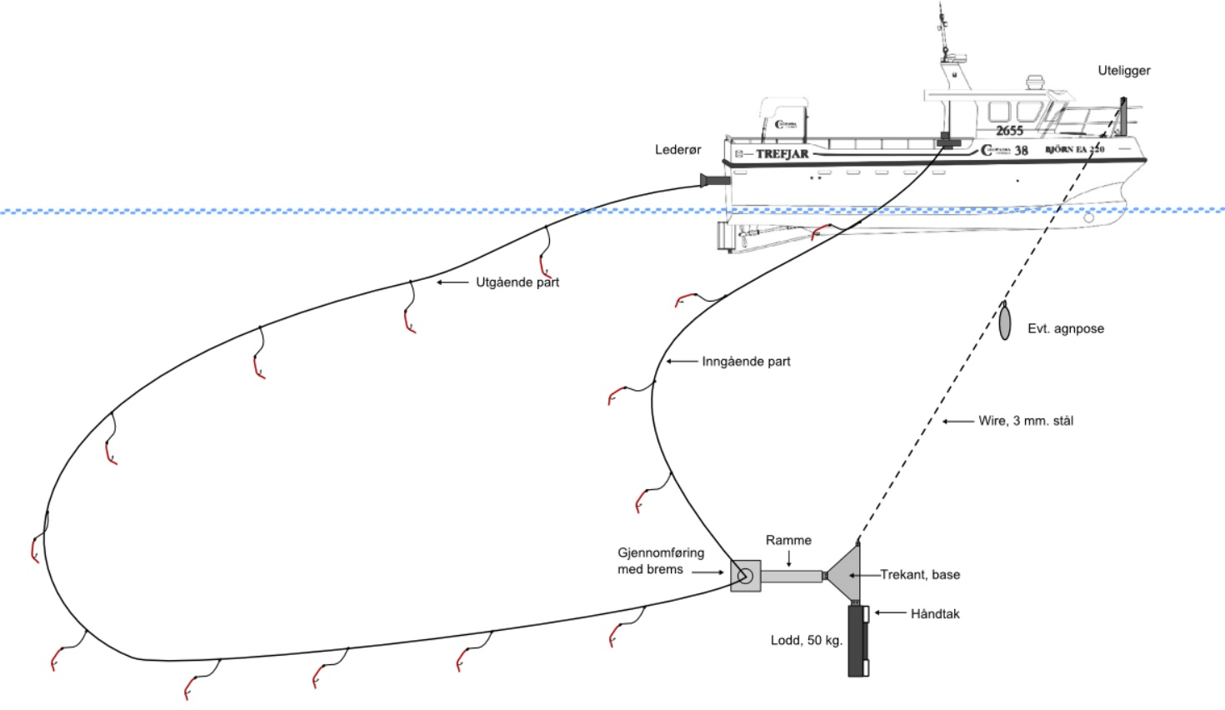
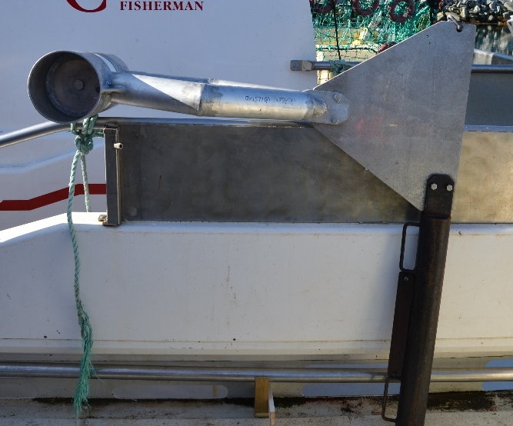

Further testing and development of CPD concepts
CPDs – Catch Protection Devices
FISKEVEGN is currently modelling hydrodynamic forces in deep-water tornado trolling and deep-sea longline fishing
With and without CPDs
COLTO Whale Depredation Workshop – Punta Arenas, Chile, 16-18 March 2016

Slide 3
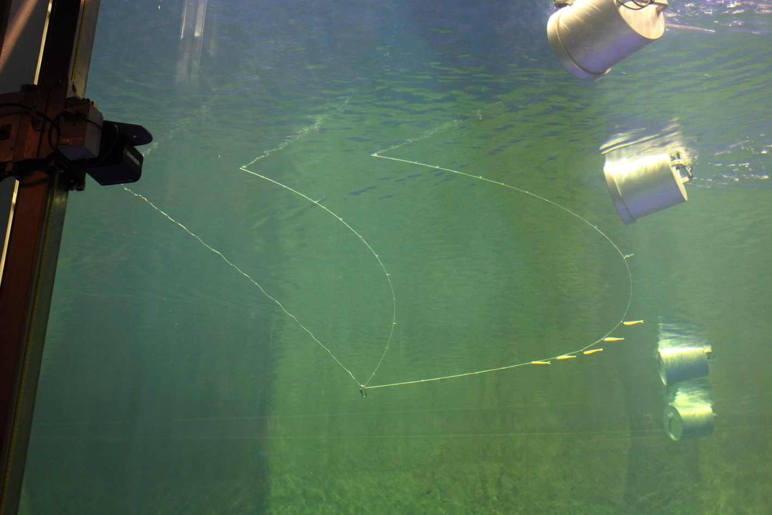
Further testing and development of CPDs concepts
DEEPWATER TORNADO TROLLING
Flume tank experiments
COLTO Whale Depredation Workshop – Punta Arenas, Chile, 16-18 March 2016

Slide 4
Further testing and development of CPD concepts
FISKEVEGN pursues Catch Protection Devices based on knowledge obtained during these years to present a new solution that can be manageable at sea.
Modelling and tank trials simulating deep-sea longline fishing are on-going
Design iterations followed by field tests in deep-sea conditions are pending
Volounteer vessel(s) will be needed for field trials
COLTO Whale Depredation Workshop – Punta Arenas, Chile, 16-18 March 2016

Slide 5
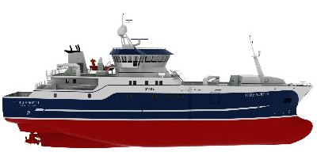

Further testing and development of the CPD concepts
Proper understanding of forces from gravitation, accelerations and hydrodynamic processes is needed, with and without deployed containment solutions.
Hydrodynamic rope drag can be estimated as two components; normal (N) and tangential (T) drag
Zone determinaded by a rapid vertical, tangential drag
$$F_{D}=F_{D}^{N}+F_{D}^{T}$$
Zone determinaded by a rapid horizontal, normal drag
Zone determinaded by gentle vertical, normal drag
COLTO Whale Depredation Workshop – Punta Arenas, Chile, 16-18 March 2016

Slide 6
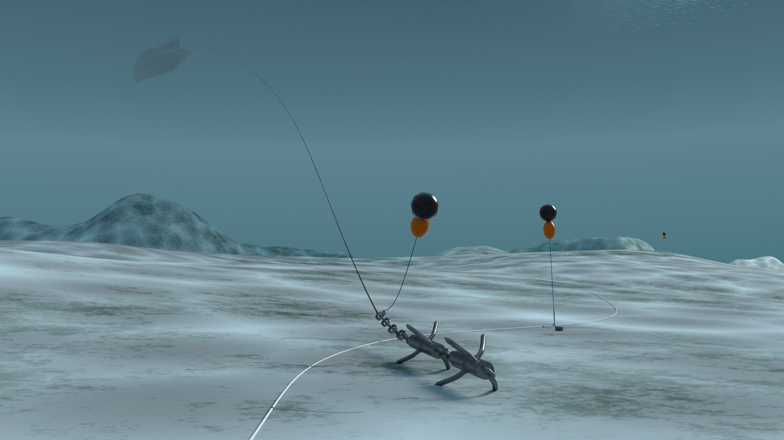
Further testing and development of the CPD concept
Already loss of longline gear occurs frequently
Preventing additional loss of containers and lines will be an essential objective
Launch and recovery of any heavy overboard object at high sea is a challenge in its own right
COLTO Whale Depredation Workshop – Punta Arenas, Chile, 16-18 March 2016

Slide 7

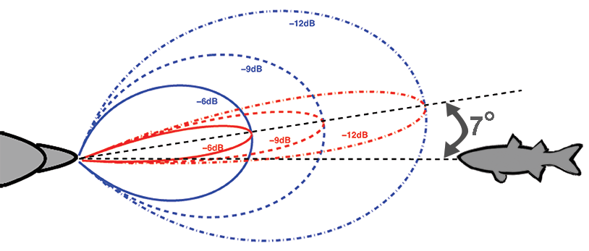
Operational approaches
We assume that orcas and other cetaceans are able to recognize the sound of longline operations.
A simple conclusion; if we are able to reduce the noise, we will be reducing the distance of detection
FISKEVEGN fishing gears are already relatively quiet. We now incorporate noise reduction criteria in the new generation of longline systems. This is already in the phase of engineering and prototypes.
COLTO Whale Depredation Workshop – Punta Arenas, Chile, 16-18 March 2016

Slide 8
Operational approaches
If rapid hauling is going to be part of the operational strategy - development of longlines and mechanical equipment has to adapt to this.
Fiskevegns tests of new prototypes show that next-generation longline systems will have an over-capacity for rapid hauling and setting.
The main contraints instead lie in:
  Health and safety issues for crew due to increased accident risks
  Time and working conditions for proper handling of longlines and hooks
  Increased risks for loss of gear, with catches on them
  Incomplete understanding of the hydrodynamics of longline hauling
  Development of longline gear that can keep up with increased physical strains
  Increased loss of fish that is ripped off fast-moving or rapidly accelerating gears by inertia or hydrodynamic drag – losses that need to be quantified
COLTO Whale Depredation Workshop – Punta Arenas, Chile, 16-18 March 2016

Slide 9
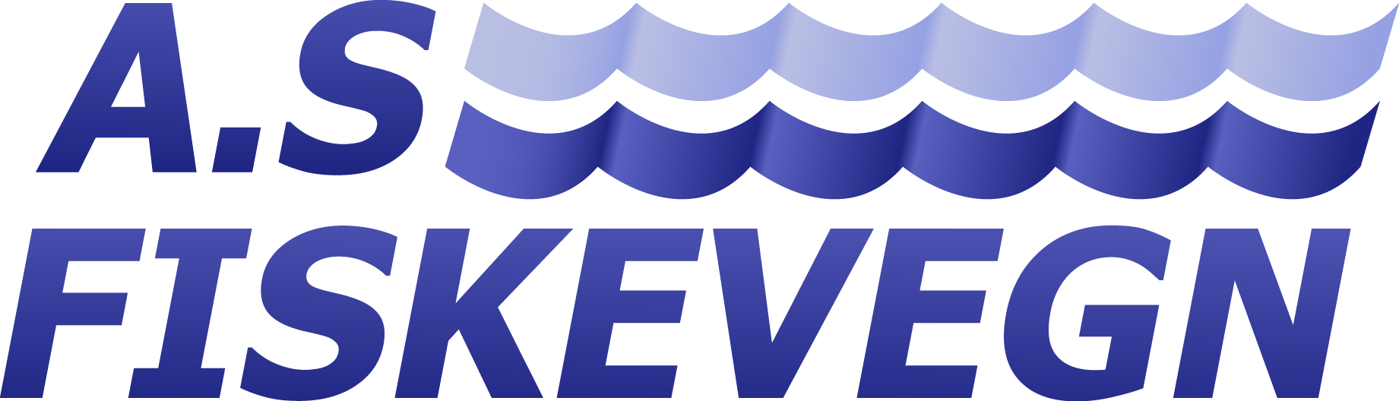
THANK YOU
COLTO Whale Depredation Workshop – Punta Arenas, Chile, 16-18 March 2016

