Slide 1
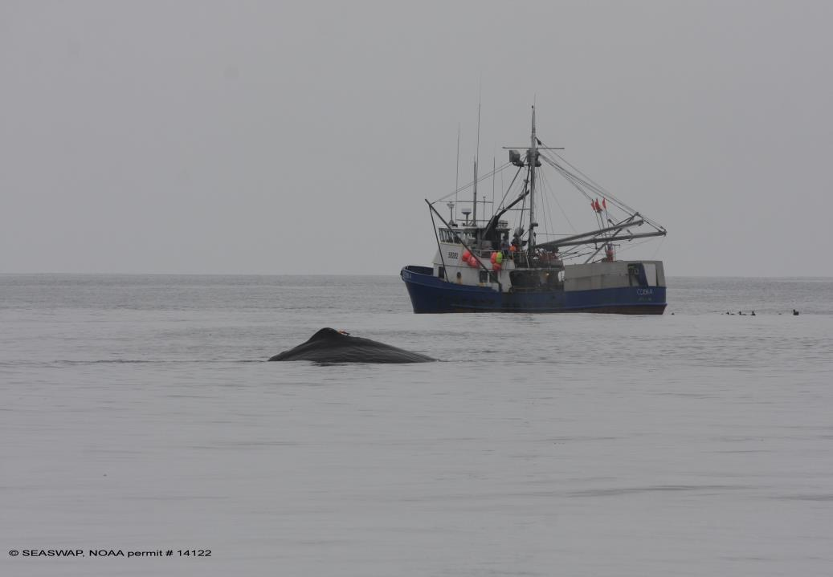
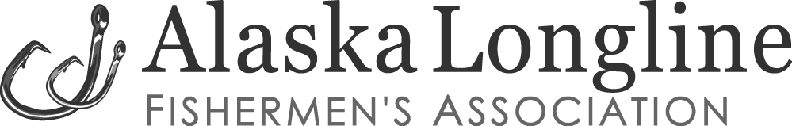

Next Steps for SEASWAP:
Refining and developing tools and strategies
Presented by Jeff Farvour
On behalf of SEASWAP and ALFA
Sitka, Alaska
Notes:
Thank you rhea for the introduction, and thank you all for coming.
Today I’ll be talking about some of the highlights of the work being done with the southeast alaska sperm whale avoidance project, or SEASWAP.
SEASWAP is a collaborative effort between fishermen, scientists, and fisheries managers, working to understand sperm whale depredation of commercial longline fishing vessels in the Gulf of Alaska. Our goal is to minimize these interactions.

Slide 2











SEASWAP
Many Partners and Collaborators
Scientists
Managers
Fishermen
Notes:
This project has many partners and key players.
We have scientists on the project that represent many different universities and non-profits, as well as managers from both NOAA and Fish and Game,
And our fishermen are full partners as well; we work both with the Alaska Longline Fishermen’s Association and Central Bering Sea Fishermen’s Association

Slide 3
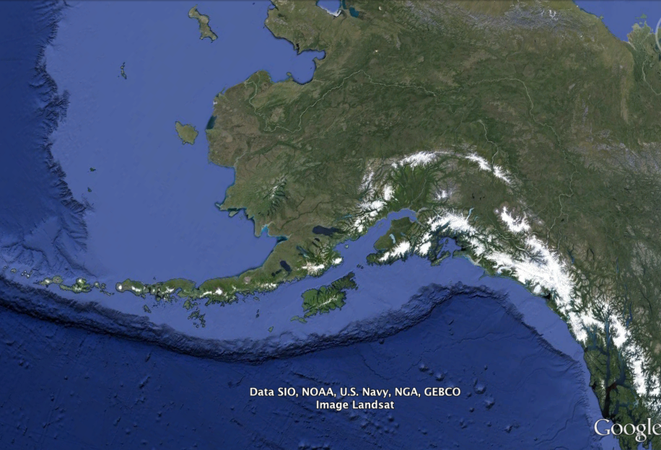
Study Area
Killer Whales
Sperm Whales
Sperm Whale / Killer Whale
SITKA
Sperm Whales
Notes:
In the central and eastern Gulf of Alaska black cod fishermen have sperm whales targeting their gear
In the Bering Sea, and Aleutian Islands we have killer whales depredating longline gear, with some overlap of both species in the western Gulf.
We work primarily in the eastern Gulf, but our work applies to all areas, and we collaborate as far out as the Central Bering Sea Fishermen’s Association in the Pribilofs.
We are based out of Sitka, here in southeast. Sitka is on the outer coast, with a pretty big longline fleet, and we have a relatively close proximity to the continental shelf edge here. It’s a fairly quick 12-15 mile trip from town to get to the black cod/sperm whale grounds.
Genetic analysis has shown these to be males only. We haven’t seen any females or calves, but we have had a few fishermen out of Seward reporting they’ve seen either a female calf or a juvenile male following a larger male behind their boats.
So just because we haven’t seen it doesn’t mean there aren’t females and calves out there.

Slide 4
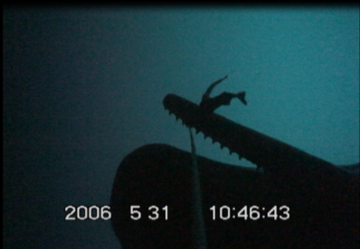
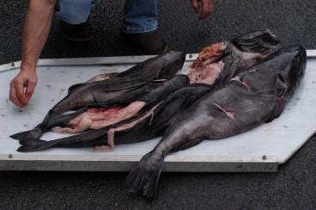
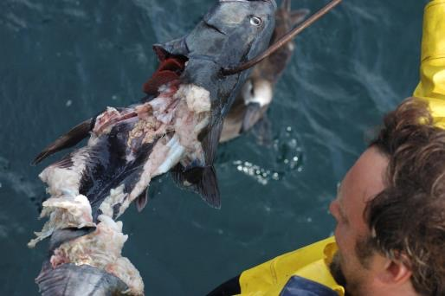
PICTURES TO USE

Slide 5
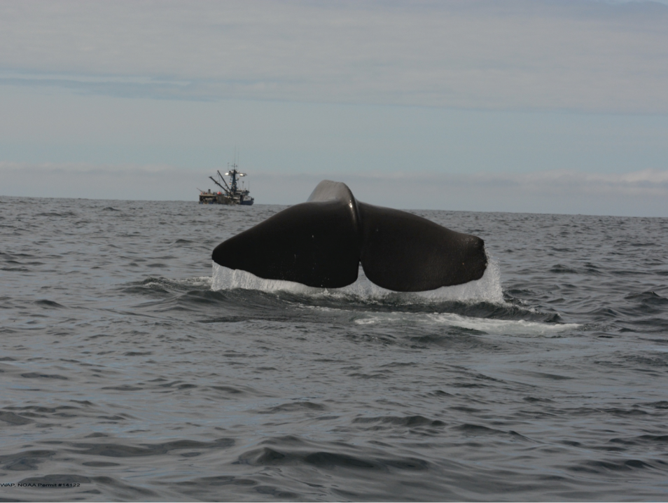
Where do we go next?
Successes:
Decoy
Avoidance
Current & Pending Deterrents:
Bubbler, Decoys, Towed Array, Pods, Acoustic Jammer
Real-time acoustic alerts
Reporting network
Notes:
So as a quick summary of our deterrents, we’ve had some success with both avoidance as a strategy for minimizing interactions, as well as the acoustic decoy working in specific scenarios to delay whales’ arrival at the gear.
There are a few ideas we are looking into for future work, such as using bubbles to create an acoustic “curtain” around the gear, or pods that protect the catch, or an acoustic jammer that jams echolocation signals. Some of these have been stalled in the development phase due to costs and practicality for fishermen.
We will be working this summer on an idea to develop a simple towed array system… fishermen deploy when get to grounds... Localize whales
We’re also actively involved in an avoidance network with tagging and fishermen self-reporting whales as I mentioned earlier.

Slide 6
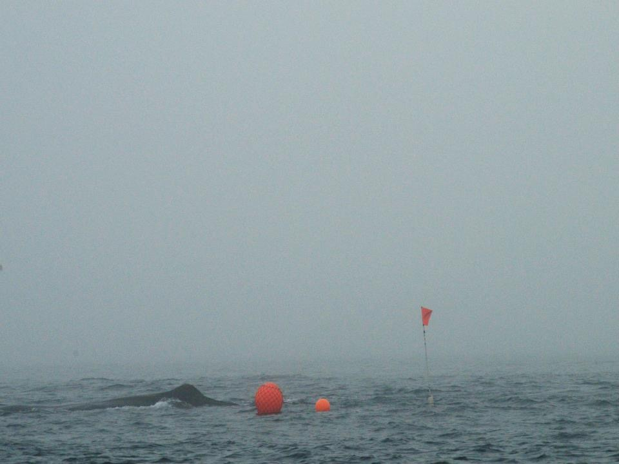
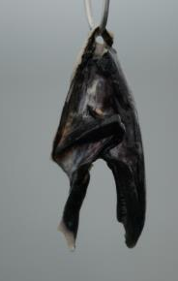
Next projects
Bubblers
Decoys
Towed Array
Pods
Jammers
Notes:
Today I’ll give you a little history of the project, and then talk about some of the main components of our research,
I’ll give you some background on the acoustic aspect of our work, including a few key findings about behavior and foraging ecology
Then I’ll dive into some of the camera work we’ve done and how we are using that to better understand the interaction
I’ll talk a bit about our tagging work – which is helping us understand individual movements and big picture patterns in where these whales go.
Finally I’ll get into some of the deterrents we’ve tried, what worked, and what hasn’t.
It’s all pretty interconnected, so I’ll bounce around a bit, but I’ll try to stay on topic.

Slide 7
Next projects
Bubblers
Decoys
Towed Array
Pods
Jammers
Notes:
Today I’ll give you a little history of the project, and then talk about some of the main components of our research,
I’ll give you some background on the acoustic aspect of our work, including a few key findings about behavior and foraging ecology
Then I’ll dive into some of the camera work we’ve done and how we are using that to better understand the interaction
I’ll talk a bit about our tagging work – which is helping us understand individual movements and big picture patterns in where these whales go.
Finally I’ll get into some of the deterrents we’ve tried, what worked, and what hasn’t.
It’s all pretty interconnected, so I’ll bounce around a bit, but I’ll try to stay on topic.

Slide 8
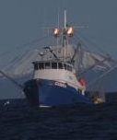

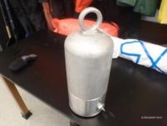
Deterrent Strategies: Gear Modification
Bubbler
Notes:
A second gear modification we tested was a bubbler. The bubbler is pressure activated, and designed to release air bubbles during haulback of gear. It was placed directly on the groundline, and the bubbles are meant to confuse the whales echolocating abilities; this idea has been used worldwide to deter dolphins and other echolocating cetaceans from areas where underwater activity is happening. The bubbler was pressurized to about 300 PSI (equal to 100 F depth) but we were not about to produce a substantial enough stream of bubbles to appear effective. There is also the problem with currents sweeping the bubbles away from the gear. Higher pressures were deemed hazardous to deploy over and over again off a fishing boat.

Slide 9
Next projects
Bubblers
Decoys
Towed Array
Pods
Jammers
Notes:
Today I’ll give you a little history of the project, and then talk about some of the main components of our research,
I’ll give you some background on the acoustic aspect of our work, including a few key findings about behavior and foraging ecology
Then I’ll dive into some of the camera work we’ve done and how we are using that to better understand the interaction
I’ll talk a bit about our tagging work – which is helping us understand individual movements and big picture patterns in where these whales go.
Finally I’ll get into some of the deterrents we’ve tried, what worked, and what hasn’t.
It’s all pretty interconnected, so I’ll bounce around a bit, but I’ll try to stay on topic.

Slide 10
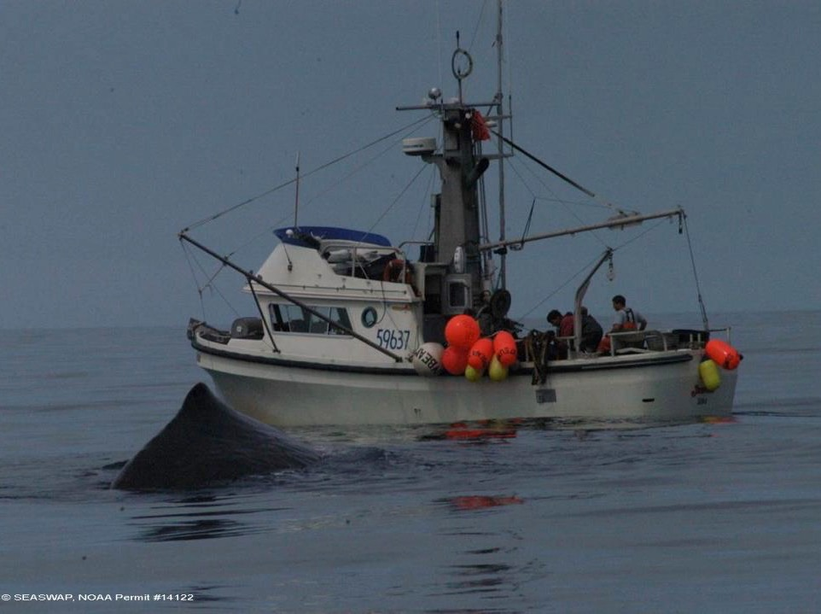
Acoustic Decoy:
Can we delay whales’ arrival at the fishing haul by attracting them elsewhere?
Notes:
So this experiment sought to use the acoustic cue to our advantage.
We thought if we could record that sound, and then play it back to whales at an area where there wasn’t any fishing, they would be attracted to it, and leave areas where real fishing was going to take place.
Fishermen drop whales on each other and that’s what gave us the idea.

Slide 11
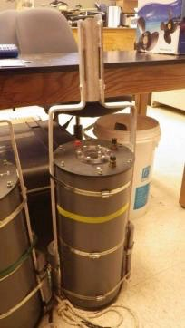
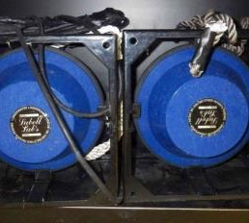
Decoy: experimental design
Autonomous playback device fitted with 3-min clips of engine cycling from a SEASWAP member vessel.
VHF communication allows captains to remotely activate playback from up to 10nm away
Decoy speakers (Lubell LL9162T)
Playback device, custom design SEASWAP Acoustic Lab, Scripps Institution of Oceanography
Notes:
We modified a custom playback device using in-house recordings of fishing vessels hauling their gear.
We loaded them onto the device, which was connected to an underwater speaker.
A deck box with communication antenna attached to the fishing vessel’s mast allowed radio communication between the vessel and the device once deployed.
This way, the fishermen could press a button on a “deck box” and activate the playback.
The device had an activation range of about 10 miles, though variable weather and sea-state conditions reduced that range at times.

Slide 12

Decoy Deployment:
Varying distances of decoy from true fishing set: Between 1-10nm
Decoy
True fishing set
Playback device & underwater speaker (20m depth)
Acoustic recorder (200-300m depth):
Confirm whale presence at fishing haul.
Acoustic recorder (200-300m depth):
Confirm decoy operation & whale presence in vicinity of Decoy
Groundline with hooks on fishing set
Notes:
For deployment, we asked fishermen who took the device to set the device 1-10nm from their true fishing set, immediately after the set of the gear
During the soak, the vessel moved away from the deployments, preferably to shallow waters on the continental shelf, where sperm whales have more difficulty detecting and tracking vessels.
After soaking the gear, the captain would remotely activate the playback device, before beginning to haul his true set.
In this way, whales would be drawn to the sounds of engine cycling at the decoy, before detecting the true fishing vessel hauling the true set.
Thus the decoy essentially acts as a pseudo vessel hauling gear in another area, to draw the whales to it.
Meanwhile, the true fishing vessel would begin hauling the true set, which would hopefully be whale-free.
Autonomous recording devices were set both with the playback and with the true fishing set to record whale activity in the area, and fishermen recorded set and distance information, as well as visual sightings of whales.

Slide 13
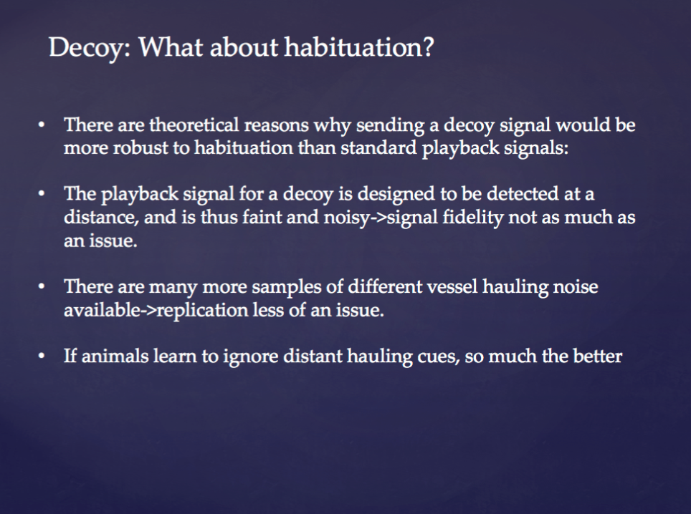

Slide 14
Next projects
Bubblers
Decoys
Towed Array
Pods
Jammers
Notes:
Today I’ll give you a little history of the project, and then talk about some of the main components of our research,
I’ll give you some background on the acoustic aspect of our work, including a few key findings about behavior and foraging ecology
Then I’ll dive into some of the camera work we’ve done and how we are using that to better understand the interaction
I’ll talk a bit about our tagging work – which is helping us understand individual movements and big picture patterns in where these whales go.
Finally I’ll get into some of the deterrents we’ve tried, what worked, and what hasn’t.
It’s all pretty interconnected, so I’ll bounce around a bit, but I’ll try to stay on topic.

Slide 15
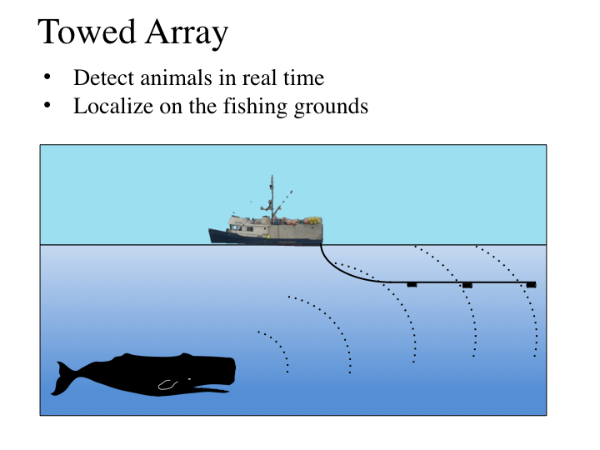
Notes:
Today I’ll give you a little history of the project, and then talk about some of the main components of our research,
I’ll give you some background on the acoustic aspect of our work, including a few key findings about behavior and foraging ecology
Then I’ll dive into some of the camera work we’ve done and how we are using that to better understand the interaction
I’ll talk a bit about our tagging work – which is helping us understand individual movements and big picture patterns in where these whales go.
Finally I’ll get into some of the deterrents we’ve tried, what worked, and what hasn’t.
It’s all pretty interconnected, so I’ll bounce around a bit, but I’ll try to stay on topic.

Slide 16
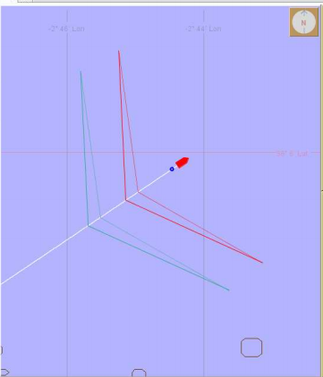
Towed Array
Notes:
Today I’ll give you a little history of the project, and then talk about some of the main components of our research,
I’ll give you some background on the acoustic aspect of our work, including a few key findings about behavior and foraging ecology
Then I’ll dive into some of the camera work we’ve done and how we are using that to better understand the interaction
I’ll talk a bit about our tagging work – which is helping us understand individual movements and big picture patterns in where these whales go.
Finally I’ll get into some of the deterrents we’ve tried, what worked, and what hasn’t.
It’s all pretty interconnected, so I’ll bounce around a bit, but I’ll try to stay on topic.

Slide 17
Next projects
Bubblers
Decoys
Towed Array
Pods
Jammers
Notes:
Today I’ll give you a little history of the project, and then talk about some of the main components of our research,
I’ll give you some background on the acoustic aspect of our work, including a few key findings about behavior and foraging ecology
Then I’ll dive into some of the camera work we’ve done and how we are using that to better understand the interaction
I’ll talk a bit about our tagging work – which is helping us understand individual movements and big picture patterns in where these whales go.
Finally I’ll get into some of the deterrents we’ve tried, what worked, and what hasn’t.
It’s all pretty interconnected, so I’ll bounce around a bit, but I’ll try to stay on topic.

Slide 18
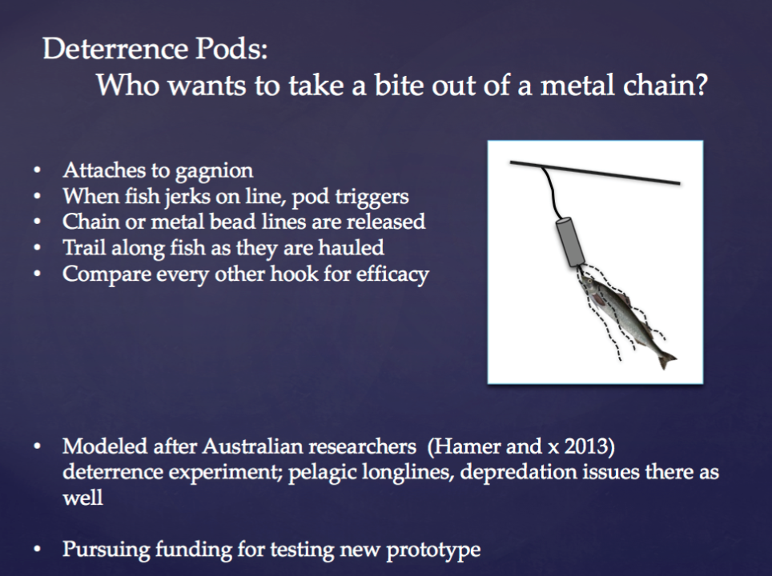

Slide 19
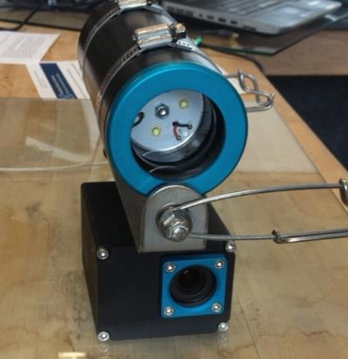
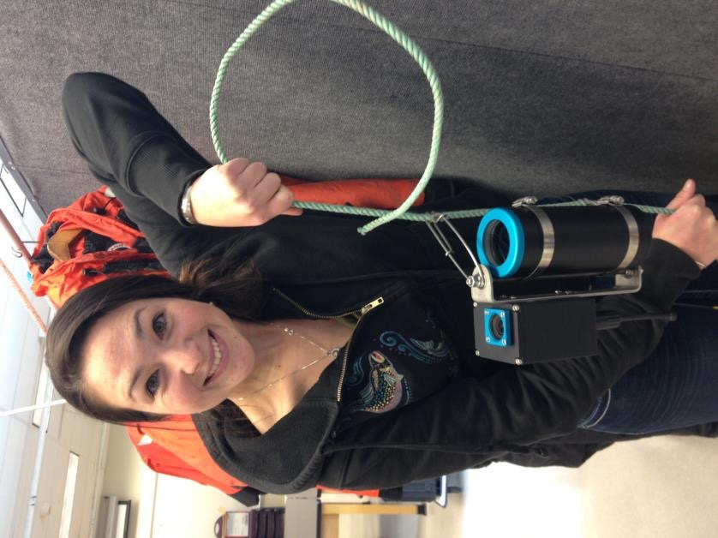
Camera Evolution: GoPros
Small
Compact
Deep-water housing
External light
Longline snaps attachment
Time delay technology
Notes:
So the drawbacks of the video used in 2006 were that the cameras couldn’t go to the bottom of the ocean with the gear, and they were very large, heavy, and difficult to attach to the fishing gear.
We have recently begun to test new ways of getting footage of whales taking fish, and in 2014 began working with GoPros

Slide 20
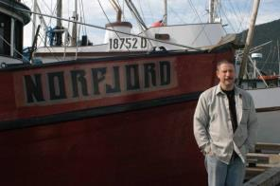
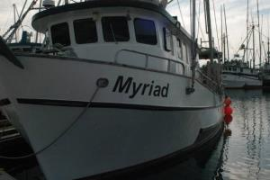
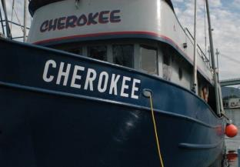
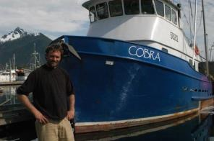
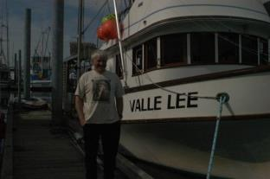
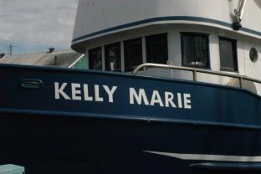
Fishermen are the eyes and ears of the ocean
l
SEASWAP has 25+ small-boat fishermen who are full partners and have designed, tested and collected quantitative data, 2003 to 2015
Notes:
Fishermen first approached ADFG groundfish manager Tory O’Connell in Sitka in the 1980s with reports of sperm whales near their boats, and later suggesting sperm whales might be loitering and taking some of their offal or spin-off. This turned into whales taking fish straight from the gear as it was hauled.
By the 90s, Tory brought the issue to Sitka whale biologist Jan Straley, and they began to look for funding. With the help of Alaska Longline Fishermen’s Association director Linda Behnken and other fishermen, by 2003 the project was funded and SEASWAP was born.

Slide 21
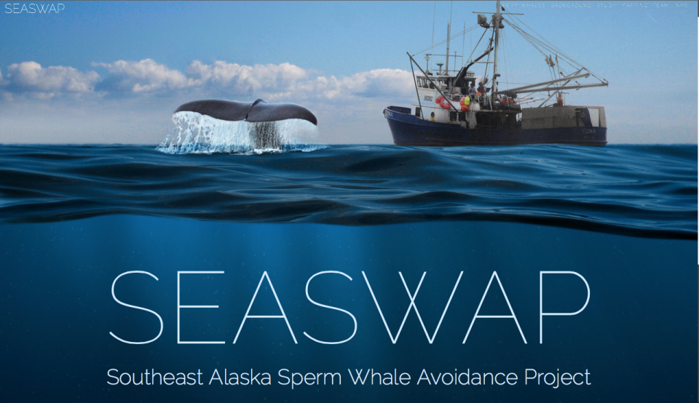
Visit our website: www.seaswap.info
Notes:
We have a website, www.seaswap.info
More videos from Go-Pro footage on Media page
Check out the team and partners
Look up our publications
Check out ongoing research

Slide 22
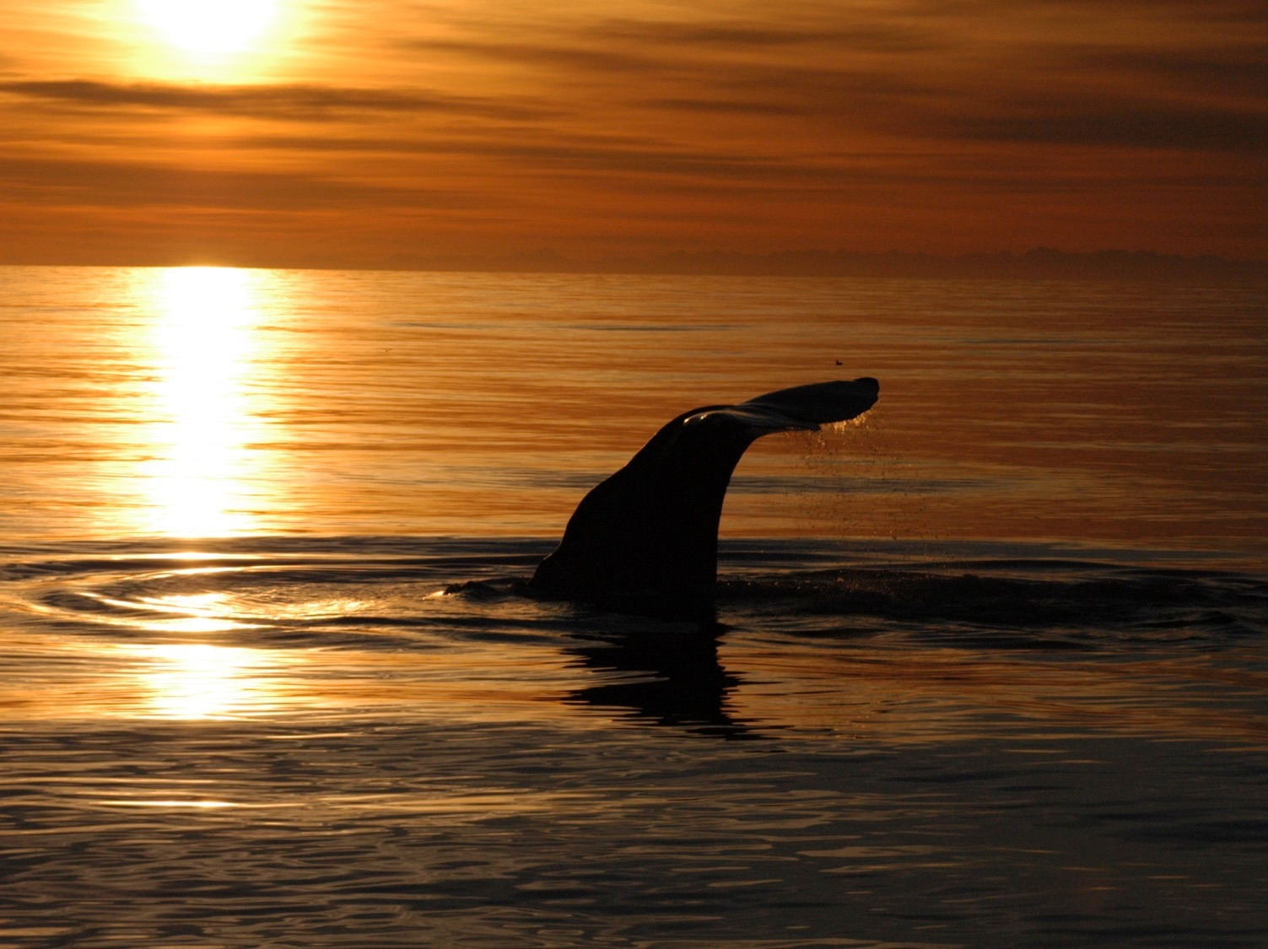
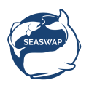









Thank You!
Photo Credit: Dick Curran, F/V Cherokee
www.seaswap.info
Notes:
I would like to just acknowledge & thank all the fishermen who collaborate with us on these projects.
They are small-vessel operators in southeast alaska that work collaboratively with us, and we wouldn’t be able to do this work without them;
It has been one of the most rewarding aspects of this project for me – growing up in Sitka, knowing personally, etc.

