Slide 1
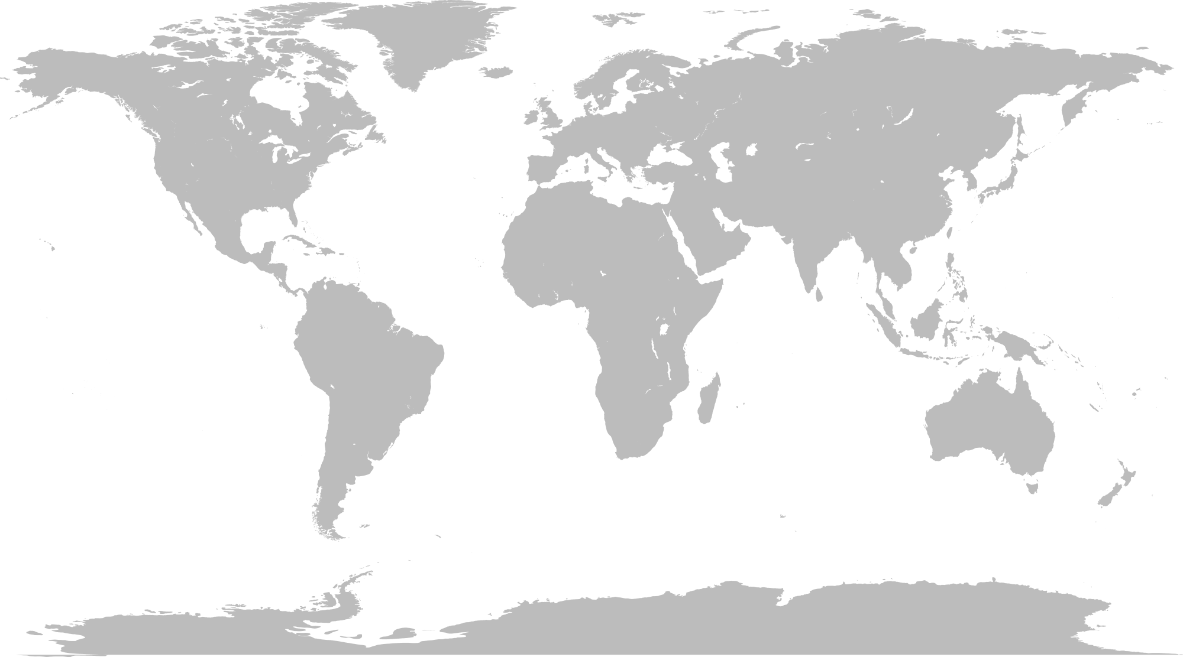
Whale depredation on longline fisheries
A worldwide issue

Slide 2
Whale depredation on longline fisheries
A worldwide issue
Tuna and swordfish pelagic longline fisheries

Slide 3
Whale depredation on longline fisheries
A worldwide issue
Sablefish demersal longline fisheries
Toothfish demersal longline fisheries

Slide 4
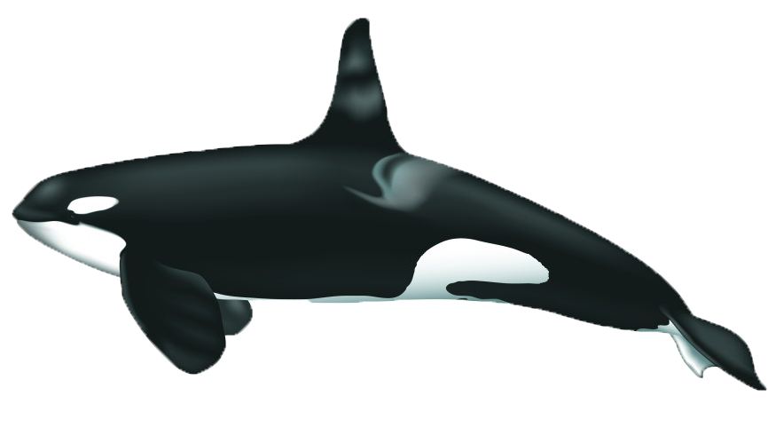
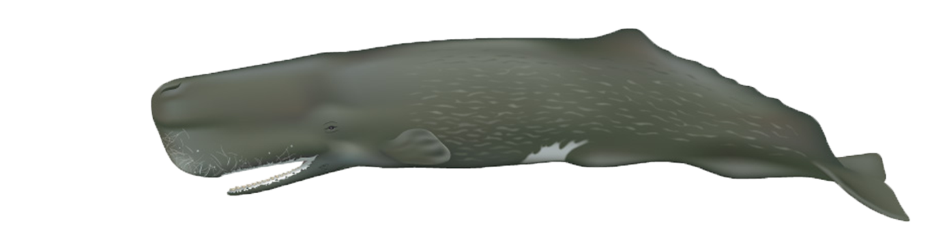
What depredates?

Slide 5
What are the depredation levels?
traditional
Trotline
Trotline
Traditional
Trotline
Traditional
Traditional
Traditional

Slide 6
What are the depredation levels?
25% sets
Avg. (NMFS)
15%
sets
10%
Catch
30%
Catch
Avg.
5% Catch
Avg.
15%
Catch
5%
Catch
Avg.
<3%
sets

Slide 7
Presence/absence
Photo-identification
tracking/diving data
Biopsy sampling
Acoustics
…
Research on depredating whale populations
Mitigating depredation
Fishing practices
Technological systems
Avoidance (communication network, displacement, seasonality, spatial patterns)
Operational factors (hauling speed, short lines, etc.)
Vessel vs. Skipper effects
…
Acoustic Harrassment Devices
Fish protection devices
Gear modification (e.g. hauling speed)
Decoys
Bubbler
Towed array
…

Slide 8
Combination of approaches
Research on depredating whale populations
Mitigating depredation
Fishing practices
Technological systems

Slide 9
Collaborative work
Fishing companies, skippers and crew
Scientists
Research on depredating whale populations
Mitigating depredation
Fishing practices
Technological systems
Fishery managers
Administration/governments

Slide 10
What’s next…
1) What we have learnt so far and what are the key priorities?
2) What are the needs of each fishery?
What are they planning to do over the next 2 years?
Outcomes of the workshop
- Peer reviewed paper = global review of depredation on demersal longlines and mitigation solution
- CCAMLR paper
- Guidelines on data collection

Slide 11
Research on depredating populations
Absence / presence data
Spatial patterns
Areas of high/low depredation
S. Georgia, Crozet, Kerguelen, HIMI, W Alaska
Time patterns
Seasonnality
Falklands, S.Georgia, Crozet,
Kerguelen, HIMI
Trend (spread?)
Link with ecological factors

Slide 12
Research on depredating populations
Photo-identification data
Number of depredating individuals
Effects on population demographics
Identification of
Specialized vs. opportunistic individuals
Within population spread of depredation, learning pathways based on social affinity
Site fidelity

Slide 13
Research on depredating populations
Satellite tracking data and diving behaviour
Areas of natural presence
Overlap with fishing grounds
Switch to depredation, detection range
Movements around vessels, swimming speed
Depth of interaction
(soaking? Hauling?)

Slide 14
Research on depredating populations
Biopsy sampling
Natural diet, part of the target fish species in diet?
Genetics
Ecological factors influencing the switch of depredation

Slide 15
Research on depredating whale populations
Mitigating depredation
Fishing practices
Technological systems

Slide 16
Fishing practices
Oper
Natural diet, part of the target fish species in diet?
Ecological factors influencing the switch of depredation

